Slide 1
UNIT 14: ADVANCED MANAGEMENT ACCOUNTING
Unit code: Y/508/0537
Credit value: 15

Slide 2
UNIT 14: ADVANCED MANAGEMENT ACCOUNTING
Learning Outcome 3: Analyse actual and standard costs to control and correct variances

Slide 3
THE BASIC SYLLABUS
1 Analyse the purpose for developing and presenting financial information.
2 Evaluate the use of management accounting techniques to support organisational performance.
3 Analyse actual and standard costs to control and correct variances.
4 Evaluate how a changing business environment impacts on management accounting.

Slide 4
LEARNING OUTCOMES
LO 3:Analyse actual and standard costs to control and correct variances.
M3: Evaluate the advantages and disadvantages of different types of variances.

Slide 5
OVERVIEW
The actual results achieved by an organisation will, more than likely, be different from the expected results when a product requires two or more materials in its make-up for example, the materials usage variance can be split into a materials mix variance and a materials yield variance. The management accountant would not stop at the calculation of variances. The next step would be to identify which warrant investigation and then to look into the reasons behind them.

Slide 6
ADVANTAGES AND DISADVANTAGES OF DIFFERENT TYPES OF VARIANCES
In cost accounting, variance is very important to evaluate the performance of company for increasing its efficiency. In variance analysis, we compare actual and standard cost and revenue to know whether it is favorable or unfavorable.

Slide 7
ADVANTAGES AND DISADVANTAGES OF DIFFERENT TYPES OF VARIANCES
In business, variance is often referred to in terms of accounting with respect to costs. For example, the actual cost of doing business might vary from the estimated cost. Obviously, this can be an advantage if actual costs are lower than expected, and vice versa if the opposite is true.

Slide 8
ADVANTAGES AND DISADVANTAGES OF DIFFERENT TYPES OF VARIANCES
Whether an advantage or disadvantage, cost variances in business should always be assessed and the cause or causes or the variance should be determined.

Slide 9
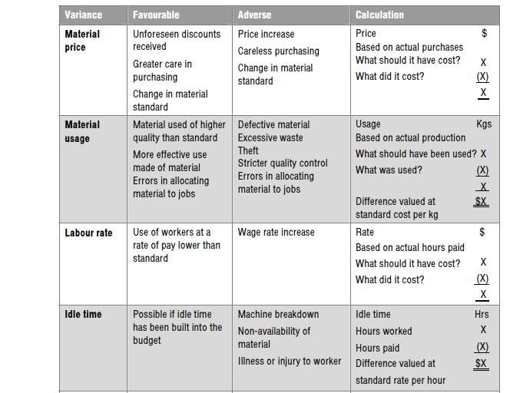
ADVANTAGES AND DISADVANTAGES OF DIFFERENT TYPES OF VARIANCES

Slide 10
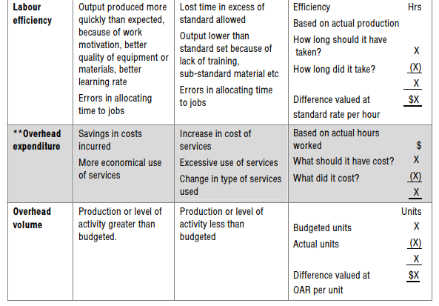
ADVANTAGES AND DISADVANTAGES OF DIFFERENT TYPES OF VARIANCES

Slide 11
ADVANTAGES AND DISADVANTAGES OF DIFFERENT TYPES OF VARIANCES
One advantage of a standard costing system considers its ability to provide a benchmark where the company can evaluate its performance. Variance analysis allows companies to recognize significant changes in the expected cost of each product. The company compares the actual cost to produce each product to the standard cost for each product.

Slide 12
ADVANTAGES AND DISADVANTAGES OF DIFFERENT TYPES OF VARIANCES
The difference between these costs represents the variance. A high variance signifies that the company performed very different than expected and requires additional investigation to find the cause of the variance. High unexplained variances identify performance issues.In business, variance is often referred to in terms of accounting with respect to costs.

Slide 13
ADVANTAGES AND DISADVANTAGES OF DIFFERENT TYPES OF VARIANCES
For example, the actual cost of doing business might vary from the estimated cost. Obviously, this can be an advantage if actual costs are lower than expected, and vice versa if the opposite is true. Whether an advantage or disadvantage, cost variances in business should always be assessed and the cause or causes or the variance should be determined.

Slide 14
ADVANTAGES AND DISADVANTAGES OF DIFFERENT TYPES OF VARIANCES
For example, the actual cost of doing business might vary from the estimated cost. Obviously, this can be an advantage if actual costs are lower than expected, and vice versa if the opposite is true. Whether an advantage or disadvantage, cost variances in business should always be assessed and the cause or causes or the variance should be determined.

Slide 15
ADVANTAGES AND DISADVANTAGES OF DIFFERENT TYPES OF VARIANCES
The analysis highlights those variances which are controllable and those which are non controllable.
• Managers' acceptance of the use of variances for performance measurement, and their
motivation, is likely to increase if they know they will not be held responsible for poor planning and
faulty standard setting.

Slide 16
ADVANTAGES AND DISADVANTAGES OF DIFFERENT TYPES OF VARIANCES
Advantages of a system of planning and operational variances:-
• The planning and standard-setting processes should improve; standards should be more
accurate, relevant and appropriate.
• Operational variances will provide a 'fairer' reflection of actual performance. The analysis highlights those variances which are controllable and those which are non-controllable.

Slide 17
ADVANTAGES AND DISADVANTAGES OF DIFFERENT TYPES OF VARIANCES
Managers' acceptance of the use of variances for performance measurement, and their motivation, is likely to increase if they know they will not be held responsible for poor planning and faulty standard setting.

Slide 18
ADVANTAGES AND DISADVANTAGES OF DIFFERENT TYPES OF VARIANCES
The limitations of planning and operational variances, which must be overcome if they are to be applied in practice.
It is difficult to decide in hindsight what the realistic standard should have been.
• It may become too easy to justify all the variances as being due to bad planning, so no operational variances will be highlighted.
• Establishing realistic revised standards and analysing the total variance into planning and operational variances can be a time consuming task, even if a spreadsheet package is devised.

Slide 19
ADVANTAGES AND DISADVANTAGES OF DIFFERENT TYPES OF VARIANCES
• Even though the intention is to provide more meaningful information, managers may be resistant to the very idea of variances and refuse to see the virtues of the approach. Careful presentation and explanation will be required until managers are used to the concepts.

Slide 20
REFERENCES
Media, B. (2009). ACCA Paper F5 – Performance Management (GBR) Study Text, 2009. London: BPP Learning Media.
Drury, C. (2018). Management and Cost Accounting. 8th ed. United Kingdom: Brendan George.
Kumar, V. (2018). Types of Variance. [online] Svtuition.org. Available at: http://www.svtuition.org/2011/06/types-of-variance.html [Accessed 10 Mar. 2018].
Sciencing.com. (2018). [online] Available at: https://sciencing.com/advantages-disadvantages-finding-variance-8364027.html [Accessed 10 Mar. 2018].

Slide 21
REFERENCES
Bizfluent. (2018). Advantages & Disadvantages of Using a Standard Costing System. [online] Available at: https://bizfluent.com/info-8553460-advantages-using-standard-costing-system.html [Accessed 10 Mar. 2018].
Acowtancy.com. (2018). FREE online learning for accountancy students : aCOWtancy. [online] Available at: https://www.acowtancy.com/ [Accessed 10 Mar. 2018].

