Slide 1
Understanding and Leading Change
Colbourne College
Summer 2017 – Week Eight
Facilitator: Dr Paul B. Thompson

Slide 2
Learning Objective
Evaluate the influences that drivers of change have on organisational behaviour.

Slide 3
Focus for Today
Today, we shall first discuss the dimensions of the Change Impact Analysis.
Then, we shall also discuss how the various models that we have highlighted may be used by managers in the implementation and management of change in the organisation.
We shall focus on SWOT Analysis, the PEST (PESTEL) Analysis, Kotter’s Eight Step Change Management Model, the Burke-Litwin Diagnostic Model, and the ADKAR Change Management Model.

Slide 4
Change Impact Analysis/ Assessment Factors to be considered
I will share screen with you in discussing these factors in greater depth

Slide 5
Deliberate Change Models
We turn now to consider how managers may implement and manage change, using different models/analyses. We will start with the SWOT Analysis

Slide 6
SWOT Analysis
An organisation must take stock to determine where it stands in relation to its current performance, and what factors in the external environment will affect its proposed future plans (Cole, 1996).
The SWOT analysis is one way of “taking stock.” It is a review of the organisation’s major internal strengths and weaknesses and an assessment of the external opportunities and threats that could impact its strategic choices.

Slide 7
SWOT Analysis Internal-External (IE) Matrix
Strengths Weaknesses
-Finances, leadership - lack of strategic direction
-economies of scale - weak managerial depth
- type of technology - obsolete facilities
Opportunities Threats
- serving new clients - competition, - sales of other
- entering new markets products, - slowing market
-falling trade barriers - protectionism

Slide 8
PEST(EL) or PEST(LE) Analysis
Another acronym which is used in strategic management is PEST. It refers to the key external influences that the organisation needs to analyse as it contemplates its strategic direction. These influences are Political, Economic, Social, and Technological.

Slide 9
PEST(EL) or PEST(LE) Analysis Palmer, Dunford, & Akin (2009)
The initial PEST has been extended to PESTEL, with Environmental and Legal issues being included for consideration. Thus,
Political – e.g. the threat of terrorism, tax policy, foreign trade law
Economic – e.g. unemployment levels, inflation, interest rates, exchange rates, economic growth
Social – e.g. demographic challenges, population growth, age distribution, health consciousness, career attitudes

Slide 10
PEST(EL) Analysis Palmer, Dunford, & Akin (2009)
Technological – e.g. introduction of new products that influence production, distribution, communication
Environmental – e.g. antipollution policies, ethical issues pertaining to companies, carbon footprint targets, environmental impact assessment
Legal – e.g. antitrust law (controlling monopolies), health and safety laws, equal opportunities, product safety, advertising and labelling laws, consumer rights

Slide 11
Kotter’s Eight-Step Change Management Model
Establish the need for urgency – perform market analyses, determine problems and opportunities
Ensure there is a powerful change group to guide the change – create and empower teams, missionaries, to drive the change
Develop a vision – this should give focus to the change

Slide 12
Kotter’s Eight-Step Change Management Model
Communicate the vision – role model the behaviour implied by the vision; use multiple means constantly to convey the vision
Empower the staff – encourage risk-taking, remove obstacles that inhibit achievement of the vision, remove barriers to empowerment
Ensure there are short-term wins – wins which are rewarded provide motivation, wins help to justify change

Slide 13
Kotter’s Eight-Step Change Management Model
Consolidate gains – remove other obstacles by using winds as basis for other changes, reward those who are involved in the change
Embed the change in the culture – link change to organisational performance and leadership, establish new, related change products. (Dessler, 2001; Palmer, Dunford, & Akin, 2009, p. 225)

Slide 14
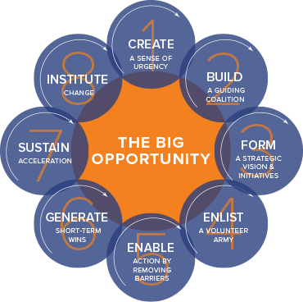
Kotter’s Eight-Step Change Management Model

Slide 15
The Burke-Litwin Model
The model makes the following key points:
• The external environment is the most powerful driver for organisational change
• Changes in the external environment lead to significant changes within an organisation – its mission and strategy, its organisational culture and its leadership.

Slide 16
The Burke-Litwin Model
Changes in these key factors lead to other changes within an organisation – changes to structure, systems and management practices. These are more operational factors and changes in them may or may not have an organisation-wide impact
Together these changes affect motivation, which in turn impacts on individual and organisational performance
http://www.crowe-associates.co.uk/wp-content/uploads/2013/07/Organisational-assessment-tools.pdf

Slide 17
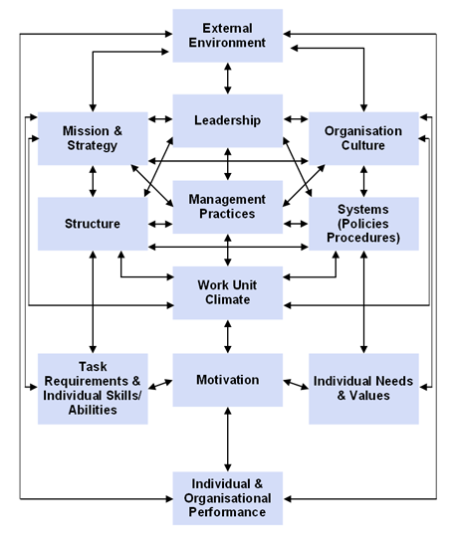
The Burke-Litwin Model

Slide 18
The ADKAR Model in Organisations
When applied to organizational change, this model allows leaders and change management teams to focus their activities on what will drive individual change and therefore achieve organizational results

Slide 19
The ADKAR Model https://www.prosci.com/adkar/adkar-model
The Prosci ADKAR Model is a goal-oriented change management model to guide individual and organizational change.
Created by Prosci founder Jeff Hiatt, ADKAR is an acronym that represents the five outcomes an individual must achieve for change to be successful: awareness, desire, knowledge, ability, reinforcement.

Slide 20
The ADKAR Model in Organisations
Awareness: Is your employee aware of the need for change?
Desire: Does your employee have the desire to participate in the change?
Knowledge: Does your employee have the knowledge to make the change?
Ability: Can your employee put his/her knowledge into practice?
Reinforcement: Do you have reinforcements in place to prevent your employee from reverting to old habits?

Slide 21
NB
Ensure that you revise and apply the following:
- Lewin’s Force-field theory
- The unfreeze, change, and freeze model
- The concepts involved in Kaizen

