Slide 1
UNIT 13: FINANCIAL REPORTING
UNIT CODE: K/508/0526
CREDIT VALUE: 15

Slide 2
UNIT 13: FINANCIAL REPORTING
Learning Outcome 2: Interpret Financial Statements

Slide 3
THE BASIC SYLLABUS
1. Analyse the context and purpose of financial reporting.
2.Interpret Financial statements
3.Evaluate financial reporting standards and theoretical models and concepts
4. Evaluate international differences in financial reporting

Slide 4
LEARNING OUTCOMES
Interpret Financial Statements
P3: Interpret profit and loss, cashflow and balance statements

Slide 5
OVERVIEW
Financial Statement Analysis is a method of reviewing and analyzing a company’s accounting reports (financial statements) in order to gauge its past, present or projected future performance. This process of reviewing the financial statements allows for better economic decision making.

Slide 6
FINANCIAL STATEMENTS
Financial statement provides multiple years of data. Used together analysts can track performance measures across financial statements using several different methods for financial statement analysis, including vertical and horizontal analysis. An example of vertical analysis is when each line item on the financial statement is listed as a percentage of another. Horizontal analysis compares line items in each financial statement against previous time periods. In ratio analysis, line items from one financial statement are compared with line items from another.

Slide 7
FINANCIAL STATEMENTS
Analysts like to know how many times a company can pay off debt with current earnings. Analysts can do this by dividing debt, which comes from the balance sheet, by net income, which comes from the income statement. Likewise, return on assets (ROA) and the return on equity (ROE) compare company net income found on the income statement with assets and stockholders' equity as found on the balance sheet.

Slide 8
Users of Financial Statement Analysis
There are a number of users of financial statement analysis. They are:
Creditors. Anyone who has lent funds to a company is interested in its ability to pay back the debt, and so will focus on various cash flow measures.
Investors. Both current and prospective investors examine financial statements to learn about a company's ability to continue issuing dividends, or to generate cash flow, or to continue growing at its historical rate (depending upon their investment philosophies).

Slide 9
Users of Financial Statement Analysis
Management. The company controller prepares an ongoing analysis of the company's financial results, particularly in relation to a number of operational metrics that are not seen by outside entities (such as the cost per delivery, cost per distribution channel, profit by product, and so forth).
Regulatory authorities. If a company is publicly held, its financial statements are examined by the Jamaica Stock Exchange Council (if the company files in Jamaica ) to see if its statements conform to the various accounting standards and the rules of the JSEC.

Slide 10
INTERPRET PROFIT AND LOSS
A profit and loss report, also known as an income statement, shows the profitability of your business over a specific period. It can cover any period of time, but is most commonly produced monthly, quarterly or annually.
A profit and loss report is a useful tool for monitoring business activity.

Slide 11
INTERPRET PROFIT AND LOSS
For business owners, it highlights where their business is succeeding and where it is struggling. Investors will use profit and loss reports to gauge the financial health of a potential investment, or to see what kind of return they are getting on an existing investment.

Slide 12
PROFIT AND LOSS/INCOME STATEMENT
Source:courses.lumenlearning.com

Slide 13
INTERPRET CASHFLOW
A cash flow statement shows how much cash is moving in and out of your business over a certain period of time (i.e. it reflects your 'liquidity').
Having enough cash available to pay your debts and to buy materials and assets is an important part of business planning. A cash flow statement will quickly tell you if you are likely to have any issues in this area.

Slide 14
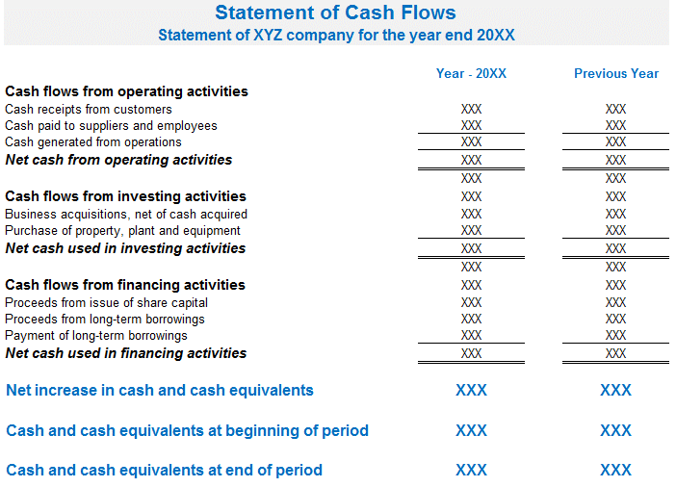
CASHFLOW STATEMENT
http://www.assignmenthelp.net/assignment_help/cash-flow-statement

Slide 15
INTERPRET BALANCE SHEET STATEMENTS
A balance sheet is also called a 'statement of financial position' because it provides a snapshot of your assets and liabilities - and therefore net worth - at a single point in time (unlike other financial statements, such as profit and loss reports, which give you information about your business over a period of time).

Slide 16
INTERPRET BALANCE SHEET STATEMENTS
There are 3 different sections in a balance sheet, represented by the following formula:
Assets – liabilities = owner's equity
It is called a balance sheet because, at any given moment, each side of this equation must 'balance' out.

Slide 17
INTERPRET BALANCE SHEET STATEMENTS
A balance sheet is a summary of all of your business assets (what the business owns) and liabilities (what the business owes). At any particular moment, it shows you how much money you would have left over if you sold all your assets and paid off all your debts (i.e. it also shows 'owner's equity').

Slide 18
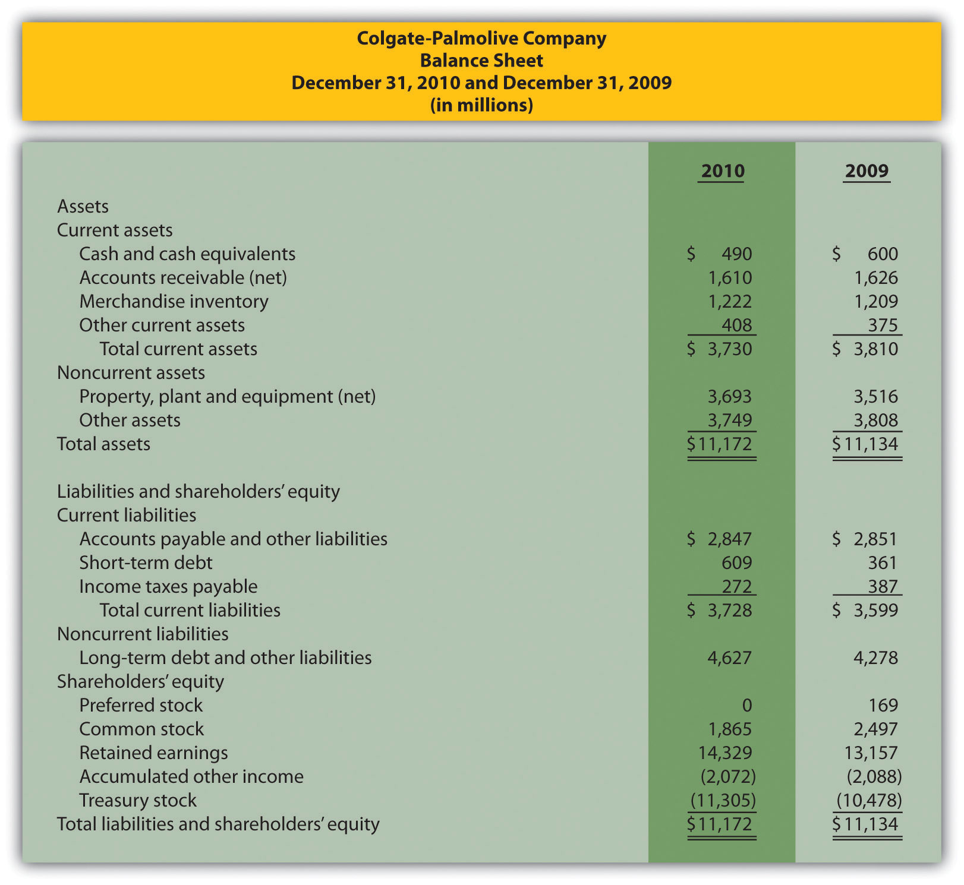
BALANCE SHEET /STATEMENT OF FINANCIAL POSITION
https://courses.lumenlearning.com

Slide 19
REFERENCES
http://highered.mheducation.com/sites/dl/free/.../1009641/sub_10963_ch01_002_065.pdf [Accessed 25 Sep. 2017].
http://www.bbc.co.uk/schools/gcsebitesize/business/environment/stakeholders1.shtml [Accessed 25 Sep. 2017].
http://www.investopedia.com/terms/f/financial-statement-analysis.asp

Slide 20
REFERENCES
https://www.accountingtools.com/articles/2017/5/14/financial-statement-analysis [Accessed 25 Sep. 2017].
https://www.business.qld.gov.au/running-business/finances-cash-flow/managing-money/financial-statements-forecasts/ [Accessed 25 Sep. 2017].

Slide 21
REFERENCES
https://www.cleverism.com/financial-statement-analysis-introduction/ [Accessed 25 Sep. 2017].

