Slide 1
UNIT 13: FINANCIAL REPORTING
UNIT CODE: K/508/0526
CREDIT VALUE: 15

Slide 2
UNIT 13: FINANCIAL REPORTING
Learning Outcome 2: Interpret Financial Statements

Slide 3
THE BASIC SYLLABUS
1. Analyse the context and purpose of financial reporting.
2.Interpret Financial statements
3.Evaluate financial reporting standards and theoretical models and concepts
4. Evaluate international differences in financial reporting

Slide 4
LEARNING OUTCOMES
Interpret Financial Statements
D2: Using appropriate theories and models suggest how organisations can effectively respond to existing and potential financial problems.

Slide 5
OVERVIEW
The main purpose of financial statement analysis is to utilize information about the past performance of the company in order to predict how it will fare in the future. Another important purpose of the analysis of financial statements is to identify potential problem areas and troubleshoot those.

Slide 6
CASHFLOW STATEMENTS
The purpose of the cash flow statement is to show where an entities cash is being generated (cash inflows), and where its cash is being spent (cash outflows), over a specific period of time (usually quarterly and annually). It is important for analyzing the liquidity and long term solvency of a company.

Slide 7
CASHFLOWS STATEMENTS
The cash flow statement uses cash basis accounting instead of accrual basis accounting which is used for the balance sheet and income statement by most companies. This is important because a company may accrue accounting revenues but may not actually receive the cash. This could produce profits and taxes payable but not provide the resources to stay solvent.

Slide 8
CASHFLOW STATEMENTS
Cash Flow Statement Components
The cash flow statement components provide a detailed view of cash flow from operations, investing, and financing:
Cash Flow from Operating Activities:
The net amount of cash coming in or leaving from the day to day business operations of an entity is called Cash Flow From Operations.

Slide 9
CASHFLOW STATEMENTS
Cash Flow From Investing Activities
Cash flow from investing activities would include the outflow of cash for long term assets such as land, buildings, equipment, etc., and the inflows from the sale of assets, businesses, securities, etc. Most cash flow investing activities are cash out flows because most entities make long term investments for operations and future growth.

Slide 10
CASHFLOW STATEMENTS
Cash Flow From Finance Activities
Cash flow from finance activities is the cash out flow to the entities investors (i.e. interest to bondholders) and shareholders (i.e. dividends and stock buybacks) and cash inflows from sales of bonds or issuance of stock equity. Most cash flow finance activities are cash outflows since most entities only issue bonds and stocks occasionally.

Slide 11
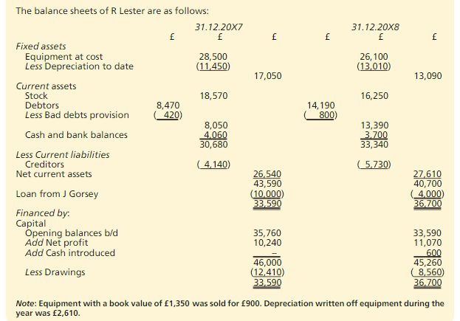
CASHFLOW STATEMENTS

Slide 12
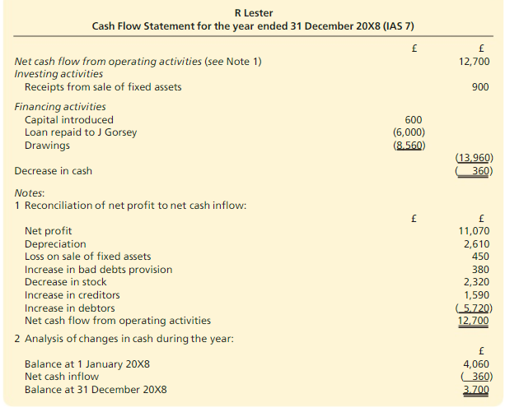
CASHFLOW STATEMENTS

Slide 13
PROFIT AND LOSS ACCUNTS
A Profit and Loss (P&L) statement measures a company’s sales and expenses during a specified period of time. The function of a P&L statement is to total all sources of revenue and subtract all expenses related to the revenue. It shows a company’s financial progress during the time period being examined.

Slide 14
PROFIT AND LOSS ACCUNTS
There are two reasons to prepare a P&L statement. One reason is the P&L statement answers the question, “Am I making any money?” It is a valuable tool to monitor operations. A regularly prepared P&L statement either quarterly or monthly for new businesses will give owners timely and important information regarding revenues and expenses and tell them whether adjustments might be necessary to recoup losses or decrease expenses.

Slide 15
PROFIT AND LOSS ACCUNTS
The P&L statement also allows outsiders to evaluate your ability to manage and use your company’s resources. The second reason to prepare a P&L statement is because it is required by the tax authority. It is the record of a business’ operation that is used to assess taxes on profits earned by a comapny.

Slide 16
PROFIT AND LOSS ACCUNTS

Slide 17
BALANCE SHEET
The balance sheet is a summary statement of what a company owns (or is owed) and what a company owes (or what others own) at a specific point in time. It categorizes all of a company’s resources as assets, liabilities, and owner’s equity. The basic structure of a balance sheet is shown below.

Slide 18
BALANCE SHEET
Note, as with the income statement, that these are not the only accounts that may appear on a balance sheet and some balance sheets may utilize slightly different terminology.
The basic balance sheet identity is:
Assets = Liabilities + Capital.

Slide 19
BALANCE SHEET
Some companies offer more detail on their statements than others. Certain accounts that are important for one company may be minor or non existent for another company. Nonetheless, these are the major items and delineations that appear on most standard balance sheets.

Slide 20
BALANCE SHEET
Current assets and current liabilities
The suggested statement of financial position format makes a distinction between current and non-current assets and liabilities. IAS 1 sets down the rules to be applied in making this distinction.
Assets
An asset should be classified as a current asset if it is:
held primarily for trading purposes
expected to be realised within 12 months of the statement of financial position date; or
cash or a cash equivalent (i.e. a short term investment, such as a 30 day bond).
All other assets should be classified as non-current assets.
Note that this definition allows inventory or receivables to qualify as current assets under (a) above, even if they may not be realised into cash within twelve months.

Slide 21
BALANCE SHEET
Liabilities
The rules for current liabilities are similar to those for current assets.
A liability should be classified as a current liability if:
it is expected to be settled in the normal course of the enterprise's operating cycle
it is held primarily for the purpose of being traded
it is due to be settled within 12 months of the statement of financial position date or
the company does not have an unconditional right to defer settlement for at least 12 months after the statement of financial position date.
All other liabilities should be classified as non-current liabilities.

Slide 22
BALANCE SHEET

Slide 23
REFERENCES
https://www.cleverism.com/financial-statement-analysis-introduction/ [Accessed 15 Oct. 2017].
http://www.arborinvestmentplanner.com/cash-flow-statement-analysis-purpose-components-and-format/ [Accessed 15 Oct. 2017].
AccountingCoach.com. (2017). Income Statement (Profit and Loss Statement) | Explanation | AccountingCoach. [Accessed 15 Oct. 2017].
Wood, F. and Sangester, A. (2017). Business Accounting Volume 1. 13th ed. Essex: Pearson Education Limited.

Slide 24
REFERENCES
Anon, (2017). how to prepare a profit and loss (income) statement. [online] Available at: https://www.zionsbank.com/pdfs/biz_resources_book-3.pdf [Accessed 15 Oct. 2017].
Kfknowledgebank.kaplan.co.uk. (2017). [online] Available at: http://kfknowledgebank.kaplan.co.uk/KFKB/Wiki%20Pages/The%20Statement%20of%20Financial%20Position.aspx?mode=none [Accessed 15 Oct. 2017].

Slide 25
REFERENCES
www2.gsu.edu/. (2017). Chapter 2 Accounting Review: Income Statements and Balance Sheets. [online] Available at: http://www2.gsu.edu/~wwwfnc/3300/chapter2.
Wood, F. and Sangester, A. (2017). Business Accounting Volume 1. 13th ed. Essex: Pearson Education Limited.

