Slide 1
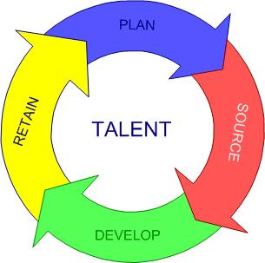
UNIT 19: RESOURCE AND TALENT PLANNING
UNIT CODE: T/508/0531
CREDIT VALUE: 15

Slide 2
UNIT 19: RESOURCE AND TALENT PLANNING
Learning Outcome 1: Analyse labour market trends and appropriate legal requirements which influence workforce planning.

Slide 3
THE BASIC SYLLABUS
1. Analyse labour market trends and appropriate legal requirements which influence workforce planning.
2. Determine current and anticipated skills requirements in varying contexts.
3. Apply the appropriate documents and processes which contribute to effective recruitment and selection.
4. Evaluate how to manage the human resource life-cycle within the context of a HR strategy.

Slide 4
LEARNING OUTCOMES
Analyse labour market trends and appropriate legal requirements which influence workforce planning.
P2: Analyse the different types of legal requirements and organisation must take into account when workforce planning.
M1: Analyse the influences of labour market trends and legal requirements on the workforce planning of a specific organisation.
D1: Critically evaluate the impact of labour market trends and skills requirements on workforce planning and make appropriate recommendations for effective response to supply and demand forecast, succession planning and performance management.

Slide 5
OVERVIEW
Understanding labour market trends is key to de-signing effective policies for job creation. Global and regional employment estimates and projections trace the potential of different regions in the world to absorb an ever growing global labour force. Un-employment rates by age group and sex allow the identification of vulnerable groups most in need of support.

Slide 6
Demographics and Labour Market Trends
Demographics is the collection of data regarding a specific population. Demographic trends can have direct implications for labour markets through three primary channels: labour supply, labour productivity, and labour demand (because of shifts in the structure of aggregate demand).

Slide 7
Demographics and Labour Market Trends
The conventional wisdom is that aging societies will face difficult economic and social challenges because of what will inevitably happen in the labour market—that is, output will be reduced because the labour force will shrink as large numbers of workers retire and because older workforces cannot produce at the level of younger ones.

Slide 8
Labour Market and Changing Economic Trends
Organizations which operate in a market, management is faced with problems of economic and non-economic nature, which are a result of the long transition period. As a result of changes, economic elements were defined and clarified even more as to the role and importance of human resources in the new organizational mentality. From that time and until now human resources have been and are the focus of many researchers.

Slide 9
Labour Market and Changing Economic Trends
The economic development is not satisfactory, but that influenced in the creation of new jobs and this influenced in the changing role and perspectives of the human resources in organizations. These changes are driven by the challenges facing managers today in modern organizations. In order to maximize revenue managers should pay great attention to the professional management of human resources, seeking and exploring the factors that influence motivation and de-motivation to work in human resources.

Slide 10
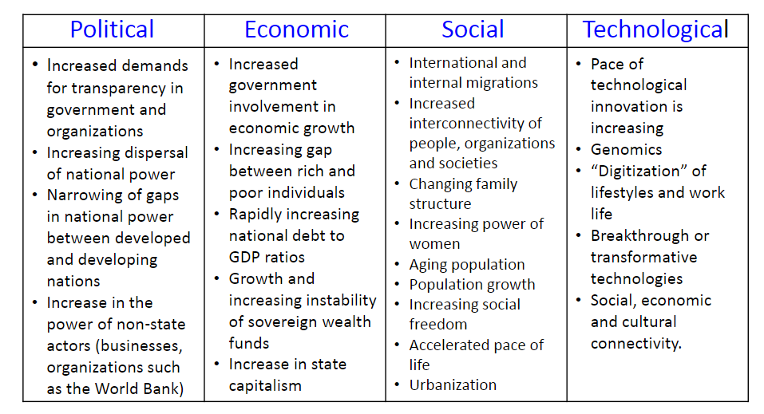
Labour Market Trends and Political Composition of a Population and Social Trends

Slide 11
Labour Demand and Supply Forecasting
Workforce planning is about forecasting your current and future staffing needs in relation to your strategic business objectives, then addressing matters relating to the supply of labour, for example are there candidates with the skills you require available? The final step is to get the right balance between labour demand and supply, so that you have the right number of employees, with the right skills at the right time.

Slide 12
Labour Demand and Supply Forecasting
Labour demand forecasting is crucial, as businesses don’t want a surplus of employees who are not being fully and effectively deployed, nor do they want gaps in their employee pool which results in reduced productivity, performance and profitability.

Slide 13
Labour Demand and Supply Forecasting
Once a business has forecast what it’s future requirements are likely to be, it is then important to determine what number of employees will be needed, with what skills and when. Labour supply may come from within the organisation or outside.

Slide 14
HR Legislation Constraints and Requirements
The field of human resources management is greatly influenced and shaped by various laws governing employment issues. Indeed, regulations and laws govern all aspects of human resource management recruitment, placement, development, and compensation. These acts made illegal the discrimination against employees or potential recruits for reasons of race, colour, religion, sex, and national origin. It forces employers to follow and often document fairness practices related to hiring, training, pay, benefits, and virtually all other activities and responsibilities related to HRM.

Slide 15
HR Legislation Constraints and Requirements
Labour laws in Jamaica may be divided into three broad categories:
a) Employment law
b) Industrial relations law
c) Industrial safety law

Slide 16
HR Legislation Constraints and Requirements
Employment Law is based largely upon common law concept of the contract of employment. The Employment (Termination and Redundancy) Payments Act (ETRP) 1974 (Jamaica) covers the separation payment whenever an employee is being made redundant or terminated.
In Britain employment protection rights, includes sex and race discrimination, unfair dismissal, etc.
Industrial relations law is characterized by the principle of voluntarism. The Trade Union Act, 1919 (amended 1938), Labour Relations & Industrial Disputes Act (LRIDA),1975 provides legislative framework for recognition, industrial dispute resolution and statutory arbitration.

Slide 17
HR Legislation Constraints and Requirements
Industrial Safety Law comprise of the Factories Act, 1943. Under section 12 of this act includes provision. Therefore, the Building Operations and Works of Engineering Construction Regulations of 1968 as well as the Docks (Safety, Health and Welfare) Regulations of 1968 provide the framework for these laws.
In Jamaica there are no comprehensive industrial safety laws in place. However, in Britain the Health and Safety at Work Act, 1974 provides a guideline for health and safety act. Jamaica is however drafting legislations for a comprehensive Health & Safety Act.

Slide 18
HR Legislation Constraints and Requirements
Protective Legislations
Primary purpose to protect the workers against unfair treatment, examples;
• Minimum Wage Act
• Factory Act (Occupational Safety and Health Act)
• Equal Pay (for Men and Women) Act
• Maternity Leave Act
• Employment (Termination and Redundancy) Payments Act

Slide 19
HR Legislation Constraints and Requirements
Auxiliary Legislations
Auxiliary legislation is intended to support the establishment of collective bargaining.
Laws that serve to advance the practice collective bargaining are;
• Trade Union Act (1919) is the piece of Jamaican labour legislation solely devoted to the entrenchment of a trade union movement.
• Labour Relations and Industrial Disputes Act (LRIDA)

Slide 20
HR Legislation Constraints and Requirements
The LRIDA Act provides for:
Registration of Trade Unions: Within 30 days of its formation, the union must apply to the registrar of trade unions for registration. Penalties are prescribed for failure to comply with this requirement and for continued membership in the unregistered union.
Membership: For people over 16 except that persons between 16 and 18 cannot hold offices such as Treasurer, Trustee or Committee Member.
Filing of Statements: Treasurer on or before Aug. 1 each year file audited statements providing information on revenues and expenditure as well as assets.
Peaceful Picketing: Persons acting on behalf of a union may, “in contemplation or furtherance of a trade dispute” may picket the employers’ premises peacefully. But they may not intimidate or to block entry or exit or to breach the peace.
Prohibition of Certain Practices: use of violence or intimidation, following people from place to place, hide tools, etc.

Slide 21
HR Legislation Constraints and Requirements
Restrictive Legislation
Restrictive legislation is directed primarily at trade union and is intended to limit the scope of their activity, particularly as it relates to the disruptive impact of industrial action, example LRIDA.

Slide 22
Contemporary HR Issues
Human resources managers face a myriad challenges with today’s workforce. There are issues concerning the diverse workforce, legislation affecting the workplace and technology matters that rise to the top of the list of challenges. Human resources managers who encounter these challenges use their leadership skills and expertise to avert issues that might arise from these challenges.

Slide 23
Contemporary HR Issues
Human capital includes knowledge, skills and attributes such as perseverance. For individuals, investment in human capital provides an economic return, increasing both employment rates and earnings. This can be demonstrated either by looking at education levels, or at more direct measures of human capital such as numeracy and literacy scores.

Slide 24
Contemporary HR Issues
Social capital has been defined variously by different researchers, but is here taken to include the networks, norms, values and understandings that facilitate cooperation within or among groups. It is to be distinguished from the more formal political, institutional and legal arrangements which have a complementary role in this process.

Slide 25
Contemporary HR Issues
Both HR and the Ethics function have a very powerful role to play in the embedding of ethical values into an organisation and collaboration operates in two directions. The departments mutually support each other in a number of areas.

Slide 26
Contemporary HR Issues
As a code draws on existing company policies and processes, employee concerns and employment law, HR has a role in assisting the Ethics function with developing or updating content. They can also help with internal dissemination, communication and awareness of the code and the monitoring of employee readership and acceptance.

Slide 27
Contemporary HR Issues
With increasing globalization there have been enormous and far-reaching changes in the global organization of capitalism. These changes are the result of the fierce international competitive pressures faced by enterprises operating in the global marketplace. One of the most significant changes has been the dramatic increase in the rate of global merger and acquisition (M&A) activity. Another has been the pronounced tendency of global enterprises to reorganize their operations so that they are transformed into coordinators of activities performed on their behalf by others. The sub-contracting and outsourcing of operations, particularly the more labor intensive ones, enable firms to reduce their overheads by externalizing the capital and other costs associated with the direct employment of labor. Naturally, outsourcing and subcontracting have resulted in the lengthening, indeed the globalization, of supply chains which have accordingly also grown in complexity. Globalization, and the development of global capitalism, has been greatly facilitated by, amongst other things, the reduction or removal of trade barriers, and the drastic weakening of barriers to the global movement of capital. Labor market deregulation, reflected in the emasculation of national Industrial Relations Systems (IRSs), has also contributed to increasing and accelerating globalization.

Slide 28
Contemporary HR Issues
Technological Advances And Workplace
The workplace setting is changing because of technology. Telecommuting, telework and remote reporting relationships are becoming the norm rather than an anomaly. Flexible work schedules and arrangements are ways to improve productivity for some employees; however, these types of technology-based changes aren’t for all employees. Human resources managers must ensure there is a mutual agreement between the employer and employee for options that include telecommuting.

Slide 29
SUCCESSION PLANNING
A succession plan, is a component of good HR planning and management. Succession planning acknowledges that staff will not be with an organization indefinitely and it provides a plan and process for addressing the changes that will occur when they leave. Most succession planning focuses on the most senior manager - the executive director, however, all key positions should be included in the plan. Key positions can be defined as those positions that are crucial for the operations of your organization and, because of skill, seniority and/or experience, will be hard to replace.

Slide 30
PERFORMANCE MANAGEMENT
There is much more to performance management than the annual performance review meeting. As mentioned in the introduction, performance management is a continuous process of planning, monitoring and reviewing employee performance.

Slide 31
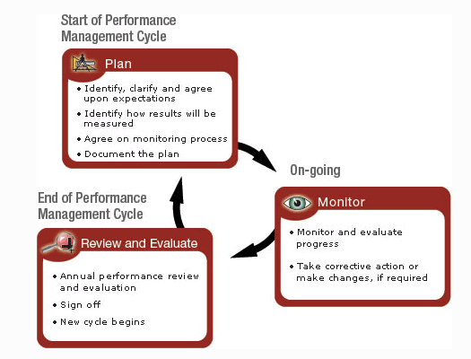
PERFORMANCE MANAGEMENT

Slide 32
REFERENCES
Ernst, E. (2017). EMPLOYMENT FOR SOCIAL JUSTICE AND A FAIR GLOBALIZATION. [online] www.ilo.org/trends. [Accessed 17 Sep. 2017].
worldbank.org. (2017). http://siteresources.worldbank.org/ECAEXT/Resources/.../chaw_073-116_ch02.pdf [Accessed 17 Sep. 2017].
GJINOVCI, A. (2017). Perspective on Human Resources as a Result of Economic Changes. EUROPEAN ACADEMIC RESEARCH, [online] 1(6). Available at: http://www.euacademic.org.
Myrtle,, R. (2017). Emerging trends in Human Resources Management. [online] USC University of Southern California. Available at: http://www.nacs.gov.tw/NcsiWebFileDocuments/69b9ec3510e3d7b5d8768a2cc6d2fd93.pdf [Accessed 18 Sep. 2017].

Slide 33
REFERENCES
BusinessBlogs Hub. (2017). Workforce Planning – Balancing Demand and Supply. [online] Available at: https://www.businessblogshub.com/2012/10/workforce-planning-balancing-demand-and-supply/ [Accessed 18 Sep. 2017].
Human Resources Management and the Law. [online] Available at: https://www.inc.com/encyclopedia/human-resources-management-and-the-law.html [Accessed 18 Sep. 2017].
Jtug.info. (2017). Jamaica Trade Union - Labour Laws. [online] Available at: http://www.jtug.info/labour-laws.html [Accessed 18 Sep. 2017].
Smallbusiness.chron.com. (2017). Contemporary Issues Faced by Human Resource Managers Today. [online] Available at: http://smallbusiness.chron.com/contemporary-issues-faced-human-resource-managers-today-1875.html [Accessed 18 Sep. 2017].

Slide 34
REFERENCES
www.oecd.org. (2017). The Well-being of Nations. [online] Available at: http://www.oecd.org/site/worldforum/33703702.pdf [Accessed 18 Sep. 2017].
What is HR's role in ethics?. [online] Hrmagazine.co.uk. Available at: http://www.hrmagazine.co.uk/article-details/what-is-hrs-role-in-ethics-1 [Accessed 18 Sep. 2017].
Hoq, M. (2009). The Effect of Globalization, Labor Fexibilization and National Industrial Relations Systems on Human Resource Management. International Business and Research, [online] 2.(No. 4), pp.36-37. Available at: http://www.ccsenet.org/journa [Accessed 18 Sep. 2017].
"Succession Planning | HR Planning | HR Toolkit | Hrcouncil.Ca." Hrcouncil.ca. N.p., 2017. Web. 20 Sept. 2017.

Slide 35
REFERENCES
"Performance Management | Keeping The Right People | HR Toolkit | Hrcouncil.Ca." Hrcouncil.ca. N.p., 2017. Web. 20 Sept. 2017.

