Slide 1
Unit 22: Onboard Passenger Operations
P3 Explain how onboard procedures and services are coordinated
P4 Define the role of the senior cabin crew member

Slide 2
Coordination of routine procedures and services during the stages of a flight: PRE-DEPARTURE
safety and security checks
On a commercial flight in the United States, there must be one flight attendant for every 50 passengers. These attendants have a variety of responsibilities in their work, which begins before the first passenger boards and continues through the entire flight. These include checking the safety equipment and doing security checks, ensuring the aircraft is clean and tidy and that information in the seat pockets is up to date and all meals, drinks and stock are on board. Before boarding, the whole crew meets, the captain reviews the flight schedule and any safety concerns, and the lead attendant assigns each attendant to a particular section of the plane. Before the plane takes off, the attendants must:
Greet passengers and direct them to their seats
Help passengers stow their carry-on luggage
Make sure passengers near the emergency exits are prepared to help out in an emergency
Run over safety procedures or show a safety video
Check every seat to make sure all passengers are buckled-in and that their seats are in the right position
Lock the doors and arm them so that the emergency slides will inflate if they are opened
After they have worked through this checklist, flight attendants strap themselves into their jump seats. Once the plane levels off, the attendants prepare food and drinks, load the refreshment and meal carts, and serve the passengers.

Slide 3
Coordination of routine procedures and services during the stages of a flight: PRE-DEPARTURE
safety and security checks
The pre-flight safety briefing (also known as a pre-flight demonstration, in-flight safety briefing, in-flight safety demonstration, safety instructions, or simply the safety video) is a detailed explanation given before take-off to airline passengers about the safety features of the aircraft they are aboard.
Aviation regulations do not state how an airline should deliver the briefing, only that ‘The operator of an aircraft shall ensure that all passengers are orally briefed before each take-off’.[1] As a result, and depending on the inflight entertainment system in the aircraft, as well as the airline’s policy, airlines may deliver a pre-recorded briefing or provide a live demonstration. A live demonstration is performed by a flight attendant/s standing up in the aisle/s, while another flight attendant narrates over the public address system. A pre-recorded briefing may feature audio only, or may take the form of a video (audio plus visual). Pre-flight safety briefings typically last two to six minutes. In consideration for travelers not speaking the airline's official language and for the passengers with hearing problems, the video may feature subtitles, an on-screen signer, or may be repeated in another language.

Slide 4
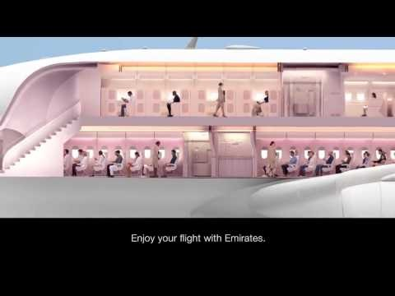
Pre flight safety briefing

Slide 5
Coordination of routine procedures and services during the stages of a flight: PRE-DEPARTURE
Boarding
At the time of the boarding, passengers, most of the time, are welcomed at the door of the airplane by the smiling faces of the cabin crew. The posture and their language must be positive, to make the passengers impressed even before take off. Once obtained the approval of the captain, the passenger can be boarded, taken to their seats by the cabin crew, process followed by distribution of some products on ground (amenity kit, menus, perfumed napkins, candies, newspapers) and a video and audio presentation of the safety equipment and the evacuation procedures in case of emergency. As soon as the passengers buckled their seatbelts, raised the seatbacks, table trays, feet support and sunshades and closed the electronic equipment, the cabin crew will transmit to the cabin manager that the entire cabin is ready to take off. Such a preparation of the cabin will take place, as well, before landing, insisting on the fact that the passengers must remain seated till the airplane is completely stopped and the “Fasten the seatbelts” sign is off.

Slide 6
Coordination of routine procedures and services during the stages of a flight: PRE-DEPARTURE
Boarding
This announcement is usually made while the aircraft is parked at the gate and the last passengers are boarding:
“Ladies and gentlemen, the Captain has turned on the Fasten Seat Belt sign. If you haven’t already done so, please stow your carry-on luggage underneath the seat in front of you or in an overhead bin. Please take your seat and fasten your seat belt. And also make sure your seat back and folding trays are in their full upright position.
If you are seated next to an emergency exit, please read carefully the special instructions card located by your seat. If you do not wish to perform the functions described in the event of an emergency, please ask a flight attendant to reseat you.
We remind you that this is a non-smoking flight. Smoking is prohibited on the entire aircraft, including the lavatories. Tampering with, disabling or destroying the lavatory smoke detectors is prohibited by law.
If you have any questions about our flight today, please don’t hesitate to ask one of our flight attendants. Thank you.”

Slide 7
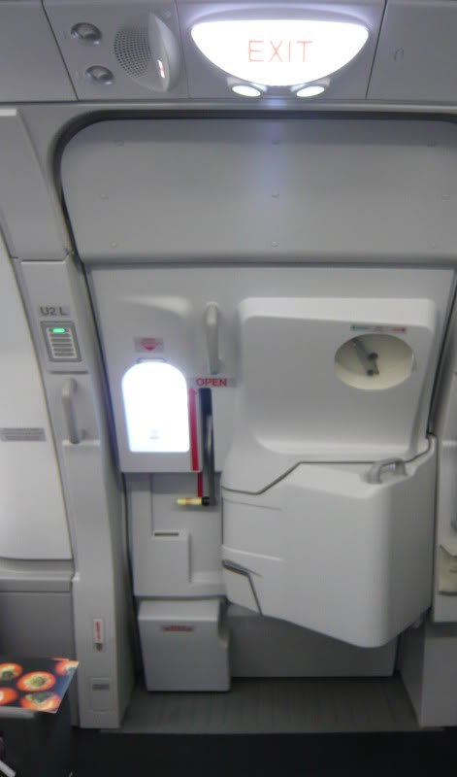
Coordination of routine procedures and services during the stages of a flight: PRE-DEPARTURE
closing and arming of doors
“Cabin Crew – Arm doors and cross check”
You’ll hear this at the start of every flight, just as the aircraft starts to push back from the gate. Simply, it means that the door is ready for use in an emergency evacuation. If the door is opened the escape slide or raft will deploy and inflate.
Crew arm and disarm the door by moving a special lever, locked with a pin. after landing, you’ll hear the pilot ask crew to disarm doors – this means that the emergency slide has been deactivated.

Slide 8
Coordination of routine procedures and services during the stages of a flight: PRE-DEPARTURE
Disinsection
Aircraft disinsection is the use of insecticide on international flights and in other closed spaces for insect and disease control. Confusion with disinfection, the elimination of microbes on surfaces, is not uncommon. Insect vectors of disease, mostly mosquitoes, have been introduced into and become indigenous in geographic areas where they were not previously present. Dengue, chikungunya and Zika spread across the Pacific and into the Americas by means of the airline networks. Cases of "airport malaria", in which live malaria-carrying mosquitoes disembark and infect people near the airport, may increase with global warming.
Definitions in the International Health Regulations (IHR) of the World Health Organization are:
"Disinfection" means the procedure whereby health measures are taken to control or kill infectious agents on a human or animal body surface or in or on baggage, cargo, containers, conveyances, goods and postal parcels by direct exposure to chemical or physical agents.
“Disinsection” means the procedure whereby health measures are taken to control or kill the insect vectors of human diseases present in baggage, cargo, containers, conveyances, goods and postal parcels.

Slide 9
Coordination of routine procedures and services during the stages of a flight: IN-FLIGHT
food, beverage and tax-free service
Food on board a flight is usually free on full-service Asian airlines and on almost all long-distance flights, while they might cost extra on low-cost airlines or European full-service airline flights. Quality may also fluctuate due to shifts in the economics of the airline industry.
On long-haul international flights in first class and business class, most Asian and European airlines serve gourmet meals, while legacy carriers based in the US tend to serve multicourse meals including a cocktail snack, appetizer, soup, salad, entrée (chicken, beef, fish, or pasta), cheeses with fruit, and ice cream. Some long-haul flights in first and business class offer such delicacies as caviar, champagne, and sorbet

Slide 10
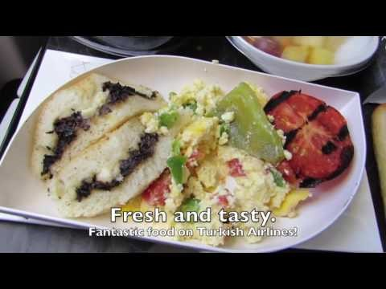
Top 8 Best Economy class Airline Meals of the world

Slide 11
Coordination of routine procedures and services during the stages of a flight: IN-FLIGHT
maintaining passenger welfare
Cabin crew aids in maintaining the health and happiness of passengers through:
showing passengers to their seats and providing special attention to certain passengers, such as the elderly or disabled
serving meals and refreshments
checking the condition and provision of emergency equipment and information for passengers
administering first aid
dealing with emergencies
supplying passengers with newspapers, magazines and in-flight entertainment
selling duty-free commercial goods that customers may need

Slide 12
Coordination of routine procedures and services during the stages of a flight: IN-FLIGHT
ancillary services
Ancillary revenue has been defined as, “Revenue beyond the sale of tickets that are generated by direct sales to passengers, or indirectly as a part of the travel experience.” Ancillary revenue has been further defined to include these categories: à la carte features, commission-based products, and frequent flier activities.
Examples of ancillary services used to offset reduced ticket costs include pay-per-view television, shopping, internet gaming, car hire and hotel bookings

Slide 13
Coordination of routine procedures and services during the stages of a flight: prior to landing
securing of cabin
In the announcement made after landing, the cabin crew can give information regarding to the airport, connections, terminals and smoking lounges in the airport. Once landed, as soon as the last passengers leave the airplane, the cabin crew will check again the security process to make sure that nobody forgot any luggage in the airplane, intentional or not, and the compartments in the kitchen will be sealed if the plane landed on base or if it will be another cabin crew without them to meet on board.

Slide 14
Coordination of routine procedures and services during the stages of a flight: prior to landing
securing of cabin
After touchdown, and as the aircraft is turning off the active runway and taxiing to the gate, the flight attendant will do one last announcement.
“Ladies and gentlemen, welcome to ??? Airport. Local time is ??? and the temperature is ???.
For your safety and comfort, please remain seated with your seat belt fastened until the Captain turns off the Fasten Seat Belt sign. This will indicate that we have parked at the gate and that it is safe for you to move about. (Depending on the airline’s policy/local laws: At this time, you may use your cellular phones if you wish./Cellular phones may only be used once the Fasten Seat Belt sign has been turned off.)
Please check around your seat for any personal belongings you may have brought on board with you and please use caution when opening the overhead bins, as heavy articles may have shifted around during the flight.
If you require deplaning assistance, please remain in your seat until all other passengers have deplaned. One of our crew members will then be pleased to assist you.
On behalf of ??? Airlines and the entire crew, I’d like to thank you for joining us on this trip and we are looking forward to seeing you on board again in the near future. Have a nice day/evening/night/stay!”

Slide 15
communication methods
Normally, the flight attendants take care of the whole cabin, and the pilots are not engaged in passenger service, except in special circumstance, such as medical emergency. Typically, there is a lead flight attendant (also called as “A line” or Chief) who command the other flight attendants in the cabin. In general, the lead flight attendant has highest authority in cabin crew, and may have responsibility for any important decisions, particular ones relating in safety rather than passenger services. She/ he is also the cabin personnel with whom the cockpit crew need deal with. However, in fact the lead flight attendant does not tend to use much authority: the relationship between lead and other cabin crew members is not constructed as well as the relationship between the captain and other cockpit crew members. the cabin is organized along a loose chain of command; the lead flight attendant does not, as a strict chain of command would dictate, serve as the exclusive link between cabin and cockpit. Other flight attendants are seldom allowed to walk into the cockpit. The culture of cockpit crew is built upon the basis of military discipline, with clear structure of hierarchy, powerfully enforcing authority lines. The culture of cabin crew tend to be more equalitarian, it is not usual to see that the flight attendants inform a lead flight attendant with the information for the flight deck, rather than reporting it themselves.

Slide 16
communication methods
The cabin crew talk on little handheld devices that look similar to a telephone and allows them to communicate with passengers and with each other. To let the cabin crew know we want to speak with them, we press a button for either Fwd or Aft, which will ring the call bell at the front or back of the cabin respectively and they will know we want to have a chat (seen in the bottom left corner of this picture under the “Calls” section).
Communications such as flight information and general announcements are all done over the intercom.

Slide 17
correct flow and order of procedures and services
The air cabin crew of a commercial airline are jointly responsible for the safety and comfort of its passengers. Duties include:
attending a pre-flight briefing, during which air cabin crew are assigned their working positions for the upcoming flight. Crew are informed of flight details, the schedule, the number of infants on board and if there are passengers with any special requirements, such as diabetic passengers or passengers in wheelchairs
carrying out pre-flight duties, including checking the safety equipment and doing security checks, ensuring the aircraft is clean and tidy and that information in the seat pockets is up to date and all meals, drinks and stock are on board
welcoming passengers on board and directing them to their seats
informing passengers of the aircraft safety procedures and ensuring that all hand luggage is securely stored away
checking all seat belts and galleys are secure prior to take-off
making announcements on behalf of the pilot and answering questions during the flight
serving meals and refreshments
selling duty-free goods and advising passengers of any allowance restrictions in force at their destination
reassuring passengers and ensuring that they follow safety procedures correctly in emergency situations
giving first aid where necessary
ensuring passengers disembark safely at the end of a flight and checking that there is no luggage left in the overhead lockers and no stowaways or suspicious items on board
completing paperwork, including writing a flight report.

Slide 18
teamwork (to maintain safety and service standards)
The words Crew and Team have the same meaning. A group of people working together. The flight & cabin crew are a team and each crew member is a team player. A military phrase heard often is "there are no individuals here! You are a team!" It should be the same way aboard an aircraft. In order for flights to be safe, efficient and enjoyable the crew needs to be able to work together. It's not enough for the Captain to give orders and the crew obeys no matter what, there needs to be open communication.
Human error is the main cause of aircraft accidents, and it's a chain of errors that sets the accident into motion. Poor flight and cabin crew communication does exist. A program called Crew Resource Management has been developed to improve teamwork, proper task delegation, communication and trust among the crew. Interpretation of the Findings the need for crew communication is evident. When crews' don't work together their performance level is low and this is when they are vulnerable to accidents.
Programs like CRM are very helpful in instilling these principles and breaking the bad habits. Poor attitudes and habits can't be changed overnight. That's why there is a need for recurrent CRM training. Communication and teamwork is the key to safe and effective operations.

Slide 19
Role of senior cabin crew
Senior cabin crew are also known as in-flight supervisors, cabin supervisors and cabin service directors. Much like cabin crew members, seniors are responsible for the comfort and safety of all passengers onboard. The role includes: preparing and serving meals and drinks; selling duty free goods onboard such as perfume, alcohol, cigarettes and toys.
And senior cabin crew will also be helping passengers with carry-on luggage, providing leadership in the event of an emergency such as an evacuation of the aircraft or severe weather conditions, and giving first aid during a medical situation with one of the passengers.
Aside from these responsibilities, senior cabin crew are in charge of the performance of all other cabin crew members – ensuring that the best levels of safety and comfort are met. Training new members of staff is also something senior cabin crew can get involved in and they will be responsible for supervising new recruits on their first flights. After each flight there is paperwork to complete and flight forms which must be dealt with by senior cabin crew.

Slide 20
Role of senior cabin crew
Summary The Senior Cabin Crew Member is responsible for the overall customer experience and wellbeing of the passengers on board by ensuring that the highest standard of safety and service is delivered by all crewmembers. Responsibilities:
Checking the passenger cabin for correct location and security of all items of emergency equipment and the visual serviceability checks of portable emergency equipment and reporting to the PIC (pilot in command) these checks have been carried out.
Responsible to ensure that the cabin crew deliver a high standard of safety, service and the overall inflight customer experience.
The pre-flight briefing of passengers on emergency equipment and exits and bringing to the passenger’s attention the written instructions when these are provided.
Ensuring that items of passenger baggage in the passenger cabin are properly secured and stowed in the passenger compartment approved stowage spaces.
On the Captain's instructions, showing the passengers where life jackets are situated and giving practical demonstration as to how they are to be fitted and used.
Complying with and ensuring that your appearance and that of the Cabin Crew Members meets the requirements of the airline.
Promoting a co-operative teamwork environment on board the aircraft with all crew members.
Ensuring that all on board sales cash and receipts is accounted for and submitted at the end of each flight.

Slide 21
Summary: Role of senior cabin crew
Role of senior cabin crew:
• leadership, e.g. leading by example, promoting teamwork, generate enthusiasm, demonstrate
integrity, role model
• monitoring and motivating, e.g. manager of team performance, service levels, sales targets,
maintaining brand identity, upholding company reputation, mentoring
• ensuring compliance with company and regulatory policies and procedures, e.g. reporting
procedures, airline policies

Slide 22
bibliography
https://science.howstuffworks.com/transport/flight/modern/airline-crew2.htm
https://en.wikipedia.org/wiki/Pre-flight_safety_demonstration
https://www.qantasnewsroom.com.au/roo-tales/cabin-crew-lingo-101/
http://howtobecabincrew.com/the-responsabilities-of-cabin-crew-before-and-after-each-flight/
https://airodyssey.net/reference/inflight/
https://en.wikipedia.org/wiki/Ancillary_revenue
https://targetjobs.co.uk/careers-advice/job-descriptions/277171-airline-cabin-crew-job-description
http://www.english-for-students.com/the-importance-of-teamwork-among-the-crew.html

