Slide 1
UNIT 2 MANAGING THE CUSTOMER EXPERIENCE

Slide 2
LEARNING OUTCOME 1 Explain the needs and expectations of market segments for the service industry

Slide 3
P2: Explore the different factors that drive and influence customer engagement of different target customer groups within a service sector organisation

Slide 4
Customer Behaviour; what is
Consumer behavior is the study of how people make decisions about what they buy, want, need, or act in regards to a product, service, or company. It is critical to understand consumer behavior to know how potential customers will respond to a new product or service. It also helps companies identify opportunities that are not currently met (Schofield, 2018).
Consumer behaviour is physiological it is human behaviour it can change with the slightest change in the market, the atmosphere and the trend.

Slide 5
Customer Behaviour; what is
The term ‘customer‘ is specific in terms of brand, company, or shop. It refers to person who customarily or regularly purchases particular brand, purchases particular company‘s product, or purchases from particular shop. Thus a person who shops at Bata Stores or who uses Raymond’s clothing is a customer of these firms (Pondiuni.edu.in, n.d.).
Whereas the ‘consumer‘ is a person who generally engages in the activities - search, select, use and dispose of products, services, experience, or ideas.

Slide 6
Customer Attitude
Customer attitudes are a composite of a person’s beliefs about, feelings about, and behavioral intentions toward your business. Based in past experience with your business and those of your competitors, understanding customer attitudes can help you monitor and change their intentions about doing business with you.

Slide 7
Customer Behaviour; how to study
EDUCBA (2018) identified 2 steps in studying consumer behaviour
You need to first understand the physiology of the consumer of a specific class, standard and of a specific market. You need to understand how does the customer think, reason, feel, and select between the option of products and services offered
Then understanding the environment of the customer is important. The environment includes the family of the consumer, their social atmosphere, their culture, etc

Slide 8
Customer Behaviour; role
Barkman (2018) believes that the role of consumer behavior in marketing is so huge that you can better meet the needs of your customers and prospective customers if you know why they’re buying what they’re buying. And if you can answer that question, then you can better market your products.
The importance of knowing and understanding consumer behavior in modern marketing is vital. If it’s bright and shiny that everyone’s after, give it to them.

Slide 9
Customer Behaviour; questions to ask
How should the company improve their marketing strategy and marketing campaigns based on their focused consumer behaviour?
How can you motivate the consumer buying behaviour, helping him make a decision in selecting between products, the importance of their product and how will their decision affect them?

Slide 10
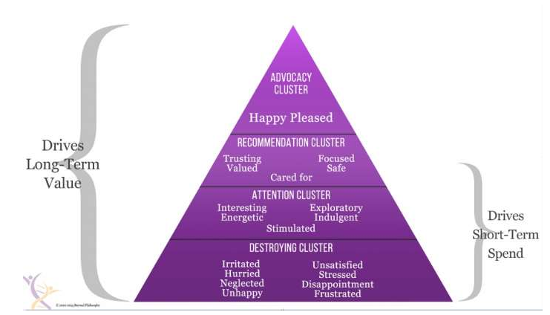
Hierarchy of emotional value

Slide 11
Customer Behaviour; Models
Surabaya (2006) Identified several different models of customer behaviour. Here are four selected models:
Economic Model
Psychological Model
Model of Family Decision-making
Sociological Model

Slide 12
Economic model
In this model, consumers follow the principle of maximum utility based on the law of diminishing marginal utility. The consumer wants to spend the minimum amount for maximising his gains.
Economic man model is based on:
Price effect: Lesser the price of the product, more will be the quantity purchased.
Substitution effect: Lesser the price of the substitute product, lesser will be the utility of the original product bought.
Income effect: When more income is earned, or more money is available, more will be the quantity purchased.

Slide 13
Economic model
This model, according to behavioural scientists, is not complete as it assumes the homogeneity of the market, similarity of buyer behaviour and concentrates only on the product or price. It ignores all the other aspects such as perception, motivation, learning, attitudes, personality and socio-cultural factors.

Slide 14
Economic model
It is important to have a multi-disciplinary approach, as human beings are complex entities and are influenced by external and internal factors. Thus, price is not the only factor influencing decision-making and the economic model according to scientists have shortcomings.

Slide 15
Psychological Model
Psychologists have been investigating the causes which lead to purchases and decision-making. This has been answered by A.H. Maslow in his hierarchy of needs. The behaviour of an individual at a particular time is determined by his strongest need at that time.
This also shows that needs have a priority. First they satisfy the basic needs and then go on for secondary needs.

Slide 16
Psychological Model
The purchasing process and behaviour is governed by motivational forces. Motivation stimulates people into action. Motivation starts with the need. It is a driving force and also a mental phenomenon. Need arises when one is deprived of something.
A tension is created in the mind of the individual which leads him to a goal directed behaviour which satisfies the need. Once a need is satisfied, a new need arises and the process is continuous.

Slide 17
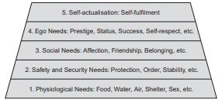
Hierarchy of needs

Slide 18
Model of Family Decision-making
In a family decision-making model, it is important to understand how the family members interact with each other in the context of their consumer decision-making. There are different consumption roles played by various members of the family.

Slide 19
Model of Family Decision-making
These roles are as follows:
Influencers- The members who influence the purchase of the product by providing information to the family members, the son in a family may inform the members of a new fast food joint. He can influence the family members to visit the joint for food and entertainment.
Gate keepers- These members control the flow of information for a product or brand that they favour and influence the family to buy the product of their choice. They provide the information favourable to themselves and, withhold information about other product which they do not favour.
Deciders- These are the people who have the power or, money and authority to buy. They play a major role in deciding which product to buy.

Slide 20
Model of Family Decision-making
Buyers- Buyers are the people who actually buy. A mother buying ration for the house etc. Father buying crayons for his children.
Preparers- Those who prepare the product in the form it is actually consumed. Mother preparing food by adding ingredients to the raw vegetable. Frying an egg for consumption, sewing clothes for the family, etc.
User- The person who actually uses or consumes the product. The product can be consumed individually or jointly by all members of the family. Use of car by the family, use of refrigerator, TV, etc

Slide 21
Model of Family Decision-making
The roles that the family members play are different from product to product. Some products do not involve the influence of family members—vegetables bought by the housewife. She can play many roles of a decider, preparer as well as the user. In limited problem solving or extensive problem solving there is usually a joint decision by family members.

Slide 22
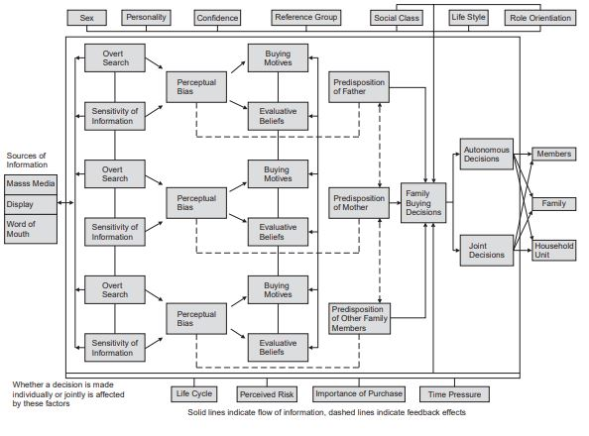
Model of family decision making

Slide 23
customer engagement
Customer engagement is the emotional connection between a customer and a brand. Highly engaged customers buy more, promote more, and demonstrate more loyalty. Providing a high-quality customer experience is an important component in your customer engagement strategy (Clarabridge, 2019).

Slide 24
Customer Engagement; what is
This is concerned with the society. A consumer is a part of the society and he may be a member of many groups in a society. His buying behaviour is influenced by these groups. Primary groups of family friends and close associates exert a lot of influence on his buying.
A consumer may be a member of a political party where his dress norms are different. As a member of an elite organisation, his dress requirements may be different, thus he has to buy things that conform to his lifestyles in different groups (Clarabridge, 2019).

Slide 25
customer engagement strategies
Ference (2017) identified six (6) strategies that can be used to engage customers:
Customer Experience is priority #1
Humanize your brand
Utilize social media
Personalize customer communications
Create useful content
Collect and utilize feedback

Slide 26
Customer Onboarding; what is
‘Customer Onboarding is defined by Shelley (2015) as an umbrella term that’s often used to describe the entire process that users go through when they start their journey as a customer of your product or service. The onboarding experience can define the ongoing relationship your customer has with the product.

Slide 27
onboarding strategies
Schroeder (2017)identified six (6) steps to an effective customer onboarding program:
Step 1: Set Goals And Build Your Team
Step 2: Map The Customer Onboarding Journey
Step 3: Create Learning Content For Customer Onboarding
Step 4: Select The Technology
Step 5: Edit, Test And Pre-launch
Step 6: Launch Onboarding Program

Slide 28
customer engagement factors
Accessibility- You need to ensure that customers are able to find and access your products and services efficiently, without barriers and friction, on their preferred channel. Also, make sure that they can reach your company and obtain good service whenever they have a question or need assistance to make a purchase decision.
Language- Speaking to your customers in their preferred language is pivotal for your business. More than 50% of consumers won’t make a purchase if information about a product isn’t available in their language. However, language doesn’t only apply to language in terms of geographical demographics but also how certain phrases or terms resonate with your audience and reflect back on your business.

Slide 29
customer engagement factors
Choice- The more choices you can give your customers during the buying process, the more likely they are to feel in control of the experience that they have with your brand. However, when offering choices make sure to support your customers and enable them to figure out the optimal choice that is right for them.
Personalized- It’s kind of ironic that shoppers want personalized experiences in a sphere in which so many business and personal interactions can be anonymous. By personalizing the experience and sharing the right content, at the right time with the right people, you can make interactions faster, easier and more efficient for your customers.

Slide 30
customer engagement factors
Pricing- The challenge here is determining just how price sensitive your target market is. In some industries, price is the number one non-product factor. In others, it plays a very minimal role.
Packaging- If you remove the packaging and dispose of it in order to access the product, it’s not part of the product itself. With that being said, you should spend a considerable amount of time and effort perfecting packaging if you want to grab attention and positively influence purchase decisions.

Slide 31
bibliography
Alton, L. (2015). 5 Factors That Directly Influence Customer Purchase Decisions. [Blog] Customer Think. Available at: http://customerthink.com/5-factors-that-directly-influence-customer-purchase-decisions/ [Accessed 13 Jan. 2019].
Barkman, A. (2018). Why Consumer Behavior Is So Important in Marketing. [online] Techfunnel. Available at: https://www.techfunnel.com/martech/why-consumer-behavior-is-so-important-in-marketing/ [Accessed 14 Jan. 2019].
Carter, R. (2017). The 15 Key Factors That Influence Customer Satisfaction. [Blog] Guided Selling. Available at: https://www.guided-selling.org/customer-satisfaction-factors/ [Accessed 14 Jan. 2019].
Clarabridge. (2019). Customer Engagement | Why is Customer Engagement important?. [online] Available at: https://www.clarabridge.com/customer-engagement/ [Accessed 14 Jan. 2019].
EDUCBA. (2018). 4 important Factors that Influence Consumer Behaviour. [online] Available at: https://www.educba.com/4-factors-influencing-consumer-behaviour/ [Accessed 14 Jan. 2019].

Slide 32
bibliography
FERENCE, A. (2017). 7 Customer Engagement Strategies That Marketers Can’t Ignore. [Blog] Outbrain. Available at: https://www.outbrain.com/blog/3-golden-customer-engagement-strategies-that-marketers-cant-ignore/ [Accessed 14 Jan. 2019].
Infosurv. (n.d.). Customer Attitude Survey | Customer Attitudes | Infosurv. [online] Available at: https://www.infosurv.com/customer-attitude-survey/ [Accessed 14 Jan. 2019].
Pondiuni.edu.in. (n.d.). predominant components of brand equity in making decision by Indian consumers regarding air conditioning. [online] Available at: http://www.pondiuni.edu.in/storage/dde/downloads/markiii_cb.pdf [Accessed 14 Jan. 2019].
Schofield, T. (2018). What Is Consumer Behavior in Marketing? - Factors, Model & Definition. [online] Study.com. Available at: https://study.com/academy/lesson/what-is-consumer-behavior-in-marketing-factors-model-definition.html [Accessed 14 Jan. 2019].

Slide 33
bibliography
Schroeder, P. (2017). Six Steps to an Effective Customer Onboarding Program. [Blog] NorthPass. Available at: https://www.northpass.com/blog/six-steps-to-an-effective-customer-onboarding-program [Accessed 21 Jan. 2019].
Shaw, C. (2017). The Hierarchy of Emotional Value. [image] Available at: https://www.mycustomer.com/experience/engagement/the-20-emotions-that-drive-or-destroy-value-in-customer-experience [Accessed 14 Jan. 2019].
Shelley, E. (2015). A Guide to SaaS Customer Onboarding. [online] ChartMogul. Available at: https://blog.chartmogul.com/a-guide-to-saas-customer-onboarding/ [Accessed 21 Jan. 2019].
Surabaya, P. (2006). Models of Consumer Behaviour. [ebook] Politeknik NSC Surabaya, pp.174-183. Available at: http://21. Chapter 20 - Models of Consumer Behaviour.pdf [Accessed 15 Jan. 2019].

