Slide 1
UNIT 2 MANAGING THE CUSTOMER EXPERIENCE

Slide 2
LEARNING OUTCOME 2 Explore the customer experience map to create business opportunities and optimise customer touch points

Slide 3
P3: Create a customer experience map for a selected service sector organisation

Slide 4
customer journey experience map
Sales force UK (2014) defines customer journey maps as a visual representation of every experience your customers have with you. It helps to tell the story of a customer's experience with your brand from original engagement and into hopefully a long-term relationship.

Slide 5
customer journey experience map
At first glance, a customer’s journey is pretty simple. You offer something, they buy it. But once you get into the detail, customer journeys are quite complex and come in many varieties.
Your customers can come into contact with your business in a multitude of ways and from many different starting points, for example, marketing, referrals, search, social media, customer service enquiries and above-the-line campaigns.

Slide 6
customer journey experience map
Customer journey mapping helps businesses step into their customer’s shoes and see their business from the customer's perspective. It helps businesses gain insights into common customer pain points, how they can improve the customer experience, and define what customers, and prospective customers, need in order to complete a purchase..

Slide 7
customer journey experience map
From a customer’s perspective, they want their experience with a brand to be connected and seamless. They expect companies to know and remember, across multiple touchpoints, who they are and what they’re looking for, so that the necessary information is available and without the necessity to repeat or clarify their needs. A map helps reveal issues with siloes in your business.

Slide 8
customer journey experience map
The benefits of a customer journey map include (Agius, 2018):
Helping you see where customers interact with your business
Focusing the business on particular customer needs at different stages in the buying funnel
Identifying whether the customer journey is in a logical order
Givings an outside perspective on your sales process
Showing the gaps between the desired customer experience and the one actually received
Highlighting development priorities
Allowing you to concentrate efforts and expenditure on what matters most to maximise effectiveness

Slide 9
customer journey experience map

Slide 10
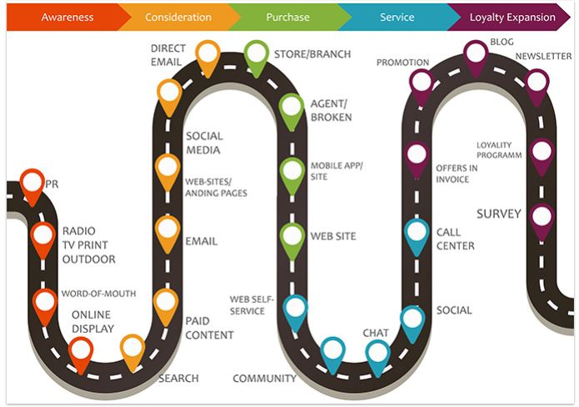
customer journey experience map

Slide 11
customer journey experience map; creation
Clark (nd) idenfied six (6) critical steps in creating a customer journey experience map
Step 1: Nail down your buyer persona
Step 2: Understand your buyer’s goals
Step 3: Map out buyer touchpoints
Step 4: Identify customer pain points
Step 5: Prioritize and fix roadblocks
Step 6:Update and improve

Slide 12
Nail down your buyer persona
The first step in creating a journey map is understanding who your customers are. Keep in mind that it isn’t sufficient to have just one buyer persona.
People at different buying stages will behave differently and interact with your business differently, so it’s worth distinguishing between someone who has been doing market research for a few months and is ready to make their purchase, and someone who has only recently begun thinking about solving his/her particular need (by trying your product/service).

Slide 13
Understand your buyer’s goals
Some great ways to get valuable customer feedback is through questionnaires and user testing. The important thing is to only reach out to actual customers or prospects.
You want the feedback of people who are actually interested in purchasing your products and services and who have interacted with your company before or plan to do so.

Slide 14
Questions to ask
How did you hear about our company?
What first attracted you to our website?
What are the goals you want to achieve with our company? In other words, what problems are you trying to solve?
How long have you / do you typically spend on our website?
Have you ever made a purchase with us? If so, what was your deciding factor?
Have you ever interacted with our website with the intent of making a purchase but decided not to? If so, what led you to this decision?
On a scale of 1 to 10, how easy is it for you to navigate our website?
Did you ever require customer support? If so, how helpful was it, on a scale of 1 to 10?
Is there any way that we can further support you to make your process easier?

Slide 15
Map out buyer touchpoints
A “touchpoint” refers to any time a customer comes into contact with your brand – before, during, or after they purchase something from you. This also includes moments that happen offline/online, through marketing, in person, or over the phone.
Some touchpoints may have more impact than others. For example, a bad check-in experience at a hotel can taint the entire stay.
You’ll want to take all potential touchpoints that occur between your customers and your organization into account. That way, you won’t miss out on any opportunities to listen to your customers and make improvements that will keep them happy.

Slide 16
Questions to ask
“Where do I go (and how do I get there) when…”
…I have a [problem that your product/company solves]?
…I discover the product or business that solves my problem?
…I make my purchase decision?
…I encounter the business again after the purchase?

Slide 17
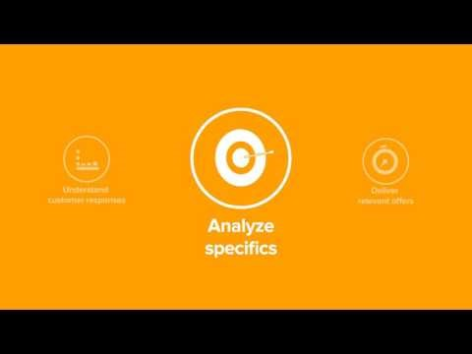

Slide 18
Identify customer pain points
At this point, it’s time to bring together all your data (both quantitative and qualitative) and look at the big picture to identify potential roadblocks or pain points in the customer journey. You may also want to note down areas where you’re currently doing things right, and figure out ways to improve.
Get to know what road blocks are stopping your customer from making their desired action. One common obstacle is cost. For example, one of your customers could love your product but abandon their cart on discovering unexpectedly high shipping rates.

Slide 19
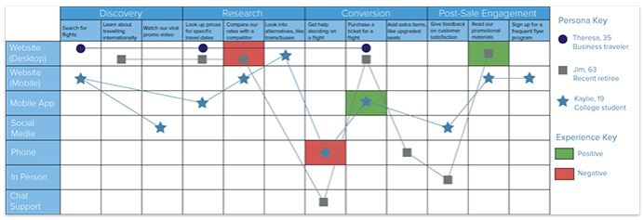
Negative & positive customer experience

Slide 20
Prioritize and fix roadblocks
If you look at it from a micro perspective, here are some questions you can ask yourself: What needs to be corrected or built? Is there a need to break everything down and start from scratch? Or are a few simple changes all that’s necessary for a big impact?
For instance, if customers frequently complain about how complicated your sign up process is, it’s probably time to revamp it and make things easier.

Slide 21
Prioritize and fix roadblocks
After you’ve identified these roadblocks, take a step back and look at the big picture from a macro perspective. Recognize that the end goal is not to optimize each step or touchpoint just for the sake of optimizing it, but so that you can push your customers down the funnel, and bring them one step closer to converting.
Highlighting these potential obstacles in your customer journey can help you to mitigate them. For example, you could provide an FAQ page which answers common questions about shipping costs.

Slide 22
Update and improve
Your customer journey map shouldn’t be left to gather dust on the shelf once it’s completed. Because your customers are constantly changing and evolving, your customer journey map should be doing the same as well. Consider it a living document that will continue to grow and develop.
If possible, test, update and improve your customer journey map every 6 months or so. In addition, customer journey maps should also be tweaked accordingly whenever you introduce significant changes to your product/service.

Slide 23
customer journey experience map; Types
Bodine (2014) identified four (4) main types of customer journey experience maps.
Current State
Day in the Life
Future State
Service Blueprint

Slide 24
Current state
These journey maps illustrate what your customers do, think, and feel as they interact with your business today. Because these maps highlight existing pain points between you and your customers, they’re best suited for driving incremental improvements to your customer experience. They’re also the most common type of journey map.

Slide 25
Current state Steps
Understand the objectives of the mapping initiative
Define the scope
Collect and evaluate existing customer data and research
Run a journey mapping workshop to create a hypothetical map
Use primary customer research to test and update your hypothesis
Make your journey map visually compelling
Socialize and Activate

Slide 26
Current state Steps
Understand the objectives of the mapping initiative- Journey maps are single artifacts that can tell a fairly comprehensive story in a short period of time. You can learn a lot from a well-made journey map about what’s working, what’s not, and most importantly, what it’s like to be a customer.
An effective journey mapping initiative starts with a clear statement of its goals. One of the goals frequently cited by our clients is a desire to identify where their current customer experience is falling short, leading to negative impressions.

Slide 27
Current state
Define the scope
After everyone agrees on a set of goals, the next step is to identify the scope of the journey to be mapped. Scope definition of the map is critical. It will determine what kind of research you will need to do, and the level of resolution and storytelling employed in the map.
In this step your team should determine the ideal scope to meet the goals previously agreed upon. For example, should the map focus on the customer onboarding process, nurturing a completely anonymous web visitor to becoming a customer of a service?” Or will the map target the ongoing customer experience post-acquisition?

Slide 28
Current state
Collect and evaluate existing customer data and research
Many organizations have built a treasure chest of pre-existing customer research. It is important to harvest as much insight as you can from pre-existing research as your prepare for your first journey mapping workshop. This will help the team understand who the target customers are and often provides multiple windows into the health of the current customer experience

Slide 29
Current state
These types of assets can be:
Call center logs
Survey data and findings reports
Usability test results
Contextual inquiry observations and reports
Segmentation data
Personas
Customer satisfaction reports
Customer care reports
Market value studies

Slide 30
Current state
Run a journey mapping workshop to create a hypothetical map
In this workshop, you will do the work to uncover and organize the content to build your first map of the journey. In order begin to build a shared understanding of the customer, you should invite as much of the full business, design and development team as is practical. You will want to bring in business process owners, and people who have a good understanding of the target customers. When possible, you should also include current customers to describe their experiences with different stages in the process first hand.

Slide 31
Current state
Use primary customer research to test and update your hypothesis
With a good baseline understanding of the customer experience and your hypothetical map in hand, its now time to validate your assumptions with a round of primary customer research. We like to use an interview process called contextual inquiry, which emphasizes observing customers in the normal environments in which they use the product or service.
Instead of asking customers a long list of questions, this process encourages customers to use the product or service as they normally would. This allows interviewers to record observations of customer behavior, occasionally prompt the customer to provide insight on why they are taking the action they are taking, and ask them how they feel about different aspects of the experience.

Slide 32
Current state
Make your journey map visually compelling
With final map attributes in hand, this step allows you to tell the best story you can in a visually compelling format. Ideally, you should try to find a way to publish this map in the same context as the target customer personas, research data, and customer observations.
Team members who are creating this final map should pull out all the stops for this version to make sure the story jumps off the page and that the most important messages come through clearly.

Slide 33
Current state
Socialize and Activate
It’s time to bring your customer journey map to a wider audience of stakeholders. If you are using a customer experience management platform, you can send invites to additional stakeholders to view your cloud hosted journey map and the research used to produce it. The identified activities and pain points can also be integrated directly into application development environments (ADEs) such as Rally, Version One, and Atlassian Jira.

Slide 34
Day in the life
These journey maps also illustrate what people do, think, and feel today. But they take a wider view by examining everything that customers or prospects do (within a specific area of focus), whether that involves your company or not. Because these maps highlight existing pain points in peoples’ lives, they’re best suited for driving innovation through addressing unmet needs.
This type gives a wider lens into the lives of your customers and what their pain points are in real life. They are best used for addressing unmet customer needs before customers even know they exist.

Slide 35
Future State
These journey maps illustrate what your customers will do, think, and feel as they interact with your business at some point in the future. They’re best suited for communicating your vision for how new products, services, and experiences will function.
Based on what the current experience is, you map out where you want to be with this style. They are best used for illustrating your vision and setting a clear objective.

Slide 36
Service blueprint
Often called service blueprints, these diagrams usually start with a simplified version of either an existing or future state journey map. Then they layer on the system of people, processes, policies, and technologies (both customer-facing and behind-the-scenes) that are responsible for delivering that experience today or in the future. If built on an current-state journey map, journey blueprints can help you identify the root causes of existing customer paint points.
If built on a future-state journey map, they can help you identify the ecosystem that needs to be in place to support the intended experience.
They are best used for identifying the root causes of current customer journeys or identifying the steps needed to attain desired future customer journeys.

Slide 37
Include kpis
Key performance indicators can help provide the evaluative framework to make your journey map actionable.
For instance, one of the main functions of a customer journey map is to pinpoint opportunities based on qualitative research of your customers’ perceptions and experiences.
Many companies use journey maps to help them gain qualitative insights of customer highs and lows. Indicators like “meets/does not meet/exceeds expectations” are used to effectively visualize opportunities for improvement in the customer journey (Ross, 2014).

Slide 38
Deconstructing customer experience
So much research today emphasizes the customer experience (CX) and the technology that either makes it or breaks it. Gartner, for example, predicts that more than 40% of all data analytics projects will relate to some aspect of the CX by 2020 (Lucey, 2017).
Brands know this good and well, with most currently or planning to invest more in technology to drive the CX. Still they tend to come up short. In fact, IBM’s “2017 Customer Experience Index (CEI) Study” reports an average CEI score of 33 out of 100. Scores ranged from as low as 4 to as high as 85, a span of 81 points separating the highest and lowest performers.
Long gone is the question of whether companies struggle with CX. Rather, we need to know why and how improvements can be made. The way I see it, the answer can be found by backtracking. For executives and decision makers, this means retracing steps past technology and even the CX itself (Lucey, 2017).

Slide 39
bibliography
Agius, A. (2018). How to Create an Effective Customer Journey Map [Examples + Template]. [online] Blog.hubspot.com. Available at: https://blog.hubspot.com/service/customer-journey-map [Accessed 21 Jan. 2019].
Bodine, K. (2014). The 4 Types of Customer Journey Maps. [Blog] Kerry Bodine &Co.. Available at: http://kerrybodine.com/the-4-types-of-customer-journey-maps/ [Accessed 21 Jan. 2019].
Clark, D. (n.d.). 7 Steps to an Effective Customer Journey Mapping Process. [online] TandemSeven - The Experience Innovation Company. Available at: https://www.tandemseven.com/journey-mapping/effective-current-state-customer-journey-mapping-process/ [Accessed 21 Jan. 2019].
Lucey, M. (2017). Deconstructing the CX: Looking Inward to Maximize Impact. [Blog] Avaya. Available at: https://www.avaya.com/blogs/archives/2017/08/deconstructing-cx-looking-inward-maximize-impact.html [Accessed 21 Jan. 2019].

Slide 40
bibliography
Ross, L. (2014). Six Steps to Creating The Complete Customer Journey Maps. [Blog] Invespcro. Available at: https://www.invespcro.com/blog/six-steps-to-creating-the-complete-customer-journey-maps/ [Accessed 21 Jan. 2019].
Sales Force Uk (2016). What is Customer Journey Mapping & Why is it Important?. [Blog] Sales Force Uk. Available at: https://www.salesforce.com/uk/blog/2016/03/customer-journey-mapping-explained.html [Accessed 21 Jan. 2019].
VisualParadigm (2017). What is Customer Journey Mapping?. [video] Available at: https://www.youtube.com/watch?v=5Ly33ZLjeyI [Accessed 21 Jan. 2019].

