Slide 1
UNIT 2 MANAGING THE CUSTOMER EXPERIENCE

Slide 2
LEARNING OUTCOME 2 Explore the customer experience map to create business opportunities and optimise customer touch points

Slide 3
P4: Discuss how the customer touch points throughout the customer experience create business opportunities for a selected service sector organisation

Slide 4
Touch point; what is
Customer touchpoints in general are not often understood for what they really are, or appreciated from the customer’s perspective. Therein lies the problem. And they are more than just business jargon! They are meaningful only if and when the company understands them as a whole inventory, and as individual opportunities to improve the customer experience.
Understanding your customers’ current situations, and what drives them toward loyalty or defection, is the first step in delivering a superior customer experience. Understanding the actual touchpoints your customers have with your organization is a basic part of that understanding.

Slide 5
Service encounter vs service experience
There has been inconsistency in the terminology used to refer to
customer-ﬁrm or customer-employee interactions in service contexts. In
light of the need for a comprehensive service experience framework,
especially problematic is the interchangeable use of the terms “service
encounter” and “service experience.” To suggest a speciﬁc protocol
regarding the future use of these terms, we consider a recent take on
their conceptualizations, and adapt the deﬁnitions of service encounter
and service experience accordingly.

Slide 6
Service encounter vs service experience
In their review of the literature on service encounters and service experiences, Bitner and Wang (2014) illuminate the distinction and relationship between the terms. The distinction essentially lies in the discreteness of service encounters (Bitner & Hubbert, 1994) and the continuous nature of a service experience.

Slide 7
Service encounter vs service experience
In presenting a broadened framework for service experience research, we adhere to this distinction and extend the conceptualization of each term to account for the newly-deﬁned pre-core, core, and post-core service encounter periods within a service experience.
In line with Bitner and Wang (2014),we deﬁne service encounter as any discrete interaction between the customer and the service provider relevant to a core service oﬀering, including the interaction involving provision of the core service oﬀering itself

Slide 8
Service encounter vs service experience
This deﬁnition encompasses pre- and post-core encounters as well as those built into the core service provision as “moments of truth” that inﬂuence cumulative customer outcomes. Encounters have many forms and can be face-to-face in an actual service setting or online; they can also be over the phone, through the mail or even by catalogue (Bitner, Brown, & Meuter, 2000).
Moments of truth are described as critical encounters between customers and ﬁrms that signiﬁcantly impact customers' impressions of the ﬁrm and consumption (Beaujean, Davidson, & Madge, 2006; Bitner & Wang, 2014; Löfgren, 2005).

Slide 9
Service encounter vs service experience
We deﬁne service experience as the period during which all service encounters relevant to a core service oﬀering may occur. This concept comprises pre- and post-core encounters, as well as the encounters built into the core service provision as “moments of truth” that inﬂuence customer outcomes. This conceptualization widens the lens through which we view service experience by highlighting the pre-core, core and post-core service encounter periods

Slide 10
Moments of truths
Moments of truth are those interactions where customers put in a high amount of energy to reach a satisfactory outcome. A company could have thousands of moments of truth in a single day. Whether adversely or favourably, they incredibly affect companies’ relationship with customers and their perception about the brand.

Slide 11
Moments of truths
Moments of truth are those interactions where customers put in a high amount of energy to reach a satisfactory outcome. A company could have thousands of moments of truth in a single day. Whether adversely or favourably, they incredibly affect companies’ relationship with customers and their perception about the brand.

Slide 12
Moments of truths
Moments of Misery
Moments of Mediocrisy
Moments Of Magic

Slide 13
example
When you call to make a reservation to take a flight,
When you arrive at the airport and check your bags curbside,
When you go inside and pick up your ticket at the ticket counter,
When you are greeted at the gate,
When you are taken care of by the flight attendants onboard the aircraft,
And when you are greeted at your destination.

Slide 14
Moments of misery
These are complaints, problems, negative experiences, friction; anything less than a positive interaction. It’s not a matter of if you will ever have a Moment of Misery. It’s when. Even the best companies have them, but these great companies have trained employees and have a system on how to turn them around.

Slide 15
Moments of mediocracy
Another word for mediocrity is average. In other words, not good or not bad. Just okay. Just satisfactory. And, satisfactory is not good enough to create loyalty. If you ask your friend how dinner was at a restaurant and the response is, “It was okay (in other words, satisfactory),” you will probably want to spend your money elsewhere. Satisfactory or average is mediocre.

Slide 16
Moments of magic
The type of experiences you want to create for your customers are Moments of Magic, which are simply above average interactions. Don’t let the word magic fool you. Most people think that magic has to be over-the-top or a “Wow” type of customer interaction, but it doesn’t. It just has to be above average. However, the key is to be above average all of the time. That’s what the best companies do. They create customer interactions that are above average… all of the time. They are consistent and predictable.

Slide 17
example
There are many obvious Moments of Truth when traveling: the passenger makes a reservation, checks bags on the day of departure, checks in at the ticket counter, is boarded at the gate, is greeted at the destination, and picks up the baggage at the baggage claim carrousel. However, in addition to these main touch points, or Moments of Truth, there are other times that the passenger may interact with employees of the airline. For example, a flight attendant from a different flight may wave or smile at the passenger as he or she walks by. While that is not a main Moment of Truth, it is still an important one. Every interaction, however remote, is an opportunity for the customer/passenger to form an impression.

Slide 18
Building blocks
Human experience is complex, and mostly intangible. Yet the challenge of experience mapping is to uncover, little by little, critical information about your customers’ experiences.
The key building blocks are Doing, Thinking, and Feeling, but to understand the full context of customer experience, we also consider Place, Time, Devices, and Relationships. Don't forget Channel and Touchpoints

Slide 19
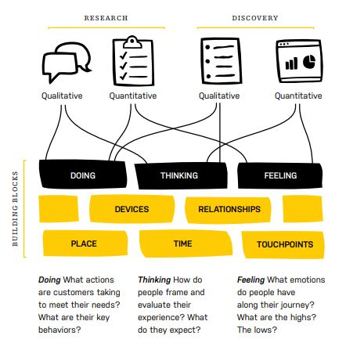
Building blocks

