Slide 1
Unit 38 & 50: Customer Value Management
P4 Determine and explain the types of market segmentation strategies that can be applied to a customer base

Slide 2
DEFINE; MARKET SEGMENTATION

Slide 3
MARKET SEGMENTATION
“Market segmentation is the process brands use to divide their target market into smaller segments of people that share common characteristics to optimize their marketing, advertising and sales efforts” (Tow, 2019, sec. 1).
“Market segmentation creates subsets of a market based on demographics, needs, priorities, common interests, and other psychographic or behavioral criteria used to better understand the target audience” (What is Market Segmentation, 2017, par. 1).

Slide 4
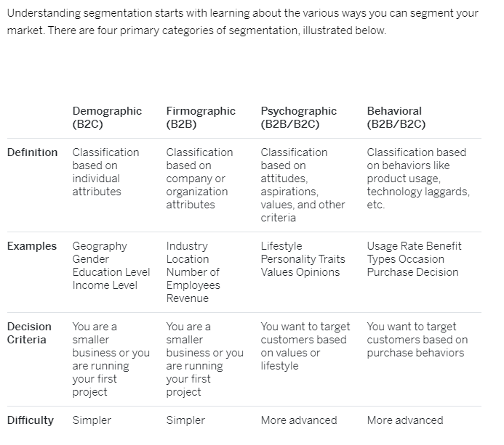
THE BASICS OF SEGMENTATION

Slide 5
Types of Market Segmentation (What Is Marketing Segmentation, 2017, sec. 2)
Geographic Segmentation
While typically a subset of demographics, geographic segmentation is typically the easiest. Geographic segmentation creates different target customer groups based on geographical boundaries. Because potential customers have needs, preferences, and interests that differ according to their geographies, understanding the climates and geographic regions of customer groups can help determine where to sell and advertise, as well as where to expand your business.
Demographic Segmentation
Demographic segmentation sorts a market by demographic elements such as age, education, income, family size, race, gender, occupation, nationality, and more. Demographic segmentation is one of the simplest and most used forms of segmentation because the products and services we buy, how we use those products, and how much we are willing to spend on them is most often based on demographic factors.
Firmographic Segmentation
Firmographic segmentation is like demographic segmentation. The difference is that demographics look at individuals while firmographics look at organizations. Firmographic segmentation would take into consideration things like company size, number of employees and would illustrate how addressing a small business would differ from addressing an enterprise corporation.
Behavioral Segmentation
Behavioral segmentation divides markets by behaviors and decision-making patterns such as purchase, consumption, lifestyle, and usage. For instance, younger buyers may tend to purchase body wash, while older consumer groups may lean towards soap bars. Segmenting markets based off purchase behaviors enables marketers to develop a more targeted approach.
Psychographic Segmentation
Psychographic segmentation considers the psychological aspects of consumer behavior by dividing markets according to lifestyle, personality traits, values, opinions, and interests of consumers. Large markets like the fitness market use psychographic segmentation when they sort their customers into categories of people who care about healthy living and exercise.

Slide 6
Examples of Market Segmentation Using Victoria’s Secret
Demographic/Firmographic
Victoria’s Secret deals in designing and marketing women lingerie and beauty products. They focused on women and “women” is the primary market segment in their marketing strategy. Victoria’s Secret is also segmenting their target market with product differentiation as PINK for teenage girls.
Geographic
Victoria’s lingerie brand is operating in almost 75 countries with 1000 stores globally. The way they market their products vary depending on the country.
Psychographic
Victoria’s Secret is segmented its customer based on women personality and self-confidence. Todays’ Female Personality traits Victoria is targeting include looking sexy, fashionable, trying new looks and styles and open minded.
Behavioral
A lot of consumers purchase Victoria’s Secret lingerie product line for its prestige.

Slide 7
Market Segmentation & Customer Lifetime Value
The aim of segmentation is to discover groups with similar needs to make your operations more efficient.
In terms of CLV, you can identify groups who have different projected spend and lifetimes with the business, discover and reduce their specific pain points and reasons for churn, and take steps to increase that group’s CLV.
How companies choose to segment their customers will vary by business.
B2B companies might segment by criteria such as industry or revenue.
For B2C companies it could be demographics, psychographics, lifestyle, geography, and so on.

Slide 8
The role of Market Segmentation in enhancing Customer Lifetime Value
“Customer segmentation allows for an effective allocation of marketing resources and maximizes opportunities to cross-sell and up-sell customers in order to increase average order value & customer lifetime value. Communication with customers through email marketing can be broken down to fit segmented customer profiles and therefore will seem more personalized, genuine, and relevant to their audiences. This means more opens, page views and higher click through rates for their email marketing campaigns.
Arguably the most important use case with customer segmentation is to find “whale” customers in regard to the 80/20 rule - which states that 20% of a customer base brings in 80% of the revenue. Learning to both identify this group and strike a balance between investing the appropriate amount of time and resources is paramount. Exclusive incentives drive repeat purchases which hones in on this group's customer loyalty and lifetime value. Something that combined can increase a company’s growth trajectory.” (Honarvar, 2017, sec. 1).

Slide 9
BEST WAYS TO SEGMENT YOUR MARKET TO INCREASE CLV
Spoil your ‘Whale Customers’ aka Top 20%
“The easiest place to start is to find the top 20% of customers and give them every incentive to continue purchasing in order to build loyalty. Merchants should even set a threshold for having customers enter this group (eg: any customer with over $5000 in lifetime spend) and then email them letting them know that they’ve now entered this elite grouping and that it comes with many exclusive offerings. Examples of this may be free shipping, a discounted rate off every order, 1 free surprise product with every order.
First Purchase
In order to incentivize customers to continue purchasing in hopes of one day turning them into “whale customers”, merchants will need them to first come back and make a second purchase. To ensure that they have the necessary metrics in place to identify these opportunities, merchants must be sure to segment customers immediately after their first order. Tag their customer account based on attributes like order size, products purchased, country/state, and even acquisition path.
Knowing a customer's acquisition path can be a great tool to help drive future actions and drivers as a business owner - Where did they come from? How did they find you? How many times have they visited your site before making a purchase?

Slide 10
BEST WAYS TO SEGMENT YOUR MARKET TO INCREASE CLV
Recency and Frequency
Recency refers to the last time a customer made a purchase from your store. Though the boundaries you set will depend on what type of product you’re selling, you’d typically want to segment your customers into the following:
Active - Customers who have shopped recently.
At risk - Customers who have previously purchased from you but have not returned to make a purchase within the timeframe of a typical "active" shopper.
Lapsed - Customers that have purchased previously but have gone way beyond the point you’d usually expect them to return to make another purchase.
Frequency refers to how often a customer has made a purchase from your store.
Prospect - Visitor who has not shopped with you at all - you may have their info from an abandoned cart or email capture pop ups.
One-off customer - Customer who has made a single purchase from your store.
Repeat customer - Customer who has made more than one purchase from your store.
Loyal customer - Customer who has a sufficient number of times to be considered ‘loyal’.” (Honarvar, 2017, sec. 4).

Slide 11
WHAT ARE THE BENEFITS OF SEGMENTING YOUR AUDIENCE?

Slide 12
BENEFITS OF SEGMENTING YOUR AUDIENCE
Calculate and improve ROI (Return on Investment) for customer acquisition
Identifying segments with a high CLV allows you to prioritize these groups, focus your marketing on their needs, and spend more on winning their custom.
Understand key decisions
A particular group of your existing customers may have had common reasons for choosing you. Taking this knowledge into your marketing strategy gives opportunities for much more effective targeted positioning.
Enhance retention marketing
There may be common reasons for churn within a market segment. Identifying these allows product and marketing to focus on reducing these pain points, thereby increasing CLV.
Improving customer support and retention
Using CLV to identify your most valuable customers means you can pay them special attention. By fostering stronger relationships you can reduce churn among your most valuable customers.
Prioritize product improvements
Different sectors will want different products and features. By understanding these groupings, and prioritizing the high value customers, you get feedback into product development to improve your offering.

Slide 13
three Reasons Why Segmentation is Necessary to Understand Customer Lifetime Value
http://insights.marinsoftware.com/analytics/3-reasons-why-segmentation-is-necessary-to-understand-customer-lifetime-value/

Slide 14
The Importance of Customer Lifetime Value (CLV) in Marketing in 2020
https://exponea.com/blog/customer-lifetime-value-guide/

Slide 15
INDIVIDUAL CLASS ACTIVITY
This Photo by Unknown Author is licensed under CC BY-SA-NC

Slide 16
INSTRUCTIONS
Choose one of the products in the product list on the following page and conduct a little research. In this scenario, you are a business owner of a company that sells the product chosen. As the buyer for a local specialty shop, you are responsible for planning the merchandise selection and then buying the merchandise for your business. Selection and inventory are critical to the success of your store as there are a number of nationally branded stores in your trading area.
For the products and services on the next page, you are to:
1. Identify the market segment.
2. Give a summary paragraph(minimum of five useful sentences) explaining why you believe this is an appropriate segment.

Slide 17
STEP 1: SELECT A PRODUCT/SERVICE FROM THE LIST BELOW
PRODUCTS AND SERVICES LIST
(Prices are listed in USD)
1. A cruise of the Caribbean during February 10-17. $1,500 per person.
2. An audio cassette tape and “read-along” picture book of The Lion King. $6.99
3. A “Genie” brand garage door opener not installed. $192
4. Tickets to performance of Shakespeare’s Merchant of Venice at the Performing Arts
Center. $33 per ticket.
5. Embroidered Collegiate Sweater. $35
6. “The Club” WIN 1000 auto security system. $45
7. A Richard Simmons exercise video. $19.95
8. A small 2’ X 2’ X 2’ refrigerator. $110
9. Baldwin Baby Grand Piano. $23,000
10.Subscription to Netflix. $15 a month with the offer of a “free one month trial”
11.Cannon TM all-in-one color inkjet printer for a computer, $155.

Slide 18
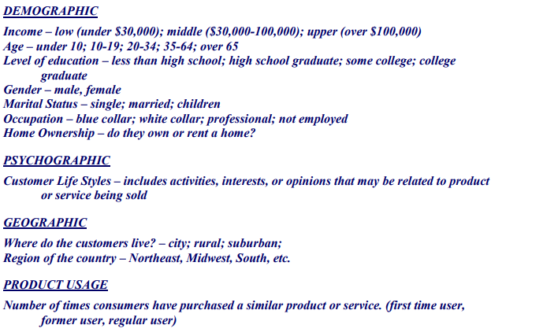
Step 2: You will need the information below to segment your market

Slide 19
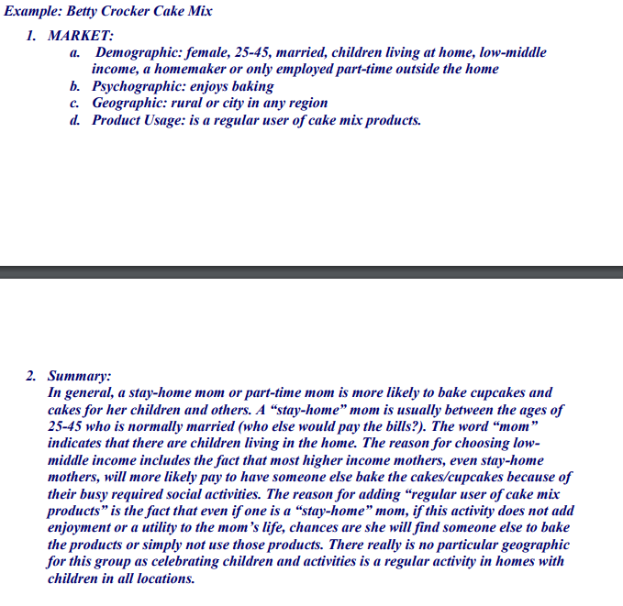
Example.

Slide 20
REFERENCES
Honarvar, Z. (2017). Customer Segmentation: The key to maximizing customer lifetime value (CLV). [online] Linkedin.com. Available at: https://www.linkedin.com/pulse/customer-segmentation-key-maximizing-lifetime-value-clv-zack-honarvar [Accessed 17 Jan. 2020].
Qualtrics.com. (2017). What is Market Segmentation?. [online] Available at: https://www.qualtrics.com/experience-management/brand/what-is-market-segmentation/ [Accessed 17 Jan. 2020].
Tow, H. (2019). The 4 Main Types of Market Segmentation (+How to Implement It in Your Marketing Strategy). [online] Learn.g2.com. Available at: https://learn.g2.com/market-segmentation [Accessed 17 Jan. 2020].

