Slide 1
WEEK 3
UNIT 4: MANAGEMENT AND OPERATIONS
UNIT 5: LEADERSHIP AND MANAGEMENT FOR SERVICE INDUSTRIES

Slide 2
OVERVIEW
While the words manager and leader may appear to mean they same thing, they do not. A manager is someone who manages and is responsible for the important aspects of a job, project, or team. A leader is someone who is influential, takes charge, and is an example for others. Managers and leaders usually obtain their title in a work, educational, or team environment through a demonstration of their management and leadership skills.

Slide 3
DEFINITION OF A LEADER
A leader is "a person who influences a group of people towards the achievement of a goal". A mnemonic for this definition would be 3P's - Person, People and Purpose as illustrated by the following diagram.

Slide 4
DEFINITION OF A LEADER

Slide 5
DEFINITION OF A LEADER
Person - Is leadership a position of office or authority? Or, is leadership an ability in the sense that he is a leader because he leads? We all may know or hear of people who are in positions of leadership but who are not providing leadership. A position of office is no guarantee of leadership but it helps in the sense that a leadership position usually commands a listening ear from its people and that is a good starting point for anyone who desires to be a leader.
A leader by its meaning is one who goes first and leads by example, so that others are motivated to follow him. This is a basic requirement. To be a leader, a person must have a deep-rooted commitment to the goal that he will strive to achieve it even if nobody follows him!

Slide 6
DEFINITION OF A LEADER
Purpose - A requirement for leadership is personal vision - the ability to visualize your goal as an accomplished fact; a thing already achieved.
"The very essence of leadership is that you have to have vision. You can't blow an uncertain trumpet." Theodore M. Hesburgh
RELATED: Edward de Bono's 5-Stage Thinking Structure
In communicating your goal (AIMS), bear in mind that it should meet the following criteria:
Achievable ... realistic yet faith stretching
Inspiring ... challenging your people to give of their best
Measurable ... quantifiable
Shared ... declaring your conviction in and commitment to the goal
“The leader has to be practical and a realist, yet must talk the language of the visionary and the idealist.” Eric HofferPerson

Slide 7
DEFINITION OF A LEADER
People - The next requirement is the realization that the goal cannot be achieved alone, without the help of others. Is there a natural grouping of people from whom you can elicit help? Or do you have to recruit your followers? In the latter, you face a greater challenge. But whatever the situation, the leader must integrate his (or the organization's) goal with his followers’ personal goals and then communicates this goal in such a way that they embrace it too and the goal becomes a common goal.

Slide 8
DEFINITION OF A LEADER
To be a leader, one must have followers. To have followers, one must have their trust. How do you win their trust? Why would others trust you? Most important, are you worthy of their trust?
“He who thinketh he leadeth and hath no one following him is only taking a walk.” Anonymous

Slide 9
DEFINITION OF A LEADER
Why are some individuals more effective than others at influencing people? Effectiveness in leadership has been attributed to (1) persuasion skills, (2) leadership styles and (3) personal attributes of the leader.

Slide 10
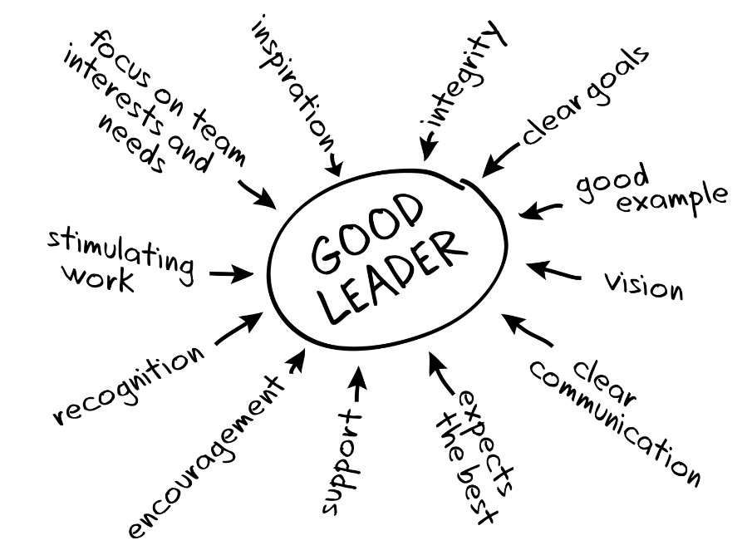
DEFINITION OF A LEADER
Source: johncdonahue.com/leadership-definition/

Slide 11
DEFINITION OF A MANAGER
It is very difficult to give a precise definition of the term management. Different management authors have viewed management from their own angles moreover, during the evolutionary process of management different thinkers laid emphasis on different expects.
For example, F.W. Taylor emphasized engineering aspects, Elton Mayo laid emphasis on human relations aspects, E.F.L, Brech, George R. Terry emphasis on, decision making aspect, Ralph Davis stresses leadership aspect and some other like Barry Richman etc. emphasized integration or coordination aspect.

Slide 12
DEFINITION OF A MANAGER
Some Important Definition of Management
1. Harold Koontz Management is the art of getting things done through and with people in formally organized groups.
2. George R. Terry: Management is a disconnect process consisting of planning organizing activating and controlling performed to determine and accomplish the objectives by the use of people and resources.
3. Donald J. Cough: Management is the art and science of decision making and leadership.

Slide 13
DEFINITION OF A MANAGER
4. Mary Cushing Nile: Good Management, or scientific management, achieves a social objective with the best use of human and material energy and time, and with satisfaction for the participants and the public.
5. Henry Fayol: To manage is to forecast, to plan, to organize, to command, to coordinate, and to control.
6. Theo Haimann and William Scott: Management is a social and technical process which utilizes, resources, influences, human action and facilitates changes in order to accomplish organizational goals.

Slide 14
DEFINITION OF A MANAGER
Management is the organizational process that includes strategic planning, setting; objectives, managing resources, deploying the human and financial assets needed to achieve objectives, and measuring results.
Management also includes recording and storing facts and information for later use or for others within the organization. Management functions are not limited to managers and supervisors.

Slide 15
DEFINITION OF A MANAGER
Every member of the organization has some management and reporting functions as part of their job. Management is a universal phenomenon. It is a very popular and widely used term. All organizations - business, political, cultural or social are involved in management because it is the management which helps and directs the various efforts towards a definite purpose.

Slide 16
DEFINITION OF A MANAGER
According to Harold Koontz, “Management is an art of getting things done through and with the people in formally organized groups. is an art of creating an environment in which people can perform and individuals and can co-operate towards attainment of group goals”. According to F.W. Taylor, “Management is an art of knowing what to do, when to do and see that it is done in the best and cheapest way”.

Slide 17
DEFINITION OF A MANAGER
According to the functions approach managers perform certain activities to efficiently and effectively coordinate the work of others.
They can be classified as:
1) Planning involves defining goals, establishing strategies for achieving those goals, and developing
plans to integrate and coordinate activities.
2) Organizing involves arranging and structuring work to accomplish the organization’s goals.

Slide 18
DEFINITION OF A MANAGER
3) Directing involves give direction to the staff and how to do their jobs.
4) Leading involves working with and through people to accomplish organizational goals.
5) Controlling involves monitoring, comparing, and correcting work performance. Since these four management functions are integrated into the activities of managers throughout the workday, they should be viewed as an ongoing process and they need not the done in the above sequence.

Slide 19
THE ROLE OF THE LEADER VERSUS THE ROLE OF THE MANAGER
A manager is the member of an organization with the responsibility of carrying out the four important functions of management: planning, organizing, leading, and controlling. But are all managers leaders?
Most managers also tend to be leaders, but only IF they also adequately carry out the leadership responsibilities of management, which include communication, motivation, providing inspiration and guidance, and encouraging employees to rise to a higher level of productivity.

Slide 20
THE ROLE OF THE LEADER VERSUS THE ROLE OF THE MANAGER
Unfortunately, not all managers are leaders. Some managers have poor leadership qualities, and employees follow orders from their managers because they are obligated to do so—not necessarily because they are influenced or inspired by the leader.
Managerial duties are usually a formal part of a job description; subordinates follow as a result of the professional title or designation. A manager’s chief focus is to meet organizational goals and objectives; they typically do not take much else into consideration. Managers are held responsible for their actions, as well as for the actions of their subordinates. With the title comes the authority and the privilege to promote, hire, fire, discipline, or reward employees based on their performance and behaviour.

Slide 21
THE ROLE OF THE LEADER VERSUS THE ROLE OF THE MANAGER
The primary difference between management and leadership is that leaders don’t necessarily hold or occupy a management position. Simply put, a leader doesn’t have to be an authority figure in the organization; a leader can be anyone.
Unlike managers, leaders are followed because of their personality, behavior, and beliefs. A leader personally invests in tasks and projects and demonstrates a high level of passion for work. Leaders take a great deal of interest in the success of their followers, enabling them to reach their goals to satisfaction—these are not necessarily organizational goals.

Slide 22
THE ROLE OF THE LEADER VERSUS THE ROLE OF THE MANAGER
A manager manages and takes responsibility of a situation. A leader takes charge, is influential, and sets an example.
The manager has responsibilities and is able to delegate and implement plans. A leader is an example for others and is someone who doesn’t necessarily have a large responsibility.
Managers have subordinates who follow their rules. Leaders have individuals who believe in what they say, otherwise known as followers.
Leaders focus on human emotion and charisma to lead. Managers focus on concise, scientifically proven methods to lead.

Slide 23
THE ROLE OF THE LEADER VERSUS THE ROLE OF THE MANAGER
There isn’t always tangible or formal power that a leader possesses over his followers. Temporary power is awarded to a leader and can be conditional based on the ability of the leader to continually inspire and motivate their followers.
Subordinates of a manager are required to obey orders while following is optional when it comes to leadership. Leadership works on inspiration and trust among employees; those who do wish to follow their leader may stop at any time. Generally, leaders are people who challenge the status quo. Leadership is change-savvy, visionary, agile, creative, and adaptive.

Slide 24
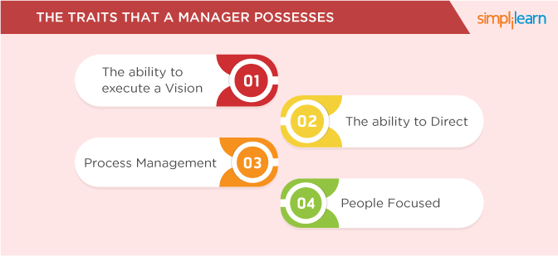
THE ROLE OF THE LEADER VERSUS THE ROLE OF THE MANAGER

Slide 25
THE ROLE OF THE LEADER VERSUS THE ROLE OF THE MANAGER

Slide 26
HARD MANAGEMENT SKILLS
Hard management skill? It’s a specific, teachable ability: something that can be measured and defined. A hard skill can be anything from being able to read to working complex software programs.
You can quantify a hard skill. That is, it can be certified, or you might earn a degree in that discipline. Therefore, hard skills are acquired through formal education or training programs. That can be in an academic environment or learning on the job as an apprentice. Usually, when referring to skilled labour, the job is one that demands proficiency in a hard skill.

Slide 27
HARD MANAGEMENT SKILLS
Hard skills are the skills that are required to perform the tasks in a particular job. Some of the trending hard skills are computer technology, data analytics, financial accounting, software proficiency, cyber security and agile methodologies just to name a few. Having a unique skill set can help in attracting good compensation and benefits; it also makes a person more employable. Since hard skills are teachable and measurable therefore more proficient a person is in a skill more the person can advance in his/her career, it can also be assessed by various methods.

Slide 28
SOFT LEADERSHIP SKILLS
It must be noted that, “soft ” is defined as “yielding readily to pressure; easily penetrated, divided or changed; deficient in hardness.” This word suggests weakness and impermanence. “Soft leadership” skills implying that the folks at the very top are weak and malleable. Soft skills are those that help with interpersonal issues. In other words, dealing with people. That might sound very general, and it is. Soft skills are notoriously difficult to define. But they include such areas as being able to clearly communicate, listen, be empathetic and the like. Just because soft skills are elusive doesn’t mean they’re not in demand.

Slide 29
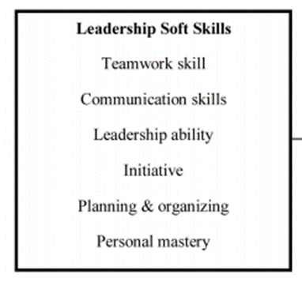
SOFT LEADERSHIP SKILLS
The conceptual framework below is based on Crosbie’s six leadership soft skills.

Slide 30
REFERENCES
(2019). Retrieved from https://www.ep.liu.se/ecp/026/076/ecp0726076.pdf
What Is Leadership? And Can You Learn to Be a Good Leader?. (2019). Retrieved from https://www.thebalancesmb.com/leadership-definition-2948275
(2019). Retrieved from https://www.britishcouncil.org/sites/default/files/final_leadership_composite_report_with_references_26-06-17.pdf
(2019). Retrieved from https://www.academia.edu/6695354/1.1_Definition_of_Management
What’s the Difference Between Leadership and Management?. (2019). Retrieved from https://www.simplilearn.com/leadership-vs-management-difference-article
Calvert, D. (2019). You Need Both: Hard Management Skills and Soft Leadership Skills. Retrieved from https://blog.peoplefirstps.com/connect2lead/hard-management-skills-soft-leadership-skills

Slide 31
REFERENCES
Calvert, D. (2019). You Need Both: Hard Management Skills and Soft Leadership Skills. Retrieved from https://blog.peoplefirstps.com/connect2lead/hard-management-skills-soft-leadership-skills
Malsam, W., & Malsam, W. (2019). Hard Skills vs. Soft Skills: Understanding the Benefits of Both. Retrieved from https://www.projectmanager.com/blog/hard-skills-vs-soft-skills
Hard Skills Definition | Human Resources (HR) Dictionary | MBA Skool-Study.Learn.Share. (2019). Retrieved from https://www.mbaskool.com/business-concepts/human-resources-hr-terms/17863-hard-skills.html
Wongkalasin, K., Bouphan, P., & Keow Ngang, T. (2013). Leadership Soft Skills that Affect Organizational Climate of District Health Offi ces in Khon Kaen, Thailand, 18(4), 709-720.

Slide 32
REFERENCES
Difference Between Manager and Leader | Difference Between. (2019). Retrieved from http://www.differencebetween.net/language/difference-between-manager-and-leader/
Definition of a Leader. (2019). Retrieved from http://www.vtaide.com/gleanings/leader.html

