Slide 1
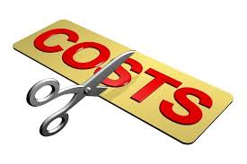
UNIT 5: MANAGEMENT ACCOUNTING
Unit Code: H/508/0489

Slide 2
UNIT 5: MANAGEMENT ACCOUNTING
LO2 Apply a range of management accounting technique.

Slide 3
UNIT 5: MANAGEMENT ACCOUNTING
P3:Calculate costs using appropriate techniques of cost analysis to prepare an income statement using marginal and absorption costs.

Slide 4
WHAT IS MEANT BY COST ?
Cost can be defined as common usage, the monetary value of goods and services that producers and consumers purchase.

Slide 5
DIFFERENT COSTS AND COSTS ANALYSIS.
Fixed Costs (FC). The costs which don’t vary with changing output. Fixed costs might include the cost of building a factory, insurance and legal bills. Even if your output changes or you don’t produce anything, your fixed costs stay the same. In the above example, fixed costs are always £1,000.
Variable Costs (VC). Costs which depend on the output produced. For example, if you produce more cars, you have to use more raw materials such as metal. This is a variable cost.

Slide 6
DIFFERENT COSTS AND COSTS ANALYSIS
Semi-Variable Cost. Labour might be a semi-variable cost. If you produce more cars, you need to employ more workers; this is a variable cost. However, even if you didn’t produce any cars, you may still need some workers to look after empty factory.
Total Costs (TC) – Fixed + Variable Costs
Marginal Costs – Marginal cost is the cost of producing an extra unit. If the total cost of 3 units is 1550, and the total cost of 4 units is 1900. The marginal cost of the 4th unit is 350.

Slide 7
DIFFERENT COSTS AND COSTS ANALYSIS
Opportunity Cost – Opportunity cost is the next best alternative foregone. If you invest £1million in developing a cure for pancreatic cancer, the opportunity cost is that you can’t use that money to invest in developing a cure for skin cancer.

Slide 8
DIFFERENT COSTS AND COSTS ANALYSIS
Economic Cost. Economic cost includes both the actual direct costs (accounting costs) plus the opportunity cost. For example, if you take time off work to a training scheme. You may lose a weeks pay of £350, plus also have to pay the direct cost of £200. Thus the total economic cost = £550.

Slide 9
DIFFERENT COSTS AND COSTS ANALYSIS
Accounting Costs – this is the monetary outlay for producing a certain good. Accounting costs will include your variable and fixed costs you have to pay.

Slide 10
DIFFERENT COSTS AND COSTS ANALYSIS
Sunk Costs: These are costs that have been incurred and cannot be recouped. If you left the industry, you could not reclaim sunk costs. For example, if you spend money on advertising to enter an industry, you can never claim these costs back. If you buy a machine, you might be able to sell if you leave the industry.

Slide 11
DIFFERENT COSTS AND COSTS ANALYSIS
Avoidable Costs. Costs that can be avoided. If you stop producing cars, you don’t have to pay for extra raw materials and electricity. Sometimes known as an escapable cost.

Slide 12
COST ANALYSIS
A cost analysis is conducted to perform an opinion on the degree to which the proposed cost, including profit, represents what the performance of the contract ‘should cost’, assuming reasonable economy and efficiency.

Slide 13
COST VOLUME PROFIT
Cost-volume-profit (CVP) analysis is a technique that examines changes in profits in response to changes in sales volumes, costs, and prices.

Slide 14
COST VOLUME PROFIT
Accountants often perform CVP analysis to plan future levels of operating activity and provide information about:
● Which products or services to emphasize
● The volume of sales needed to achieve a targeted level of profit

Slide 15
COST VOLUME PROFIT
CVP analysis begins with the basic profit equation. Profit Total = Total revenue -Total costs.
Separating costs into variable and fixed categories, we express profit as:
Profit =Total revenue Total variable costs Total fixed costs

Slide 16
FLEXIBLE BUDGETING
A flexible budget is a budget that adjusts or flexes with changes in volume or activity. The flexible budget is more sophisticated and useful than a static budget. (The static budget amounts do not change. They remain unchanged from the amounts established at the time that the static budget was prepared and approved.)

Slide 17
FLEXIBLE BUDGETING
For costs that vary with volume or activity, the flexible budget will flex because the budget will include a variable rate per unit of activity instead of one fixed total amount. In short, the flexible budget is a more useful tool when measuring a manager's efficiency.

Slide 18
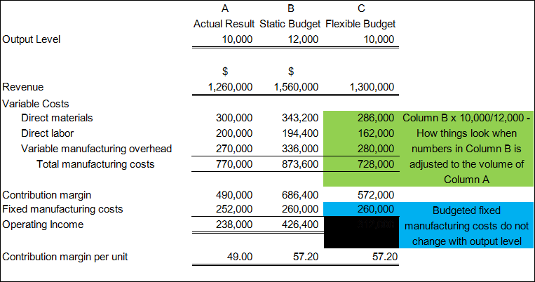
FLEXIBLE BUDGET

Slide 19
COST VARIANCES
A cost variance is the difference between the cost actually incurred and the budgeted or planned amount of cost that should have been incurred. Cost variances are most commonly tracked for expense line items, but can also be tracked at the job or project level, as long as there is a budget or standard against which it can be calculated. These variances form a standard part of many management reporting systems.

Slide 20
COST VARIANCES
Some cost variances are formalized into standard calculations. The following are examples of variances related to specific types of costs:
Direct material price variance
Fixed overhead spending variance
Labour rate variance
Purchase price variance
Variable overhead spending variance

Slide 21
COST VARIANCES
There is an unfavourable cost variance when the actual cost incurred is greater than the budgeted amount. There is a favourable cost variance when the actual cost incurred is lower than the budgeted amount. Whether a variance ends up being positive or negative is partially due to the care with which the original budget was assembled.

Slide 22
COST VARIANCES
If there is no reasonable foundation for a budgeted cost, then the resulting variance may be irrelevant from a management perspective.
Cost variances are usually tracked, investigated, and reported on by a cost accountant.

Slide 23
COST VARIANCES
This person determines the reason why a variance occurred and reports the results to management, possibly along with a recommendation for changing operations to reduce the size of the variance (if unfavourable) in the future.

Slide 24
ABSORPTION COSTING
Absorption costing is a costing system that is used in valuing inventory. It not only includes the cost of materials and labor, but also both variable and fixed manufacturing overhead costs. Absorption costing is also referred to as full costing. This guide will show you what’s included, how to calculate it, and the advantages or disadvantages of using this accounting method.

Slide 25
ABSORPTION COSTING
Components of Absorption Costing
Under the absorption method of costing (aka full costing), the following costs go into the product:
Direct material (DM)
Direct labor (DL)
Variable manufacturing overhead (VMOH)
Fixed manufacturing overhead (FMOH)

Slide 26
ABSORPTION COSTING
Under absorption costing, the costs below are considered period costs, do not go into the cost of a product, and are expensed in the period occurred:
Variable selling and administrative
Fixed selling and administrative

Slide 27
ABSORPTION COSTING
Under absorption costing, the costs below are considered period costs, do not go into the cost of a product, and are expensed in the period occurred:
Variable selling and administrative
Fixed selling and administrative

Slide 28
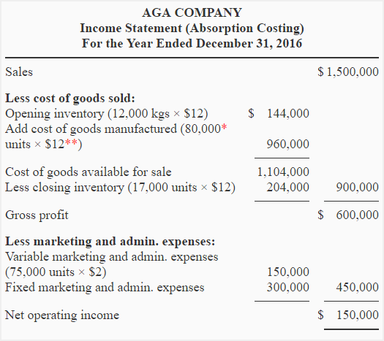
ABSORPTION COSTING

Slide 29
MARGINAL COSTING
Marginal costing is an alternative method of costing to absorption costing. In marginal costing, only variable costs are charged as a cost of sale and a contribution is calculated (sales revenue minus variable cost of sales). Closing inventories of work in progress or finished goods are valued at marginal (variable) production cost.

Slide 30
MARGINAL COSTING
Fixed costs are treated as a period cost, and are charged in full to the profit and loss account of the accounting period in which they are incurred.
The marginal production cost per unit of an item usually consists of the following.
Direct materials
Variable production overheads
Direct labour

Slide 31
MARGINAL COSTING
Direct labour costs might be excluded from marginal costs when the workforce is a given number of employees on a fixed wage or salary. Even so, it is not uncommon for direct labour to be treated as a variable cost, even when employees are paid a basic wage for a fixed working week. If in doubt, you should treat direct labour as a variable cost unless given clear indications to the contrary.

Slide 32
MARGINAL COSTING
Direct labour is often a step cost, with sufficiently short steps to make labour costs act in a variable fashion.
The marginal cost of sales usually consists of the marginal cost of production adjusted for inventory movements plus the variable selling costs, which would include items such as sales commission and possibly some variable distribution costs.

Slide 33
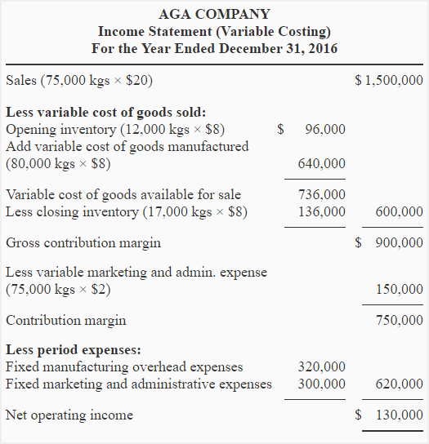
MARGINAL OR VARIABLE COSTING STATEMENT

Slide 34
REVIEW QUESTIONS
PGA company manufactures and sells a product for $50 per Kg. The data for the year 2018 is given below:
Sales in kgs: 80,000 kgs
Finished goods inventory at the beginning of the period: 10,000 kgs
Finished goods inventory at the closing of the period: 20,000 kgs
Manufacturing costs:
Variable cost: $10 per Kg
Fixed manufacturing overhead cost: $360,000 per year

Slide 35
REVIEW QUESTIONS
Marketing and administrative expenses:
Variable expenses: $5 per Kg of sale
Fixed expenses: $800,000 per year
Required:
Income statement using absorption and variable costing methods.
Explanation of the cause of difference in net operating income under two concepts.

Slide 36
REFERENCES
Encyclopedia Britannica. (2019). Cost | economics. [online] Available at: https://www.britannica.com/topic/cost [Accessed 1 Feb. 2019].
Economicshelp.org. (2019). [online] Available at: https://www.economicshelp.org/blog/4890/economics/types-of-costs/ [Accessed 1 Feb. 2019].
Federal Transit Administration. (2019). Cost/Price Analysis. [online] Available at: https://www.transit.dot.gov/funding/procurement/third-party-procurement/costprice-analysis [Accessed 1 Feb. 2019].
Wiley.com. (2019). [online] Available at: https://www.wiley.com/college/sc/eldenburg/ch03.pdf [Accessed 1 Feb. 2019].
AccountingCoach.com. (2019). What is a flexible budget? | AccountingCoach. [online] Available at: https://www.accountingcoach.com/blog/flexible-budget [Accessed 1 Feb. 2019].

Slide 37
REFERENCES
Notestoaccounts.com. (2019). [online] Available at: http://notestoaccounts.com/wp-content/uploads/2015/08/flexible_budget.png [Accessed 1 Feb. 2019].
Bragg, S. and Bragg, S. (2019). Cost variance. [online] AccountingTools. Available at: https://www.accountingtools.com/articles/what-is-a-cost-variance.html [Accessed 1 Feb. 2019].
Corporate Finance Institute. (2019). Absorption Costing - How to Use the Full Costing Method, Guide. [online] Available at: https://corporatefinanceinstitute.com/resources/knowledge/accounting/absorption-costing-guide/ [Accessed 1 Feb. 2019].
Media, B. (2009). ACCA Paper F2 - Management Accounting Study Text, 2009. London: BPP Learning Media.
Accounting for Management. (2019). Exercise-5 (Variable and absorption costing income statement, reconciliation) - Accounting for Management. [online] Available at: https://www.accountingformanagement.org/exercise-5-va [Accessed 6 Feb. 2019].

