Slide 1
UNIT 5: MANAGEMENT ACCOUNTING
Unit Code: H/508/0489

Slide 2
UNIT 5: MANAGEMENT ACCOUNTING
LO2 Apply a range of management accounting technique.

Slide 3
UNIT 5: MANAGEMENT ACCOUNTING
M2: Accurately apply a range of management accounting techniques and provide appropriate financial reporting documents.

Slide 4
FIXED COST
Fixed cost is a cost which is incurred for an accounting period that, within certain output or turnover limits, tends to be unaffected by fluctuations in the levels of activity (output or turnover).
Another term which can be used to refer to a fixed cost is ‘period cost’.
This highlights the fact that a fixed cost is incurred according to the time
elapsed, rather than according to the level of activity.
Examples of fixed costs are rent, rates, insurance and executive
Salaries

Slide 5
VARIABLE COST
Variable cost is a cost that varies with a measure of activity.
Examples of variable costs are direct material, direct labour and variable overheads. In most examination situations, and very often in
practice, variable costs are assumed to be linear.

Slide 6
COST ALLOCATION
Linking costs with cost objectives is accomplished by selecting cost drivers. When used for allocating costs, a cost driver is often called a cost-allocation base.

Slide 7
COST ALLOCATION
Major costs, such as newsprint for a newspaper and direct professional labour for a law firm, may each be allocated to departments, jobs, and projects on an item-by-item basis, using obvious cost drivers such as tonnes of newsprint consumed or direct-labour-hours used.

Slide 8
COST ALLOCATION
Other costs, taken one at a time, are not important enough to justify being allocated individually. These costs are pooled and then allocated together. Many different terms are used by companies to describe cost allocation in practice.

Slide 9
COST ALLOCATION
Terms such as allocate, attribute, reallocate, trace, assign, distribute, redistribute, load, burden, apportion, and reapportion, which can be used interchangeably to describe the allocation of costs to cost objectives.

Slide 10
COST ALLOCATION
Costs are allocated for three main purposes:
1. To obtain desired motivation. Cost allocations are sometimes made to influence management behaviour and thus promote goal congruence and managerial effort.

Slide 11
COST ALLOCATION
Consequently, in some organizations there is no cost allocation for legal or internal auditing services or internal management consulting services because top management wants to encourage their use.

Slide 12
COST ALLOCATION
In other organizations there is a cost allocation for such items to spur managers to make sure the benefits of the specified services exceed the costs.

Slide 13
COST ALLOCATION
2. To compute income and asset valuations.
Costs are allocated to products and
projects to measure inventory costs and cost of goods sold.

Slide 14
COST ALLOCATION
These allocations frequently service financial accounting purposes. However, the resulting costs are also often used by managers in planning, performance evaluation, and to motivate managers.

Slide 15
COST ALLOCATION
3. To justify costs or obtain reimbursement. Sometimes prices are based directly on costs, or it may be necessary to justify an accepted bid.
For example, government contracts often specify a price that includes reimbursement for costs plus some profit margin.

Slide 16
COST ALLOCATION
In these instances, cost allocations become substitutes for the usual working of the marketplace in setting prices.

Slide 17
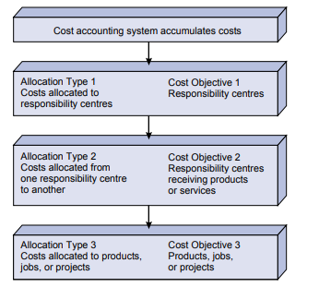
COST ALLOCATION
Three Types of Cost
Allocations

Slide 18
NORMAL COSTING
Normal costing is used to value manufactured products with the actual materials costs, the actual direct labour costs, and manufacturing overhead based on a predetermined manufacturing overhead rate.

Slide 19
NORMAL COSTING
These three costs are referred to as product costs and are used for the cost of goods sold and for inventory valuation.

Slide 20
NORMAL COSTING
If there is a difference between:
the overhead costs assigned or applied to products, and
the overhead costs actually incurred, the difference is referred to as a variance.

Slide 21
NORMAL COSTING
If the amount of the variance is not significant, it will usually be assigned to the cost of goods sold. If the variance is significant, it should be prorated to the cost of goods sold and to the work in process and finished goods inventories.

Slide 22
STANDARD COSTING
Standard costing values its manufactured products with a predetermined materials cost, a predetermined direct labour cost, and a predetermined manufacturing overhead cost. These standard costs will be used for valuing the manufacturer's cost of goods sold and inventories.

Slide 23
STANDARD COSTING
If the actual costs vary only slightly from the standard costs, the resulting variances will be assigned to the cost of goods sold. If the variances are significant, they should be prorated to the cost of goods sold and to the inventories.

Slide 24
ACTIVITY BASED COSTING AND THE ROLE OF COSTING IN SETTING PRICE
Activity-based costing as an approach to the costing and monitoring of activities, which involves tracing resource consumption and costing final outputs. Resources are assigned to activities and activities to cost objects. The latter use cost drivers to attach activity costs to outputs.

Slide 25
ACTIVITY BASED COSTING AND THE ROLE OF COSTING IN SETTING PRICE
ABC focuses attention on cost drivers, the activities that cause costs to increase. Traditional absorption costing tends to focus on volume-related drivers, such as labour hours, while activity-based costing also uses transaction-based drivers, such as number of orders received.

Slide 26
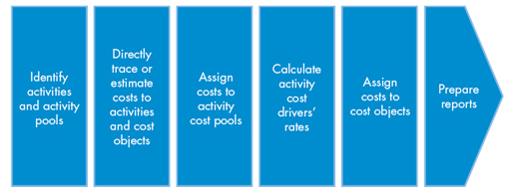
ACTIVITY BASED COSTING AND THE ROLE OF COSTING IN SETTING PRICE
The activity-based costing process

Slide 27
ACTIVITY BASED COSTING AND THE ROLE OF COSTING IN SETTING PRICE
Activity-based costing enhances the costing process in three ways. First, it expands the number of cost pools that can be used to assemble overhead costs. Instead of accumulating all costs in one company-wide pool, it pools costs by activity.

Slide 28
ACTIVITY BASED COSTING AND THE ROLE OF COSTING IN SETTING PRICE
It also creates new bases for assigning overhead costs to items such that costs are allocated based on the activities that generate costs instead of on volume measures, such as machine hours or direct labour costs.

Slide 29
ACTIVITY BASED COSTING AND THE ROLE OF COSTING IN SETTING PRICE
Finally, ABC alters the nature of several indirect costs, making costs previously considered indirect- such as depreciation, inspection, or power- traceable to certain activities.

Slide 30
ACTIVITY BASED COSTING AND THE ROLE OF COSTING IN SETTING PRICE
Alternatively, ABC transfers overhead costs from high-volume products to low-volume products, raising the unit cost of low-volume products.

Slide 31
REVIEW QUESTIONS
The following are costs that were incurred by a shoe company Determine which costs are fixed (F) and which are variable (V).
1. rubber for the sole of the shoe, $6 per shoe
2. rent on the manufacturing facility building, $188,000 annually
3. sales manager salary, $127,000 annually
4. worker who operates the machine that puts the shoe together, $2 per shoe

Slide 32
REVIEW QUESTIONS
5. shoe laces, $1.80 per shoe
6. worker who puts the shoes in the shoe box, $0.20 per shoe
7. insurance on the manufacturing facility, $23,000 annually

Slide 33
REVIEW QUESTIONS
8. water and utilities, $22,000 per month consistently
9. depreciation on manufacturing equipment, $18,000 each month
10. already contracted advertising on television, $1,800,000 annually
11. sales commission paid to salespeople based on 5% of sales

Slide 34
REVIEW QUESTIONS
12. office supplies, usually approximately $3,000 per month
13. paper for the copier in the executive offices, usually about $1,200 per month
14. glue used in the shoe, approximately $0.18 per shoe
15. company jet lease, $14,000 per month

Slide 35
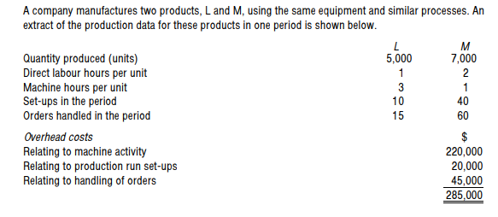
REVIEW QUESTIONS

Slide 36
REVIEW QUESTIONS

Slide 37
REFERENCES
P1 management accounting. (2014). Wokingham (Berkshire): Kaplan Publishing.
Pearsoned.ca. (2019). [online] Available at: http://www.pearsoned.ca/highered/divisions/virtual_tours/horngren/man_acc/Ch05ManAcc.pdf [Accessed 13 Feb. 2019].
AccountingCoach.com. (2019). What is the difference between normal costing and standard costing? | AccountingCoach. [online] Available at: https://www.accountingcoach.com/blog/normal-costing-standard-costing [Accessed 13 Feb. 2019].
CGMA. (2019). Activity-based costing (ABC). [online] Available at: https://www.cgma.org/resources/tools/essential-tools/activity-based-costing.html [Accessed 13 Feb. 2019].

Slide 38
REFERENCES
Investopedia. (2019). Activity-Based Costing (ABC). [online] Available at: https://www.investopedia.com/terms/a/abc.asp [Accessed 13 Feb. 2019].
Learnmanagerialaccounting.com. (2019). Easy Practice Test Answers. [online] Available at: http://www.learnmanagerialaccounting.com/FreeMaterial/costbehavior/easyanswers.html [Accessed 13 Feb. 2019].
Media, B. (2010). ACCA Paper F5 - Performance Mgt Study Text. London: BPP Learning Media.

