Slide 1
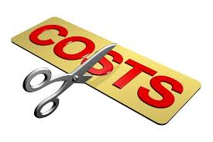
UNIT 5: MANAGEMENT ACCOUNTING
Unit Code: H/508/0489

Slide 2
UNIT 5: MANAGEMENT ACCOUNTING
LO 3 Explain the use of planning tools used in management accounting.

Slide 3
UNIT 5: MANAGEMENT ACCOUNTING
P4:Explain the advantages and disadvantages of different types of planning tools used for budgetary control.

Slide 4
PREPARING A BUDGET
A budget is part of the financial plan created during the initial planning stage for the business and is included in the business plan.
But what if you’re considering a spinoff of your current business, exploring the idea of launching a new venture, or are in the process of revamping your finances? In any of these cases, a budget is required by the business.

Slide 5
PREPARING A BUDGET
A business budget is much like any kind of budget you would use for your personal finances. In business, it can be an effective tool to help you determine whether or not your business idea is viable.
It also gives you an opportunity to evaluate your current financial situation and tailor your plan in a way that will help you reach the financial goals of your business.

Slide 6
PREPARING A BUDGET
Additionally, maintaining a budget for your business on a regular basis can help you track expenses, analyze your income, and anticipate future financial needs.
Cost can be defined as common usage, the monetary value of goods and services that producers and consumers purchase.

Slide 7
PREPARING A BUDGET
The following are the basic steps to follow when preparing a budget:
Update budget assumptions. Review the assumptions about the company's business environment that were used as the basis for the last budget, and update as necessary.
Review bottlenecks. Determine the capacity level of the primary bottleneck that is constraining the company from generating further sales, and define how this will impact any additional company revenue growth.

Slide 8
PREPARING A BUDGET
3.Available funding. Determine the most likely amount of funding that will be available during the budget period, which may limit growth plans.
4.Step costing points. Determine whether any step costs will be incurred during the likely range of business activity in the upcoming budget period, and define the amount of these costs and at what activity levels they will be incurred.
5.Create budget package. Copy forward the basic budgeting instructions from the instruction packet used in the preceding year. Update it by including the year-to-date actual expenses incurred in the current year, and also annualize this information for the full current year. Add a commentary to the packet, stating step costing information, bottlenecks, and expected funding limitations for the upcoming budget year.

Slide 9
PREPARING A BUDGET
5.Issue budget package. Issue the budget package personally, where possible, and answer any questions from recipients. Also state the due date for the first draft of the budget package.
6.Obtain revenue forecast. Obtain the revenue forecast from the sales manager, validate it with the CEO, and then distribute it to the other department managers. They use the revenue information as the basis for developing their own budgets.
7.Obtain department budgets. Obtain the budgets from all departments, check for errors, and compare to the bottleneck, funding, and step costing constraints. Adjust the budgets as necessary.

Slide 10
PREPARING A BUDGET
8.Obtain capital budget requests. Validate all capital budget requests and forward them to the senior management team with comments and recommendations.
9.Update the budget model. Input all budget information into the master budget model.
10.Review the budget. Meet with the senior management team to review the budget.
Highlight possible constraint issues, and any limitations caused by funding problems. Note all comments made by the management team, and forward this information back to the budget originators, with requests to modify their budgets.

Slide 11
PREPARING A BUDGET
11.Process budget iterations. Track outstanding budget change requests, and update the budget model with new iterations as they arrive.
12.Issue the budget. Create a bound version of the budget and distribute it to all authorized recipients.
13.Load the budget. Load the budget information into the financial software, so that you can generate budget versus actual reports.

Slide 12
DIFFERENT TYPES OF BUDGETS .
Managerial accounting approaches a company's financial situation in an operational way, giving information in a manner that supports managers in planning and control procedures. Various budget formats in managerial accounting influence how a manager forecasts department activity and how he addresses progress or shortfall to meet goals. Companies may use several types of managerial budgets concurrently.

Slide 13
DIFFERENT TYPES OF BUDGETS .
Capital expenditure budget is the budget for expected investments in capital assets and long-term projects. It is usually prepared for 3 to 10 years. Investments in capital assets include purchasing fixed assets such as plant, land, buildings, machinery, equipment, and mineral resources.

Slide 14
DIFFERENT TYPES OF BUDGETS .
Long-term projects might be undertaken to develop new products, expand existing product lines, or reduce costs. Sometimes a capital project committee is created to overlook capital budgeting processes. Such a committee is typically separate from the budgeting committee.

Slide 15
DIFFERENT TYPES OF BUDGETS .
Master budget is the set of financial and operating budgets for a specific accounting period, usually the next fiscal or calendar year. Master budget is prepared quarterly or annually. The format of the master budget varies with business nature and size. Operating budgets are used in daily operations and are the basis for financial budgets.

Slide 16
DIFFERENT TYPES OF BUDGETS .
Operating budgets include the following: sales, production, direct materials, direct labor, overhead, selling and administrative expenses, cost of goods manufactured, and cost of goods sold. Financial budgets include a budgeted income statement and balance sheet, cash budget, and capital expenditures budget. Budgeted income statement and budgeted balance sheet are also called pro forma financial statements.

Slide 17
DIFFERENT TYPES OF BUDGETS .
Cash Flow Budget is a means of projecting how and when cash comes in and flows out of a business within a specified time period. It can be useful in helping a company determine whether it's managing its cash wisely. Cash flow budgets consider factors such as accounts payable and accounts receivable to assess whether a company has ample cash on hand to continue operating, the extent to which it is using its cash productively, and its likelihood of generating cash in the near future. A construction company, for example, might use its cash flow budget to determine whether it can start a new building project before getting paid for the work it has in progress.

Slide 18
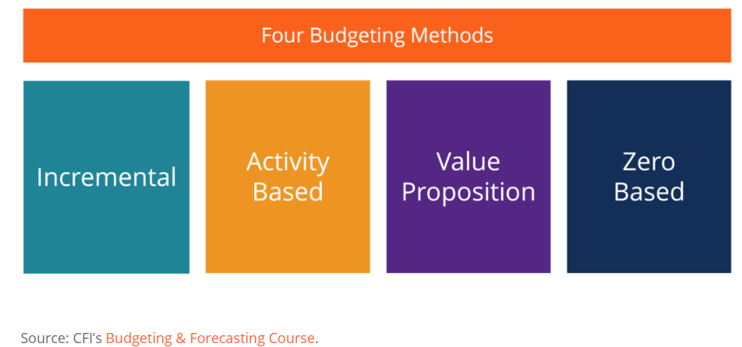
ALTERNATIVE METHODS OF BUDGETING

Slide 19
ALTERNATIVE METHODS OF BUDGETING
Incremental budgeting takes last year’s actual figures and adds or subtracts a percentage to obtain the current year’s budget. It is the most common method of budgeting because it is simple and easy to understand. Incremental budgeting is appropriate to use if the primary cost drivers do not change from year to year.

Slide 20
ALTERNATIVE METHODS OF BUDGETING
Activity-based budgeting is a top-down budgeting approach that determines the amount of inputs required to support the targets or outputs set by the company. For example, a company sets an output target of $100 million in revenues. The company will need to first determine the activities that need to be undertaken to meet the sales target, and then find out the costs of carrying out these activities.

Slide 21
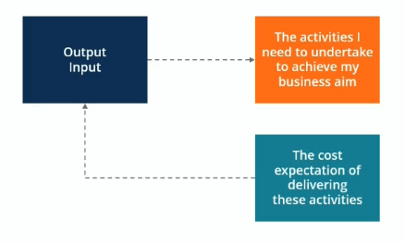
ALTERNATIVE METHODS OF BUDGETING

Slide 22
ALTERNATIVE METHODS OF BUDGETING
In value proposition budgeting, the budgeter considers the following questions:
Why is this amount included in the budget?
Does the item create value for customers, staff, or other stakeholders?
Does the value of the item outweigh its cost? If not, then is there another reason why the cost is justified?
Value proposition budgeting is really a mindset about making sure that everything that is included in the budget delivers value for the business. Value proposition budgeting aims to avoid unnecessary expenditures – although it is not as precisely aimed at that goal as our final budgeting option, zero-based budgeting.

Slide 23
ALTERNATIVE METHODS OF BUDGETING
As one of the most commonly used budgeting methods, zero-based budgeting starts with the assumption that all department budgets are zero and must be rebuilt from scratch. Managers must be able to justify every single expense. No expenditures are automatically okayed. Zero-based budgeting is very tight, aiming to avoid any and all expenditures that are not considered absolutely essential to the company’s successful (profitable) operation. This kind of bottom-up budgeting can be a highly effective way to shake things up.

Slide 24
ALTERNATIVE METHODS OF BUDGETING
The zero-based approach is good to use when there is an urgent need for cost containment, for example, in a situation where a company is going through a financial restructuring or a major economic or market downturn that requires it to reduce the budget dramatically.
Zero-based budgeting is best suited for addressing discretionary costs rather than essential operating costs. However, it can be an extremely time-consuming approach, so many companies only use this approach occasionally.

Slide 25
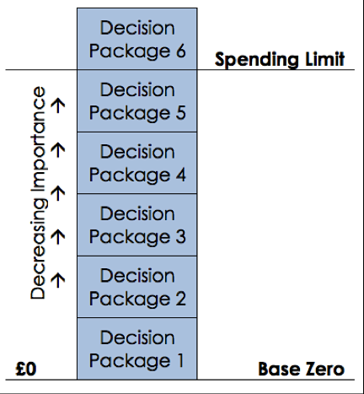
ALTERNATIVE METHODS OF BUDGETING

Slide 26
BEHAVIOURAL IMPLICATIONS OF BUDGETS
Budgets can bring positive behaviour among the people when the goals of individual managers are found in conformity with the goals of the organisation. The perfect matching (or near perfect matching) between the organisational and managerial goals is often referred to as goal congruence. The managers who participate in the budget making process may feel happy in producing a fair budget in terms of organisational goals and objectives.

Slide 27
BEHAVIOURAL IMPLICATIONS OF BUDGETS
Such a budget may induce and motivate others to bring excellence in their performance. But sometimes, due to improper implementation of the budget and unrealistic management expectations, the reaction of subordinate managers are found to be negative, which in turn has adverse impact on achieving the organisational goals.
Such a negative behaviour is known as dysfunctional behaviour which is de­fined as an individual behaviour that is in basic conflict with the goals of the organisation.

Slide 28
BEHAVIOURAL IMPLICATIONS OF BUDGETS
Budgeting processes are either top down or bottom up. In a top-down budgeting process, top management prepares budgets for the entire organisation, includ­ing those for lower-level operations. This process often is referred to as authoritative budgeting. A participative budgeting process, on the other hand, is a bottom-up approach that involves the people affected by the budget, including lower-level employees, in the budget preparation process.

Slide 29
BEHAVIOURAL IMPLICATIONS OF BUDGETS
Budgets are used in to direct control and coor­dinate all activities in the organisation. In this task, budgets should not generate excessive pressure and stress on the subordinate managers, supervisors and the people working in the organisation.

Slide 30
BEHAVIOURAL IMPLICATIONS OF BUDGETS
In order to eliminate undesirable pressure, the budget goals and standards should be set which are neither too high (tight) nor too low (loose). If the standards and the budgeted goals are too high, motivation becomes poor and failing to achieve them may frustrate the managers and in turn, this frustration can result into poorer performance.

Slide 31
BEHAVIOURAL IMPLICATIONS OF BUDGETS
Budgetary slack, also known as padding the budget, takes place when a manager deliberately underestimates revenues, overestimates costs and requests more funds than needed to support the budgeted level of activities. The difference between the revenue or cost projections that a person provides and a realistic estimate of the revenue or cost is called budgetary slack.

Slide 32
BEHAVIOURAL IMPLICATIONS OF BUDGETS
The attainment of budget goals and standards at the lower and middle level management depends to a large extent on the support, participation and cooperation extended by top management in the preparation and execution of budgets. Top managers by their actions should create an environment and give impression to the subordinate managers about their commitment and support to the budget goals and objectives. Otherwise, the planning and control function will be damaged in case subordinate managers think that their top managers are not sincere while preparing and using the budgets.

Slide 33
BEHAVIOURAL IMPLICATIONS OF BUDGETS
The budgeting process is rightly considered a technical and formal one. However, in reality, the budgeting process becomes most often an informal bargaining process or wherein managers of different departments compete for organisation scarce resources. According to Hopwood this can lead to a dilution of original goals, as managers try (and fight) for power and recognition. Departmental conflict or conflict between the managers are also due to the fact that different departments are found blaming each other when they fail to achieve their targets.

Slide 34
PRICING STRATEGIES
Pricing strategy refers to method companies use to price their products or services. Almost all companies, large or small, base the price of their products and services on production, labour and advertising expenses and then add on a certain percentage so they can make a profit. There are several different pricing strategies, such as penetration pricing, price skimming, discount pricing, product life cycle pricing and even competitive pricing.

Slide 35
PRICING STRATEGIES
The ultimate goal of the company is to maximize profit being in competition and sustaining the competitive market. However to maximize profits along with retaining your consumer you have to make sure you choose the right pricing strategy. The correct strategy will help you attain your objectives as an organization.

Slide 36
HOW DO COMPETITORS DETERMINE THEIR PRICES?
When a product is priced in accordance with what the competition is charging, it’s known as competitive pricing. It is one of the four major pricing strategies adopted by most companies. The other three include, cost-plus strategy, where a prefixed profit margin is added over the total cost of the product, demand pricing, under which the price is set by establishing the optimal relationship between volume and price, and markup pricing, where a percentage is added (as profit) over the wholesale price of the product.

Slide 37
HOW DO COMPETITORS DETERMINE THEIR PRICES?
When it comes to competition based pricing strategy, the purchasing behaviour of customers is an important criteria. Some of the factors that companies take into account are costs, competition, and price sensitivity. In order to ensure profitable sustenance of the business, managers have to set the price such that it covers the production cost, company overheads costs, and also offers suitable profits.

Slide 38
HOW DO COMPETITORS DETERMINE THEIR PRICES?
In order to establish the right competitive price for your product, the company need to take into account the product life cycle and the stage your product is in. Competition is one factor that cannot be ignored if the product is in the developmental stage. However, if it’s a part of the market, and fighting with a relatively high number of substitutes and competitors, then considering the actions of the competitors might be one factor driving your profit. There are three choices price one would be a lower, higher, or same as the competitor. The most common tactic is to set the price according to the competitors, also known as competitive pricing strategy.

Slide 39
SUPPLY AND DEMAND CONSIDERATIONS
The law of supply and demand is an economic theory that explains how supply and demand are related to each other and how that relationship affects the price of goods and services. It's a fundamental economic principle that when supply exceeds demand for a good or service, prices fall. When demand exceeds supply, prices tend to rise.

Slide 40
SUPPLY AND DEMAND CONSIDERATIONS
There is an inverse relationship between the supply and prices of goods and services when demand is unchanged. If there is an increase in supply for goods and services while demand remains the same, prices tend to fall to a lower equilibrium price and a higher equilibrium quantity of goods and services. If there is a decrease in supply of goods and services while demand remains the same, prices tend to rise to a higher equilibrium price and a lower quantity of goods and services.

Slide 41
SUPPLY AND DEMAND CONSIDERATIONS
If there is a decrease in supply of goods and services while demand remains the same, prices tend to rise to a higher equilibrium price and a lower quantity of goods and services.
The same inverse relationship holds for the demand of goods and services. However, when demand increases and supply remains the same, the higher demand leads to a higher equilibrium price and vice versa.

Slide 42
REFERENCES
July 17, 2. (2019). Four Steps to Developing a Business Budget — SitePoint. [online] SitePoint. Available at: https://www.sitepoint.com/develop-a-business-budget/ [Accessed 8 Mar. 2019].
Bragg, S. and Bragg, S. (2019). The steps in preparing a budget. [online] AccountingTools. Available at: https://www.accountingtools.com/articles/what-are-the-steps-in-preparing-a-budget.html [Accessed 8 Mar. 2019].
Smallbusiness.chron.com. (2019). Five Types of Budgets in Managerial Accounting. [online] Available at: https://smallbusiness.chron.com/five-types-budgets-managerial-accounting-50928.html [Accessed 8 Mar. 2019].
Simplestudies.com. (2019). What are the budget types in accounting? - Accounting Questions & Answers (Q&A) | Simplestudies.com. [online] Available at: http://simplestudies.com/what-are-budget-types-in-accounting.html [Accessed 8 Mar. 2019].

Slide 43
REFERENCES
Staff, M. (2019). 5 Types of Budgets for Businesses -- The Motley Fool. [online] The Motley Fool. Available at: https://www.fool.com/knowledge-center/5-types-of-budgets-for-businesses.aspx [Accessed 8 Mar. 2019].
Corporate Finance Institute. (2019). Types of Budgets - The Four Most Common Budgeting Methods. [online] Available at: https://corporatefinanceinstitute.com/resources/knowledge/accounting/types-of-budgets-budgeting-methods/ [Accessed 8 Mar. 2019].
Andrewscouller.files.wordpress.com. (2019). [online] Available at: https://andrewscouller.files.wordpress.com/2015/11/zero-based-budgeting.png [Accessed 8 Mar. 2019].

Slide 44
REFERENCES
Your Article Library. (2019). Behavioural Implications of Budgeting (6 Implications). [online] Available at: http://www.yourarticlelibrary.com/accounting/budgeting-accounting/behavioural-implications-of-budgeting-6-implications/52800 [Accessed 8 Mar. 2019].
Smallbusiness.chron.com. (2019). Definition of Pricing Strategy. [online] Available at: https://smallbusiness.chron.com/definition-pricing-strategy-4686.html [Accessed 8 Mar. 2019].
Emma, O. (2019). 10 Most Important Pricing Strategies in Marketing (Timeless). [online] EDUCBA. Available at: https://www.educba.com/pricing-strategies-in-marketing/ [Accessed 8 Mar. 2019].

Slide 45
REFERENCES
Blog. (2019). Competitive Pricing Strategy -- See How Products Are Priced. [online] Available at: https://www.intelligencenode.com/blog/competitive-pricing-strategy-see-products-priced/ [Accessed 8 Mar. 2019].
Investopedia. (2019). How Does the Law of Supply and Demand Affect Prices?. [online] Available at: https://www.investopedia.com/ask/answers/033115/how-does-law-supply-and-demand-affect-prices.asp [Accessed 8 Mar. 2019].

