Slide 1

Unit 6 managing aviation services

Slide 2
Learning outcome 3
Assess the different operational requirements of passenger service operations and airside operations

Slide 3
p5
Compare and contrast the different service operations in terminal and airside to meet with regulations and operational standards

Slide 4
Passenger service operations
People often associate air travel with waiting. A comfortable in-flight experience is often paired with hours of standing in line to check in, get through security, and finally board. The experience is tiresome for passengers, airlines, and airport workers.
But the lines do more than annoy passengers and airport staff. Airports receive a substantial part of their revenue from in-terminal stores. Americans, for instance, tend to be “gate huggers” when it comes to boarding. That means they usually blow by stores on their way to their gate and park themselves close to them as they wait to board, because they’re nervous about missing their flight.

Slide 5
Passenger service operations
As passenger numbers have increased, technology has enabled great change. One of those changes, the boarding pass, is a telling story of IT evolution in aviation.
From being a handwritten paper tag, it’s now a key part of ensuring passengers’ safe progress through the airport and onto their final destination.
On January 1st in 1914, the first scheduled commercial flight took off from the Municipal Pier in St. Petersburg, Florida. It carried one paying passenger, former mayor Abe Pheil, who paid $400 at a charity auction for the privilege.
On January 1st in 2014, almost 100,000 commercial flights carried an estimated 8 million passengers to and from over 40,000 airports in the world on this day alone.

Slide 6
Passenger service operations
Checking in for a flight is the process whereby a person announces their arrival at the airport. The check-in process at airports enables passengers to confirm they will be on the respective flight, obtain a boarding pass, possibly select their seat (if hasn’t happened already or allowed by airline), and check in luggage onto a plane, if desired.
A boarding pass is a document provided by an airline during check-in, giving a passenger permission to board the airplane for a particular flight. At a minimum, it identifies the passenger, the flight number, and the date and scheduled time for departure. Boarding Passes are always required to board a flight. Often times airlines accept paper or electronic boarding passes (on phone or tablet).

Slide 7
Passenger service operations
Boarding passes were once issued by hand at the airport check-in desk. Inventory and seat allocation were handled manually, being either handwritten or accomplished using stickers to ensure that once passengers had a seat it wasn’t possible to give it to someone else.
Migration to electronic ticketing was completed in 2008. By 2010, 2D bar-coded boarding passes (BCBP) had replaced the previous generation of more expensive and less efficient magnetic stripe boarding passes. That meant passengers could check-in online and print their boarding pass at home.

Slide 8
Passenger service operations; check-in
Today, there’s a mix of airport printed passes, passenger printed passes and mobile passes.
Airlines face more expense with airport printed boarding passes because they require airport staff and space. However, there will always be passengers who will need personal attention.
Passenger printed paper boarding passes are low tech, simple, proven, reliable and work well with all existing airport processes: marking/stamping a pass, for example, or adding a sticker as a passenger progresses through the airport.

Slide 9
Passenger service operations; check-in
There are three (3) main ways to check in:
In-person at a staffed check-in counter at airport
In-person at airport using a self check-in kiosk
Check-in online before arriving to airport

Slide 10
Passenger service operations; check-in
Checking-in in-person allows you to check in your baggage, if checking luggage, at the same time as checking in for your flight.
Items needed for check-in counter check-in:
Passport (when traveling internationally)
Paper ticket (less and less common),
or a confirmation number—usually sent via email if ticket is purchased online or through a travel agency,
or printed itinerary with a confirmation number

Slide 11
Passenger service operations
At this time passengers can select a seat (if hasn’t happened already or allowed by airline), enter number of bags to be checked (if desired), and print boarding passes. Passengers will then need to submit luggage to staffed counter or checked luggage stations. Airline staff will need to check your passport either at time of check in or at gate.
Items needed for kiosk check-in:
Confirmation number (usually sent via email if ticket is purchased online or through a travel agency),
or the credit card used for payment of the ticket,
and or a passport. Passport required when traveling internationally.

Slide 12
Passenger service operations
Passengers can check in online starting 24 hours (usually) before departure. Passengers will need to submit luggage to staffed counter or checked luggage stations if checking luggage.
Benefits of online check-in:
Avoid potential check-in lines at airport
Print boarding pass at home (can also wait or reprint at self-service kiosk at the airport)
Select seat assignment(s) before others (if applicable)
Choose to get updates of possible changes to departure times leading up to flight.

Slide 13
Passenger service operations; check-in
The reason for higher satisfaction from online check-ins is simple: Passengers want to feel in control of their trips, quickly go through all formalities, and avoid standing in line. Mobile applications and websites provide a great opportunity to avoid lines. Currently, online check-ins are supported by most major airlines. A passenger books a ticket online, checks in through a mobile app or a website several days before the departure, and receives a boarding pass.

Slide 14
Passenger service operations; check-in
The check-in process is one of the most problematic services that the airport provides because initial delays and long waiting times occur if this process is not well fulfilled. Moreover it is the most public or perceptible process by the passenger; it is at the land side and any problem, as an overload check-in hall with long queues, is easily identified by people. In principle, there are two groups of needs.
On the one hand, the passengers, as mentioned before, do not want to spend too long on the check-in process, and on the other hand, the airport manager and the airlines want to provide an excellent level of service, with quality and the minimum cost.

Slide 15
Passenger service operations; check-in
Several studies have been focused on the passengers who are served at various stages in the airport terminals. Specifically, many studies related to check-in processes, passenger flows and measuring the level of service at airport terminals have been performed in the past.
The knowledge of the departure passenger flows is a benchmark for different applications e.g., developing design plans and identifying improvements for an existing terminal, improving the airport design the quality of the service provided, as well as suggesting terminal plans before the actual construction of an airport terminal.

Slide 16
Passenger service operations; incidents and accidents
Technology and system improvements have made great contributions to safety. However, part of being safe is about attitudes and paying attention to what your surroundings are telling you. Whether through data or through the input of employees and others, recognizing that many opportunities exist to stop an accident is the first step in moving from reactive to predictive thinking.

Slide 17
Passenger service operations; incidents and accidents
Safety Management Systems (SMSs) are the product of a continuing evolution in aviation safety. Early aviation pioneers had little safety regulation, practical experience, or engineering knowledge to guide them. Over time, careful regulation of aviation activities, operational experience, and improvements in technology have contributed to significant gains in safety.
In the next major phase of improvement to safety, a focus on individual and crew performance or "Human Factors" further reduced accidents.

Slide 18
Passenger service operations; incidents and accidents
Each approach has led to significant gains in safety. However, even with these significant advances, we still have opportunities to take preventative action against accidents. The question for the aviation community is, "what is the next step?“
Careful analysis typically reveals multiple opportunities for actions that could have broken the chain of events and possibly prevented an accident. These opportunities represent the organization's role in accident prevention. The term "organizational accident" was developed to describe accidents that have causal factors related to organizational decisions and attitudes. SMS is an approach to improving safety at the organizational level.

Slide 19
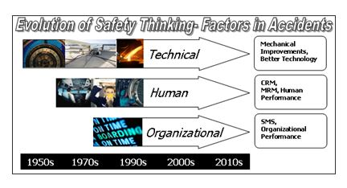
Passenger service operations; incidents and accidents

Slide 20
Passenger service operations; incidents and accidents
SMS requires the organization itself to examine its operations and the decisions around those operations. SMS allows an organization to adapt to change, increasing complexity, and limited resources. SMS will also promote the continuous improvement of safety through specific methods to predict hazards from employee reports and data collection.
Organizations will then use this information to analyze, assess, and control risk. Part of the process will also include the monitoring of controls and of the system itself for effectiveness.

Slide 21
Passenger service operations; incidents and accidents
SMS will help organizations comply with existing regulations while predicting the need for future action by sharing knowledge and information. Finally, SMS includes requirements that will enhance the safety attitudes of an organization by changing the safety culture of leadership, management, and employees.
All of these changes are designed to help the organization incorporate all three forms of rationale—reactive, proactive, and predictive thinking.

Slide 22
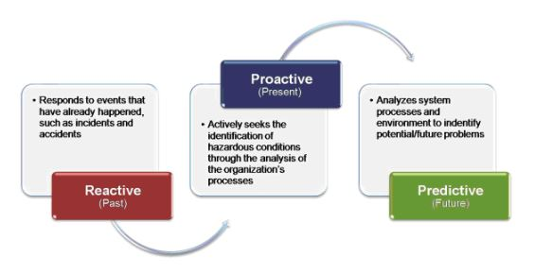
Passenger service operations; incidents and accidents

Slide 23
Passenger service operations; incidents and accidents
SMS has generated wide support in the aviation community as an effective approach that can deliver real safety and financial benefits. SMSs integrate modern safety concepts into repeatable, proactive processes in a single system, emphasizing safety management as a fundamental business process to be considered in the same manner as other aspects of business management.

Slide 24
Passenger service operations; incidents and accidents
The structure of SMS provides organizations greater insight into their operational environment, generating process efficiencies and cost avoidance. Some participants have found that benefits begin to materialize even in the early reactive stages of implementation. This continues as organizations evolve to incorporate all three phases—reactive, proactive, and predictive—into their processes.

Slide 25
Passenger service operations; incidents and accidents
Historically, about two-thirds of all general aviation (GA) accidents that occur in instrument meteorological conditions (IMC) are fatalóa rate much higher than the overall fatality rate for GA accidents

Slide 26
Passenger service operations; incidents and accidents
The total number of general aviation (GA) accidents per year has declined over the past two decades. However, the relative proportion of GA accidents that occur during instrument meteorological conditions (IMC) has remained fairly stable, ranging from 5 to 9 percent of annual GA accident totals.
The National Transportation Safety Board has long been concerned about GA accidents that occur in poor weather or in IMC (referred to in this study as ìweather-related accidentsî), especially because they are far more likely to be fatal than accidents that take place in visual meteorological conditions (VMC).

Slide 27
Passenger service operations; incidents and accidents
Weather-related accidents in general, and VFR-into-IMC accidents in particular, have generated considerable interest from other governmental agencies and the aviation research community. Studies have focused on pilots evaluations and assessments of deteriorating visibility or on their flight-related decisions in the presence of weather.
Additionally, some researchers have suggested that a lack of good weather information during flight contributes to the incidence of weather-related accidents.

Slide 28
Passenger service operations; incidents and accidents
Other researchers have attempted to characterize the types of decision-making errors that lead pilots to make unsafe decisions. One class of decision-making error attributed to pilots in weather accidents is known as a plan continuation error.
A plan continuation error is defined as failure to revise a flight plan despite emerging evidence that suggests it is no longer safe.

Slide 29
example
rather than revising the intended route of flight by changing course or altitude, deviating to an alternate airport, or returning to the departure airport, pilots may opt to press on into deteriorating weather.
Another type of decision-making error can occur when pilots continue visual flight into instrument conditions because they incorrectly assess the risks of the situation.

Slide 30
Passenger service operations; incidents and accidents
An incident is an unplanned event which has the potential to cause harm to persons, property/assets, the environment or unintended disruption to operations. This also includes near misses or nonconformance issues and any incident that has occurred on an aircraft that is returning to, or expected to arrive at an Airport.

Slide 31
Passenger service operations; check-in
An incident can be (but is not limited to) the following:
Risk or threat to people’s safety
Property damage
Near misses
Environmental damage
Injury or illness
Suspicious Behaviour
Crash, spills, releases
Storm/weather damage
Aviation Incidents
Criminal activity (theft etc)
Fire

Slide 32
Passenger service operations; incidents and accidents
For any incident there are 4 key steps to be taken in response:
Report the incident
Intervene if safe to ensure public safety
Control the site
Debrief & recover

Slide 33
Passenger service operations; incidents and accidents
All incidents have the potential to escalate (sometimes very quickly) into a larger event, emergency and/or disruption to services.
Be aware that as a result of most Airport being a location of high activity, a number of responders and agencies will likely attend an incident. Airports, police and emergency services have pre- plans that identify additional resources and specialist support ready to deploy in many scenarios.

Slide 34
example
the evacuation of a building may cause staff and public confusion, misinformation and anxiety, or have an impact on roads which then impacts traffic movements to terminals and ultimately aircraft departures, furthering confusion and wellbeing

Slide 35
Passenger service operations; incidents and accidents
For all incidents there are some basic steps to undertake which will not only assist in the immediate response to an incident, but also in understanding what occurred and how prevent future occurrences.
These steps are:
Ensure the safety of yourself, staff and visitor
Provide first aid and call emergency services and the Airport control Centre (ACC)
Take control of the area (but only if safe to do so)
Debrief and Recover

Slide 36
Passenger service operations; incidents and accidents
Ensure the safety of yourself, staff and visitors
In an incident or emergency, as the first on scene you will need to ensure that there is no further threat to you or fellow workers and visitors. Know there is danger at every scene. Don’t put yourself or others at risk.
If you identify immediate dangers to yourself – STOP and retreat immediately taking others with you. Rely on the emergency services, who are better trained and experienced to control the site.

Slide 37
Passenger service operations; incidents and accidents
If there is no direct threat to you then you should assist those who need help if you can. As an airport worker, you will also be the focus of the public for help and support, particularly if there is nearby operational activity, traffic or crowds. If an armed offender is active on airport, adopt the principal of retreating and withdraw from the area to a safer place taking anyone you can with you.

Slide 38
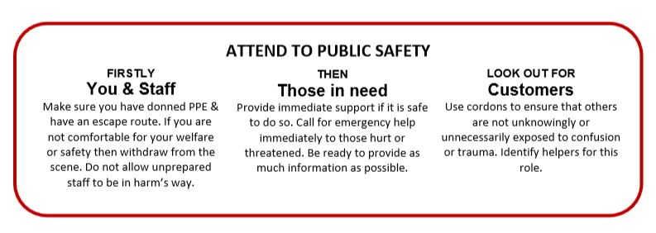
Passenger service operations; incidents and accidents

Slide 39
Passenger service operations; incidents and accidents
Provide first aid and call emergency services and ACC
Has emergency services and ACC been contacted? If not, do so ASAP.
Know that when you call you will be required to provide additional information such as:
The nature of the incident
Your location and nearest cross street
Access to the site • Who is threatened or injured
What structures are involved
Who is on site assisting
If there is any further threat
Confirm your phone number
It is important that if you ring emergency services that you also provide this information to the ACC so emergency services can be guided and staged at locations across the airport as per response plans.

Slide 40
Passenger service operations; incidents and accidents
Take Control
If it is safe to do so, the most practical way to control a site is to ‘cordon’ the site so that people can safely leave and be accounted and to prevent others from entering. Tools and techniques to implement cordons include using other workers to assist, setting up screens, using cones or vehicles or closing access to ensure others are not hurt or unnecessarily involved.
Also use cordons or access control to ensure that visitors and passengers are not unnecessarily exposed to the incident.
Good control will reduce confusion, be welcomed by the emergency services, and will prevent other secondary incidents and events occurring that may cause further harm or impacts to operations.

Slide 41
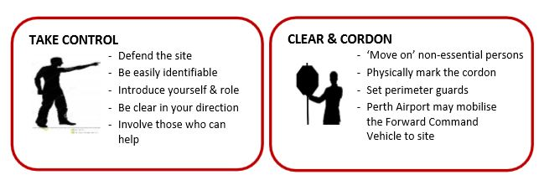
Passenger service operations; incidents and accidents

Slide 42
Passenger service operations; incidents and accidents
Debrief & Recover
Take the time to immediately note your observations and actions. This could be simply by saving your phone or message records, or making brief notes afterwards. Make sure that if there is a formal investigation or review that your notes and own observations contribute to the review.
It is important for improving operations and for your own wellbeing that you have the opportunity to discuss the response and what did and did not work well. This will allow you and your organisation to be better prepared for next time. Arrange or participate in a ‘hot debrief’ at the first opportunity

Slide 43
Passenger service operations; incidents and accidents
Everyone can be affected by an incident and can find themselves challenged in many ways. You should discuss these challenges when you attend a post incident debrief.
Do not hesitate to refer yourself or others to your company’s Employee Assistance Program should your/their wellbeing be further challenged as a result of their experience.

Slide 44
Passenger service operations; incidents and accidents
Incident Investigation
To look to prevent the incident from occurring again, an investigation must be undertaken by the Operator after the incident to address the following matters.
Circumstances of the incident;
The likely cause or causes of the incident;
Actions taken by the operator to mitigate the consequences of the incident;
Actions taken by the operator to prevent the incident or similar incidents from reoccurring; and
Any other information requested by external agencies/investigators

Slide 45
Passenger service operations; incidents and accidents
First Responders
Often airport workers are first on scene at an incident. All Airport frontline employees are trained as ‘First Responders’ to conduct first intervention to ensure that there is no further threat to any staff, worker or visitor to any Airport, or to the safe operations of the airport including airside, landside and terminal operations.
To be able to react as a first responder and intervene you should have basic workplace training.
Ensure that you have consulted your supervisor if you require First Aid, Fire Extinguisher, Warden (terminal operators) or Fuel Spill Response (airside operators) training

Slide 46
Passenger service operations; incidents and accidents
Controlling Agencies
In developing incidents that may pose a threat to public safety or airport operations, initial situation reporting will result in an organisation arriving on scene and taking control.
The agencies that have this responsibility are usually:
Police Services
Fire Services (Airport Rescue Fire Fighting and/or Fire and Emergency Services)
Ambulance Services
Airport
There are procedures and protocols that determine the agency in charge depending on the incident. The officer in charge is often referred to as the Incident Controller and the agency they represent as the Controlling Agenc

Slide 47
Passenger service operations; incidents and accidents
Incident Controller
The person responsible for commanding, coordinating and controlling an incident is referred to as the Incident Controller. The incident controller is normally the most senior member of the controlling agency (i.e. police, fire, ambulance).
In Western Australia, the Emergency Management Legislation gives the Incident Controller all authority to protect life and conduct operations even on airport land, in airport structures and facilities and airside. Their directions must be adhered to.

Slide 48
Passenger service operations; culture and diversity
From our increasingly diverse domestic workforce to the globalization of business, cultural competence is arguably the most important skill for effective work performance in the 21st century.
What is cultural diversity in the workplace? Culture refers to the 7 Essentials of Workplace Cultural Competence: the values, norms, and traditions that affect the way a member of a group typically perceives, thinks, interacts, behaves, and makes judgments. It even affects perceptions of time, which can impact day-to-day scheduling and deadlines.

Slide 49
Passenger service operations; culture and diversity
7 essentials for cultural competence:
Beliefs and Worldview
Communication Styles
Formality
Hierarchy
Perceptions of Time
Values and Priorities
Everyone’s Unique

Slide 50
Passenger service operations; culture and diversity
Cultural competence, in brief, is the ability to interact effectively with people from different cultures. This ability depends on awareness of one’s own cultural worldview, knowledge of other cultural practices and worldviews, tolerant attitudes towards cultural differences, and cross-cultural skills.
The more different cultures work together, the more cultural competency training is essential to avoid problems. Cultural problems can range from miscommunication to actual conflict, all endangering effective worker productivity and performance,

