Slide 1

Unit 6 managing aviation services

Slide 2
Learning outcome 2
Identify the scale and scope of the industry including future trends and challenges

Slide 3
p6
Using current and historic statistics and route networks, identify future trends in passenger numbers, cargo tonnes, finance and route networks

Slide 4
Scale of the aviation Industry; statistics
The International Air Transport Association (IATA) announced industry performance statistics for 2017. Worldwide annual air passenger numbers exceeded four billion for the first time, supported by a broad-based improvement in global economic conditions and lower average airfares. At the same time, airlines connected a record number of cities worldwide, providing regular services to over 20,000 city pairs* in 2017, more than double the level of 1995. Such increases in direct services improve the industry’s efficiency by cutting costs and saving time for both travelers and shippers alike.
“In 2000, the average citizen flew just once every 43 months. In 2017, the figure was once every 22 months. Flying has never been more accessible. And this is liberating people to explore more of our planet for work, leisure and education. Aviation is the business of freedom,” said Alexandre de Juniac, IATA’s Director General and CEO.

Slide 5
Scale of the aviation Industry; statistics
2017 Passenger Highlights
System-wide, airlines carried 4.1 billion passengers on scheduled services, an increase of 7.3% over 2016, representing an additional 280 million trips by air.
Airlines in the Asia-Pacific region once again carried the largest number of passengers. The regional rankings (based on total passengers carried on scheduled services by airlines registered in that region) are:
Asia-Pacific 36.3% market share (1.5 billion passengers, an increase of 10.6% compared to the region’s passengers in 2016)
Europe 26.3% market share (1.1 billion passengers, up 8.2% over 2016)
North America 23% market share (941.8 million, up 3.2% over 2016)
Latin America 7% market share (286.1 million, up 4.1% over 2016)
Middle East 5.3% market share (216.1 million, an increase of 4.6% over 2016)
Africa 2.2% market share (88.5 million, up 6.6% over 2016).

Slide 6
Scale of the aviation Industry; statistics
2017 Passenger Highlights
The top five airlines ranked by total scheduled passenger kilometers flown, were:
American Airlines (324 billion)
Delta Air Lines (316.3 billion)
United Airlines (311 billion)
Emirates Airline (289 billion)
Southwest Airlines (207.7 billion)

Slide 7
Scale of the aviation Industry; statistics
2017 Passenger Highlights
The top five international/regional passenger airport-pairs** were all within the Asia-Pacific region, again this year:
Hong Kong-Taipei Taoyuan (5.4 million, up 1.8% from 2016)
Jakarta Soekarno-Hatta-Singapore (3.3 million, up 0.8% from 2016)
Bangkok Suvarnabhumi-Hong Kong (3.1 million, increase of 3.5% from 2016)
Kuala Lumpur–Singapore (2.8 million, down. 0.3% from 2016)
Hong Kong-Seoul Incheon (2.7 million, down 2.2% from 2016)

Slide 8
Scale of the aviation Industry; statistics
2017 Passenger Highlights
The top five domestic passenger airport-pairs** were also all in the Asia-Pacific region:
Jeju-Seoul Gimpo (13.5 million, up 14.8% over 2016)
Melbourne Tullamarine-Sydney (7.8 million, up 0.4% from 2016)
Fukuoka-Tokyo Haneda (7.6 million, an increase of 6.1% from 2016)
Sapporo-Tokyo Haneda (7.4 million, up 4.6% from 2016)
Beijing Capital-Shanghai Hongqiao (6.4 million, up 1.9% from 2016)

Slide 9
Scale of the aviation Industry; statistics
2017 Passenger Highlights
One of the interesting recent additions to the WATS report is the ranking of passenger traffic by nationality, for international and domestic travel. (Nationality refers to the passenger’s citizenship as opposed to the country of residence.)
United States of America (632 million, representing 18.6% of all passengers)
People’s Republic of China (555 million or 16.3% of all passengers)
India (161.5 million or 4.7% of all passengers)
United Kingdom (147 million or 4.3% of all passengers)
Germany (114.4 million or 3.4% of all passengers)

Slide 10
Scale of the aviation Industry; statistics
Growing rapidly in relatively short period of time, India is poised to be one of the largest aviation markets in the world in the years to come. With an astounding population base of over 1.3 billion inhabitants, the move towards a more liberalized aviation market coupled with stronger economic fundamentals has helped to awaken the Bengal tiger to become one of the fastest growing markets in the world. ACI’s World Airport Traffic Forecasts predicts that the country will represent the third largest aviation market, in terms of passenger throughput, after the US and China by 2020.
Delhi (DEL), the country’s busiest airport for passenger traffic, grew by 14.1% year-over year pushing it up from 22nd to the 16th busiest airport in the world. Even with this rapid growth in throughput, DEL was also ranked first in Airport Service Quality for airports above 40 million passengers per annum. The award, which is also shared with Mumbai (BOM), the second busiest Indian airport, is based on a derived score from a battery of passenger satisfaction metrics.

Slide 11
Scale of the aviation Industry; statistics
Chinese airports are the largest contributors to both passenger traffic and air cargo volumes growth. Boasting over 10 airports with over 20 million passengers per annum each, air transport demand continues to make large strides. After Beijing (PEK) and Shanghai (PVG), Guangzhou (CAN) is the third busiest airport in China. Just shy of 66 million passengers in 2017, the airport accommodates China’s burgeoning domestic market. The airport’s total passenger traffic grew by 10.3% in 2017.
Other Chinese airport hubs that occupy a significant proportion of domestic traffic also experienced double digit growth. Hangzhou (HGH), Xi’An (XIY), Nanjing (NKG) and Tianjin (TSN) grew by 12.6%, 13.2%, 15.5% and 24.5% respectively.

Slide 12
Scale of the aviation Industry; statistics
The growth of Chinese aviation has also boosted international traffic on market segments with other regions such as North America. Asian airlines continued to make important inroads on key international and trans-Pacific segments across a number of airport pairs between US cities and China especially.
Subject to capacity considerations, according to ACI’s World Airport Traffic Forecasts 2017–2040, the Chinese appetite for air transport services has the potential to add an additional 3 billion passengers by 2040. This represents a 21% share of the contribution to projected global passenger traffic growth that is forecasted by 2040.

Slide 13
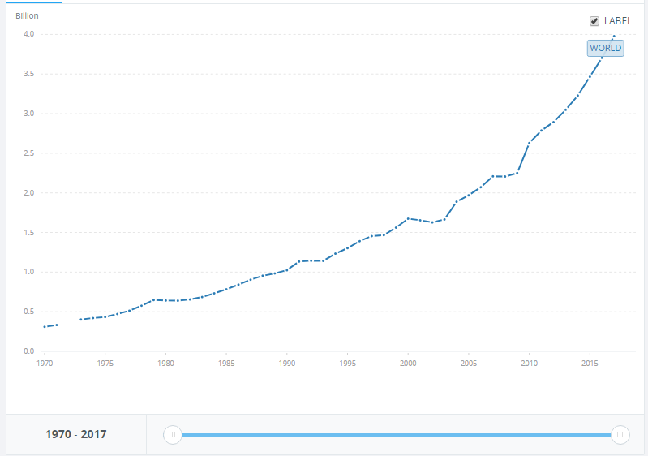

Slide 14
Scale of the aviation Industry; statistics
Based on reports from 1,202 airports worldwide, ACI’s preliminary passenger traffic results for the most-traveled airports in 2017 reveal that Atlanta-Hartsfield-Jackson (ATL) has secured top spot again. With almost 104 million passengers, the airport is within a two-hour flight of 80% of the United States’ population. Beijing (PEK), holds second spot and Dubai (DXB) remained in third position. As a major connection point for long-haul international flights, Dubai International Airport is also the world’s busiest in terms of international passengers. Total passenger traffic at DXB grew 5.5% in 2017.
Delhi (DEL) jumped from 22nd to 16th solidifying its status as one of the fastest growing airports in the world for passenger traffic; Guangzhou (CAN), in China, grew by 10.3% making it the second fastest growing airport among the top 20.

Slide 15
Scale of the aviation Industry; statistics
Air cargo volumes at the 20 busiest airports grew by 6.8% in 2017. These airports handled a combined 51 million metric tonnes of cargo. This represents 43% of global air cargo volumes.
Hong Kong (HKG) occupies top spot as the largest air cargo center handling more than five million metric tonnes of cargo in 2017. Volumes at HKG grew by 9.4% year-on-year. Shanghai (PVG), Chicago (ORD) and Doha (DOH) all experienced double digit growth of 11.2%, 12.6% and 15.0% respectively.
Air cargo experienced a revival across many of the world’s airports in 2017 and into 2018. Even with the uncertainty regarding the threat of trade wars and the growth of protectionist sentiments across the world, business confidence has remained strong through inventory build-ups and increased export orders in 2017.

Slide 16
Scale of the aviation Industry; statistics
A strengthened economy in the United States (US), together with an increase in global industrial production, and a strong US dollar have boosted inbound air cargo markets in recent years. Key air cargo centers, such as Chicago – O’Hare (ORD), experienced growth of 12.6% for 2017. The airport, which has significantly expanded its air cargo facilities, is centrally located geographically serving regional manufacturing within an intermodal transport network. The airport has also benefitted from international trade with China and other Asian countries. ORD’s international freight volumes increased by 12.2% in 2017.

Slide 17
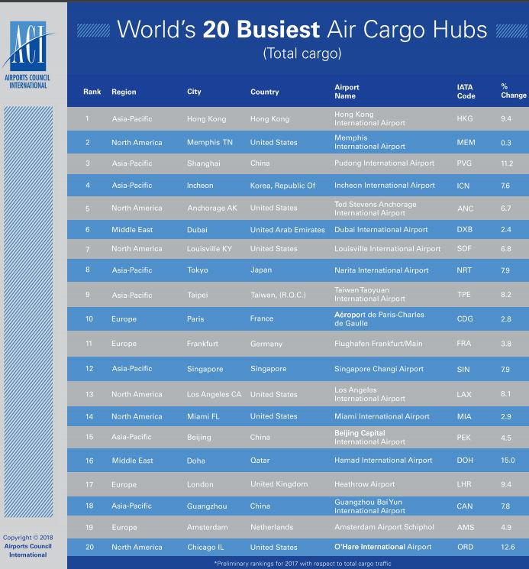

Slide 18
Scale of the aviation Industry; statistics
The surge in cargo volumes and passenger numbers across many of the world’s airports is testament to heightened business and consumer confidence, at least in the short term,” said Angela Gittens, Director General, ACI World. “The world’s airports continue to be a vital link in the economic multiplier effect that aviation provides and the role it plays as an enabler for global commerce is growing.
The universal access to online retail and e-commerce platforms represents a competitive pressure to the traditional brick and mortar retail shops in certain markets but the huge growth in e-commerce has fuelled the air cargo side of the airport business. This has resulted in increased global activity, especially in major markets such as China and the US.

Slide 19
Scale of the aviation Industry; statistics
Gittens added, “The spectre of uncertainty regarding trade policy among major economies comes at a time when global commerce and our industry has recently thrived. The trans-pacific link, for instance, is an important ingredient in boosting international passenger traffic and international freight volumes”.
“Connecting people, business and places still remains paramount to the aviation sector despite the recent threats of a step backwards in market liberalization in some major economies,” Gittens concluded

Slide 20
Scale of the aviation Industry; statistics
Given that many Asia-Pacific airports act as exporters of air cargo with North American airports acting as importers, growth in international freight traffic for each region was significantly affected by this occurrence. Both Asia-Pacific and North America experienced a jump of 11.4% and 10.3% respectively for international freight volumes in 2017.
Shanghai, a major city centre for trade and business, continues to thrive. Shanghai Pudong International Airport (PVG), the world’s 3rd busiest air cargo airport experienced an increase of 11.2% in volumes. The airport has moved up to second rank in terms of international freight volumes in 2017 after an increase of 15.2% year-over-year in volumes.

Slide 21
Scale of the aviation Industry; statistics
The world’s largest air cargo hub continued to be Hong Kong (HKG), with a robust increase of 9.4%. This was followed by Memphis (MEM, +0.3%), which was the only cargo hub to show a modest increase among the top 20 busiest airports. The airport is home to FedEx, a major express package delivery firm. Increased competition among express delivery companies has become a reality especially due to the inroads made by Amazon, a major e-commerce firm.
The company occupies strategic airports in North America such as Cincinnati/Northern Kentucky International Airport (CVG), located in the Midwest for its operations. Even though Amazon’s air cargo facilities will not be operational until 2020, the airport is among the fastest growing in the world in terms of air cargo volumes. CVG’s freight volumes grew by 27.3% in 2017. In Asia, Alibaba also continues to seize opportunities at regional hubs. The online retail giant centers its logistical operations at airports in China and recently Malaysia.

Slide 22
Scale of the aviation Industry; statistics
2017 Cargo Highlights
Globally, cargo markets showed a 9.9% expansion in freight and mail tonne kilometers (FTKs). This outstripped a capacity increase of 5.3% increasing freight load factor by 2.1%.
The top five airlines ranked by scheduled freight tonne kilometers flown were:
Federal Express (16.9 billion)
Emirates (12.7 billion)
United Parcel Service (11.9 billion)
Qatar Airways (11 billion)
Cathay Pacific Airways (10.8 billion)

Slide 23
Scale of the aviation Industry; statistics
The reliability factor and the efficiency guarantee associated with express parcel deliveries that are generated from online purchases are an important driver in the upward surge in volumes shipped by air. Moreover, there is no doubt that a temporary substitution effect away from ocean cargo in 2016 and 2017, as a result of marine industry consolidations and bankruptcies, also helped to boost air cargo volumes over the short-term.

Slide 24
Scale of the aviation Industry; statistics
TL is the world’s busiest airport for aircraft movements, ahead of ORD. Both airports experienced a decline of 2.1% and 0.7% respectively. The top 20 airports inched up by only 0.5% year-over-year in 2017 as compared to 2016.
Though there has been weaker growth in aircraft movements especially in certain North American and European markets following the Great Recession, this is consistent with the move toward consolidated operations and a curbing of capacity by aircraft operators to increase aircraft load factors and improve yields. Adoption of larger aircraft especially for long-haul operations has also contributed to this phenomenon especially among Middle Eastern and Asian airlines.

Slide 25
Scale of the aviation Industry; route demands
Over the last few decades, civil aviation sector demand has continued to grow. A recent ICAO release in January 2017 reported that there were 35 million departures globally in 2016 with global traffic expressed as revenue passenger-kilometres or RPKs accounting to 7,015 billion. The Air Transport Bureau reported +7.6 percent year-on-year growth between 2015–16 confirming the continued growth and impressive expansion of the sector in terms of RPK.
Further, the 2016 forecast of the global gross domestic product (GDP) growth has been reported to be around 2.4 percent. It is worth mentioning that more than half of the global tourist traffic and about 35 percent of the world trade by value is covered by air travel.

Slide 26
Scale of the aviation Industry; route demands
On the contrary, the global cargo traffic market follows an alternate profile and is characterised by the industry’s strong dependence on current production and handling capacities. Despite the cargo traffic being less prominent than the passenger traffic, it continues to show a growth of 3.8 percent in terms of freight tonne kilometres (FTKs) towards to end of 2016. Though the cargo sector showed a good year-end performance, there were significant challenges accounted due to stagnation of world trade.
With the ever increasing demand of aircrafts and freight liners especially in the civil market, the manufacturing sector is pursuing the development of innovative next generation platforms to achieve cost effectiveness, travel comfort and delivery targets.

Slide 27
Scale of the aviation Industry; route demands
The Airbus’s Global Market Forecast for 2016-2035 reports that the growth in air traffic would account to a rise of 4.5 percent annually with a demand of 33,000 new aircrafts approaching the value of US$5.2 trillion over the next 20 years. Further the AGP reports that, in the UK alone, there is a backlog of over 13,000 aircrafts with an equivalent value of GBP£200 billion suggesting a large scope for growth in the civil aviation sector.
The current landscape clearly indicates that the airlines continue to achieve profits not only due to good traffic behaviour but also due to an increase in efficiency in aspects such as airplane load, accurate business models and other internal activities.

Slide 28
Scale of the aviation Industry; route demands
In order to understand and establish various factors that contribute to the growth of the sector and the demands, it is essential to define them as ‘Push’ and ‘Pull’ factors. Push factors may be referred to those internal factors that push the industry to adapt and consume products. These factors are intrinsic and are dependent on intangible socio-economic, demographic and market knowledge.
‘Pull’ factors on the other hand are external forces that attract the industry to influence the consumption of the same product. These ‘pull’ factors are heavily reliant on consumer’s needs and behaviours’ including attractiveness, convenience and accessibility through innovative technological features, price, quality and a range of dependent metrics.

Slide 29
Scale of the aviation Industry; route demands
the following fundamental key performance indicators or KPIs are used;
Social
Economic
Demographic
Most of the factors have both a ‘pushing’ and a ‘pulling’ attitude and some which constitute as basic influencing factors. For the purpose of the paper, only socio-economic and demographic factors are considered. They are classified mostly based on how much they sway on the push and pull attribute.

Slide 30
Scale of the aviation Industry; route demands
Persistence and resilience are two themes that best describe air transport demand over the last few years. The large increase in passenger traffic of 6.4% (2015) represents the strongest growth rate since 2010 (6.6%), the year in which it rebounded from the Great Recession. In fact, despite a slight weakening of economic growth at 3.1% in 2015, growth in passenger traffic approached the pre-recessionary growth levels that were seen in 2004 to 2007.
International tourism in particular was irrepressible in 2015, even considering the geopolitical risks that persisted in certain parts of the world, such as Eastern Europe and the Middle East. By and large, the international traveller appears to have discounted these risks

Slide 31
Scale of the aviation Industry; route demands
The social dimension points into the direction that, demand patterns for aircrafts are different between the world regions. But, in fact, the demand patterns are strongly affected by economic and demographic factors and it is difficult to identify social factors that play a relevant role. Considering Boeing and Airbus market analysis and the factors that those companies take into account for making their future demand scenarios, social factors do not appear between the drivers that they consider.
A number of economic, performance and productivity related variables are considered in their methodology and only “Propensity to travel” (Pull) and “Environmental awareness” (Push) could be considered in the social field.

Slide 32
Scale of the aviation Industry; route demands
Moreover, both are not independent from economic trends and they would not be considered as first class factors. Where social dimensions traditionally included economic awareness, technological affinity, cultural particularities, traditions, conventions, habits, behaviour (e.g. saving behaviour), values and needs of a country’s population, none of these aforesaid dimensions appear in the market analysis by major corporations and only “second class” factors have been considered.

Slide 33
Scale of the aviation Industry; route demands
Propensity to travel
The passion to travel dominates the industry with a strong relationship between the GDP and willingness of passengers. As per Airbus GMF, European and American nationals are the most willing passengers, and it is estimated that the current level is at 25 percent as of 2015. Further the report forecasts that in 2035 the total population who will travel by air will increase to 75 percent of the population of emerging countries.
This is clearly evidenced by the world airport traffic rankings issued by Airports Council International (ACI), where Atlanta, Beijing and Dubai took the top 3 places.

Slide 34
Scale of the aviation Industry; route demands
Propensity to travel
ACI reported that of the 1,179 airports across the world, the passenger’s hub grew 4.7 percent with approximately 1.4billion people passing through the top 20 airports representing 18 percent of the global passenger traffic. These confirm the behavioural attributes of the passengers and establish that there are a variety of factors that will support the growth of the sector establishing this social factor as a ‘pull’ influence to the industry

Slide 35
Scale of the aviation Industry; route demands
Environmental awareness
Reduction of noise and fuel consumption in terms of reduction in CO2 emissions will continue to be the primary target and will be achieved through the development of commercial aviation technologies.
Development of engine technologies will be advanced through the use of innovative materials, cutting-edge aerodynamic designs and smart manufacturing techniques, which will be driven through heavy investments in research and innovation amongst other scientific groups.
Specific technologies such as advanced wing designs that contribute to better fuel efficiency (e.g. using composites) form typical examples where weight reduction would significantly reduce fuel consumption thereby contributing to further reduction in emissions.

Slide 36
