Slide 1
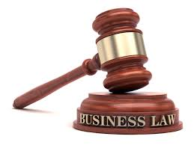
UNIT 7: BUSINESS LAW
UNIT CODE: H/617/0736

Slide 2
UNIT 7: BUISNESS LAW
LO1: EXPLAIN THE NATURE OF THE LEGAL SYSTEM

Slide 3
UNIT 7: BUSINESS LAW
M 1: EVALUATE THE EFFECTIVENESS OF THE LEGAL SYSTEM IN TERMS OF RECENT REFORMS AND DEVELOPMENTS

Slide 4
COURT STRUCTURES
The legal system of Jamaica is based on British common-law. The administration of justice is carried out through a network of courts.

Slide 5
COURT STRUCTURES
The courts of Jamaica are:
The Judicial Committee of the Privy Council, which is the final court of appeal, is based in London, England. It hears appeals on criminal and civil matters from the Jamaican Court of Appeal.

Slide 6
COURT STRUCTURES
The Court of Appeal consists of the President of the Court of Appeal, the Chief Justice (who sits at the invitation of the President) and six judges of the Court of the Appeal. A person who is dissatisfied with a decision of one of the other courts, except Petty Sessions, can appeal to this court. Petty Sessions appeals are heard by a judge in chambers.

Slide 7
COURT STRUCTURES
The Caribbean Court of Justice (CCJ) is one of the primary institutions of the Caribbean Community (CARICOM). The CCJ has two core functions − to act as the final appellate court for the CARICOM member states and as an international court ruling on matters relating to the foreign policy coordination of the Revised Treaty of Chaguaramas (2001) that outlines terms of economic cooperation among CARICOM members.

Slide 8
COURT STRUCTURES
The Supreme Court is the highest first instance court. It is a superior court of record and has unlimited jurisdiction. It has both inherent and statutory jurisdiction. Courts of equivalent jurisdiction in other countries are sometimes called “High Courts". The Supreme Court of Jamaica is responsible for hearing serious civil and criminal matters.

Slide 9
COURT STRUCTURES
The Supreme Court has jurisdiction in Civil, Criminal, Family, Commercial, Succession and Admiralty cases. There are also specialised courts which also exercise superior jurisdiction which are presided over by Supreme Court Judges. These are the High and Circuit Court Divisions of the Gun Court and the Revenue Court. Appeals from the Supreme Court are also made to the Court of Appeal

Slide 10
COURT STRUCTURES
At the parish level, the Resident Magistrates’ Courts deal with less serious civil and criminal offences. The Resident Magistrate of a parish is also the Coroner and conducts preliminary inquiries into criminal matters.

Slide 11
COURT STRUCTURES
The next tier of court is the Parish Court. This court is an inferior court of record and, as is the case with the Justices of the Peace jurisdiction, is governed entirely by statute. Parish Court Judges have the jurisdiction to try cases summarily as well as on indictment. The level of sanction, in terms of fines and imprisonment, are lower than that which may be imposed in the Supreme Court.

Slide 12
COURT STRUCTURES
There are four special courts – Traffic Court, Gun Court, Family Court and Revenue Court. There are also Petty Sessions courts that deal with minor offences and are presided over by Justices of the Peace.

Slide 13
CIVIL LAW
Civil law and criminal law serve different purposes in the Jamaican legal system. The primary purpose of civil law is to resolve disputes and provide compensation for someone injured by someone else’s acts or behaviour. In civil law, it is the injured person who brings the lawsuit.

Slide 14
CIVIL LAW
Civil law cases are concerned only with private law. In some instances, a person may be entitled to file a complaint, trusting the legal system to punish the wrongdoer with prosecution, while bringing a civil lawsuit to receive compensation for the damages done by the wrongdoer. In civil and law it is the standards of proof required to reach a verdict.

Slide 15
CIVIL LAW
A plaintiff need to only prove that his civil law case by a “preponderance of evidence.” This standard requires the plaintiff convince the court that, based on the evidence presented at trial, it is “more likely than not” that the plaintiff’s allegation is true.

Slide 16
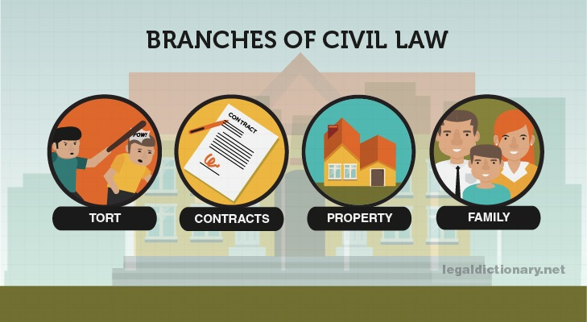
CIVIL LAW

Slide 17
CIVIL LAW
Civil Case Example
[2018] JMSC. Civ.112
IN THE SUPREME COURT OF JUDICATURE OF JAMAICA
IN THE CIVIL DIVISION
CLAIM NO. 2011HCV05274
BETWEEN RYAN ANSLIP CLAIMANT
AND NORTH EAST REGIONAL HEALTH AUTHORITY DEFENDANT
IN OPEN COURT
Mr. Andrew Irving for the Claimant
Ms. Carla Thomas for the Defendant,
instructed by the Director of State Proceedings
Heard: February 5, 6 and 16, March 2 and July 31, 2018
Employment - Dismissal – Fixed Term Contract providing for dismissal and for
termination of engagement with notice or salary in lieu of notice - Claimant's
employment terminated without notice – Salary in lieu of notice and additional
payments given – Whether Claimant dismissed for cause
No evidence presented in support of Defence - Whether court obliged to accept
Claimant’s account.

Slide 18
CIVIL LAW
Civil Case Example
Disposition
[79] Judgment for the Claimant.
[80] The Defendant shall pay to the Claimant damages representing salary and other
entitlements for the unexpired portion of his contract of $ 7,577,445.76..............
(net any applicable taxes)
(Details to be settled by Counsel)
Costs to the claimant to be taxed if not agreed.
Source: Supremecourt.gov.jm. (2019).

Slide 19
CRIMINAL LAW
The primary purpose of criminal law is to prevent undesirable behaviour and punish those who commit an act deemed undesirable by society. In criminal law, it is the government that files charges.

Slide 20
CRIMINAL LAW
The injured person may file a complaint, but it is the through the Director of Public Prosecution Office (DPP) the decision is made whether criminal charges should be filed. A violation of criminal law is considered a crime against the state or federal government and is a violation of public law rather than private law.

Slide 21
CRIMINAL LAW
In criminal law proceedings, the state must prove their case “beyond a reasonable doubt.” The reason for this higher standard is because a person’s freedom is at stake, and the fundamental belief that convicting an innocent person is worse than allowing a guilty person to go free.

Slide 22
CRIMINAL LAW
In a criminal case the State is the prosecutor because it is the community as a whole which suffers as a result of the law being broken. Persons guilty of crime may be punished by fines payable to the State, imprisonment, or a community-based punishment.

Slide 23
CRIMINAL LAW
Generally, the police take the initial decision to prosecute, but this is then reviewed by the Crown
Prosecution Service. Some prosecutions are started by the Director of Public Prosecutions, who is the head of the Crown Prosecution Service.
In a criminal trial, the burden of proof to convict the accused rests with the prosecution, which must
prove its case beyond reasonable doubt.

Slide 24
REVIEW QUESTIONS
A ______ is conduct prohibited by the law.
___________ exists to regulate disputes over the rights and obligations of persons dealing with each other and seeks to compensate injured parties.
A broken leg caused to a pedestrian by a drunken driver is a single event which may give rise to:
• Criminal/Civil case (prosecution by the State for the offence of driving with excess alcohol), and
• Civil/Criminal case (the pedestrian sues for compensation for pain and suffering)
4. In criminal cases, the _____ prosecutes the wrongdoer. .
5. What is the standard of proof in civil proceedings?

Slide 25
REVIEW QUESTIONS
6. The Caribbean Court of Justice has how many functions?
(b) Identify and explain them.
7. In Jamaica which court is the highest first instruction.

Slide 26
REFERENCES
Jamaica Information Service. (2019). The Judiciary - Jamaica Information Service. [online] Available at: https://jis.gov.jm/government/the-judiciary/ [Accessed 20 Jan. 2019].
Supremecourt.gov.jm. (2019). The Court Structure and Hierarchy | The Supreme Court of Jamaica. [online] Available at: http://supremecourt.gov.jm/content/court-structure-and-hierarchy [Accessed 20 Jan. 2019].
Legal Dictionary. (2019). Civil Law - Definition, Examples, Types, Cases, and Systems. [online] Available at: https://legaldictionary.net/civil-law/ [Accessed 20 Jan. 2019].
Supremecourt.gov.jm. (2019). [online] Available at: http://supremecourt.gov.jm/sites/default/files/judgments/Anslip%2C%20Ryan%20v%20North%20East%20Regional%20Health%20Authority.pdf [Accessed 20 Jan. 2019].

Slide 27
REFERENCES
BPP LEARNING MEDIA. (2017). Acca f4 corporate and business law (global). BPP LEARNING MEDIA

