Slide 1
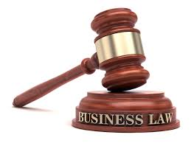
UNIT 7: BUSINESS LAW
UNIT CODE: H/617/0736

Slide 2
UNIT 7: BUISNESS LAW
LO 3: EXAMINE THE FORMATION OF DIFFERENT TYPES OF BUSINESS ORGANISATION

Slide 3
UNIT 7: BUSINESS LAW
P4 : EXPLORE HOW DIFFERENT TYPES OF BUSINESS ORGANISATIONS ARE LEGALLY FORMED

Slide 4
UNINCORPORATED V’S INCORPORATED LEGAL STRUCTURE
In incorporated business, or a corporation, is a separate entity from the business owner and has natural rights. Conversely, a business owner and an unincorporated business are the same, and the owner personally bears all results of the business.

Slide 5
UNINCORPORATED V’S INCORPORATED LEGAL STRUCTURE
Unincorporated businesses are usually sole proprietor or partnership companies. The main difference between an incorporated and unincorporated business is the way owners shoulder business activities.

Slide 6
UNINCORPORATED V’S INCORPORATED LEGAL STRUCTURE
An incorporated business protects owners from liabilities they might incur from running the business while an unincorporated business does not. If the business defaults on a debt, payment for that debt must come from the investment in the business, not the business owner's personal property.

Slide 7
UNINCORPORATED V’S INCORPORATED LEGAL STRUCTURE
The same is true with lawsuits against the business. If an incorporated business loses a lawsuit, the corporation, not the owner, is responsible for paying up. Conversely, business owners of private businesses are personally liable for any debts or lawsuits against their business.

Slide 8
UNINCORPORATED V’S INCORPORATED LEGAL STRUCTURE
This table on the next slide summarises the key differences between incorporated and unincorporated groups.

Slide 9
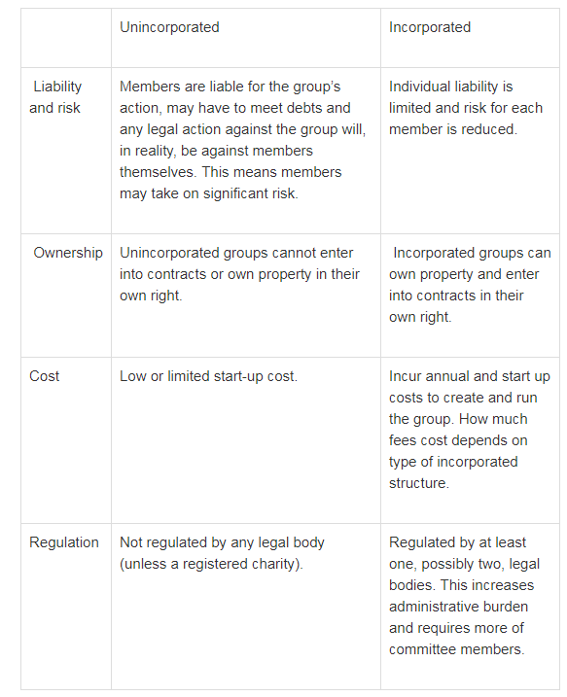
UNINCORPORATED V’S INCORPORATED LEGAL STRUCTURE

Slide 10
UNINCORPORATED V’S INCORPORATED LEGAL STRUCTURE
In choosing between a corporation and an unincorporated association, the main concerns are filing requirements, longevity, limited liability and profit making. All business entities are regulated under the laws of the country where the association is located.
Every country has business laws that are substantially similar to other countries, but not exactly the same. It is essential to understand the difference between business structures to protect oneself and other owners from unexpected liability.

Slide 11
DIFFERENT TYPES OF BUSINESS ORGANISATIONS AND LEGAL STRUCTURE: SOLE TRADER
An individual who runs an unincorporated business on his or her own. Sometimes otherwise known as a "sole proprietor" or (in the case of professional services) a "sole practitioner".

Slide 12
DIFFERENT TYPES OF BUSINESS ORGANISATIONS AND LEGAL STRUCTURE: SOLE TRADER
The sole trader structure is the most straight-forward option. The individual is taxed under the Inland Revenue Department Self-Assessment system, with income tax calculated after deduction for legitimate business expenses and personal allowances. A sole trader is personally liable for the debts of the business, but also owns all the profits.

Slide 13
DIFFERENT TYPES OF BUSINESS ORGANISATIONS AND LEGAL STRUCTURE: SOLE TRADER
The sole trader structure is the most straight-forward option. The individual is taxed under the Inland Revenue Department Self-Assessment system, with income tax calculated after deduction for legitimate business expenses and personal allowances. A sole trader is personally liable for the debts of the business, but also owns all the profits.

Slide 14
DIFFERENT TYPES OF BUSINESS ORGANISATIONS AND LEGAL STRUCTURE: PARTNERSHIP
A partnership is an association of two or more people formed for the purpose of carrying on a business. Partnerships are governed by the Partnership Act (1890). Unlike an incorporated company (see below), a partnership does not have a "legal personality" of its own. Therefore the Partners are liable for any debts of the business.

Slide 15
DIFFERENT TYPES OF BUSINESS ORGANISATIONS AND LEGAL STRUCTURE: PARTNERSHIP
Partner liability can take several forms. General Partners (the usual situation) are fully liable for business debts. Limited Partners are limited to the amount of investment they have made in the Partnership. Nominal Partners also sometimes exist. These are people who allow their names top be used for the benefit of the partnership, usually for remuneration, but they do not get a share of the partnership profits.

Slide 16
DIFFERENT TYPES OF BUSINESS ORGANISATIONS AND LEGAL STRUCTURE: PARTNERSHIP
The operation of a partnership is usually governed by a "Partnership Agreement". The specific terms of this agreement are determined by the partners themselves, covering issues such as:
- Profit-sharing - normally, partners share equally in the profits; - Entitlement to receive salaries and other benefits in kind (e.g. cars, health insurance).

Slide 17
DIFFERENT TYPES OF BUSINESS ORGANISATIONS AND LEGAL STRUCTURE: PARTNERSHIP
Interest on capital (the amount invested in the partnership) - Arrangements for the introduction of new partners - Arrangements for retiring partners - What happens when the partnership is dissolved.

Slide 18
DIFFERENT TYPES OF BUSINESS ORGANISATIONS AND LEGAL STRUCTURE: PARTNERSHIP
Partners in a partnership face unlimited liability for their debts. The only exception is in a Limited Partnership. This is where a partnership may wish to raise additional finance, but does not wish to take on any new active partners.

Slide 19
DIFFERENT TYPES OF BUSINESS ORGANISATIONS AND LEGAL STRUCTURE: PARTNERSHIP
To overcome this problem, the partnership may take on as many Sleeping (or Silent) Partners as they wish - these people will provide finance for the business to use, but will not have any input into how the business is run.

Slide 20
DIFFERENT TYPES OF BUSINESS ORGANISATIONS AND LEGAL STRUCTURE: PARTNERSHIP
In other words, they have purely put the money into the business as an investment. These Sleeping Partners face limited liability for the debts of the partnership. A partnership, just like a sole trader, is an unincorporated business.

Slide 21
DIFFERENT TYPES OF BUSINESS ORGANISATIONS AND LEGAL STRUCTURE: REGISTERED COMPANY
Public companies, corporations that sell shares of common stock to the public, must register and file with the Jamaica Stock Exchange (JSE). The JSE reviews these statements to make sure that the financial misstatements are as accurate as possible, with little to no misstatements, and that the company is accurately reporting information to its shareholders.

Slide 22
DIFFERENT TYPES OF BUSINESS ORGANISATIONS AND LEGAL STRUCTURE: REGISTERED COMPANY
The primary legal differences between a registered and unregistered holding company are the JSE compliance regulations to which a registered company must adhere. A registered holding company must comply with generally accepted accounting principles and file its financial reports with the JSE.

Slide 23
DIFFERENT TYPES OF BUSINESS ORGANISATIONS AND LEGAL STRUCTURE: REGISTERED COMPANY
It must publicly disclose any pertinent information that may affect the financial health or status of the company, such as pending lawsuits, negligent management and reasons for purchases or sales of its subsidiaries.

Slide 24
DIFFERENT TYPES OF BUSINESS ORGANISATIONS AND LEGAL STRUCTURE: REGISTERED COMPANY
In some cases, a holding company, dependent upon the main purpose of the entity, may be required to employ certain financial and legal personnel to appropriately oversee its acquisitions.

Slide 25
DIFFERENT TYPES OF BUSINESS ORGANISATIONS AND LEGAL STRUCTURE: REGISTERED COMPANY
The most obvious difference between a registered company and other business structures is the ability of a registered companies to raise large sums of money by selling stock shares to investors.

Slide 26
DIFFERENT TYPES OF BUSINESS ORGANISATIONS AND LEGAL STRUCTURE: REGISTERED COMPANY
Instead of being centred on a single person or a small group, ownership of an incorporated business is spread out among stockholders, who have the right to vote on key business decisions.
Corporations are listed on stock exchanges, such as the Jamaica York Stock Exchange (JSE), and anyone can access a wide range of financial and operational data about each company.

Slide 27
DIFFERENT TYPES OF BUSINESS ORGANISATIONS AND LEGAL STRUCTURE: REGISTERED COMPANY
Corporate businesses can struggle more than other forms of business when it comes to business ethics. The nature of the corporate structure is such that executives and managers are mainly concerned with the financial success of the company and its stockholders.

Slide 28
DIFFERENT TYPES OF BUSINESS ORGANISATIONS AND LEGAL STRUCTURE: REGISTERED COMPANY
This often single-minded drive for continual revenue and profit growth can lead corporate managers to make unethical decisions, such as outsourcing a department full of loyal, long-term employees just to add a single percentage point to the profit margin, or engaging in practices that destroy the natural environment without any regard to the cost and external stakeholders.

Slide 29
REVIEW QUESTIONS
Peter,Paul and Richard formed a partnership to run a chemical company. The partnership agreement expressly stated that the partnership business was to be limited exclusively to the sale of chemical.
In January 2018 Peter received $10,000 from the partnership's bank drawn on its overdraft facility. He told the bank that the money was to finance a short-term partnership debt but in fact he used the money to pay for a round-the-world cruise. In February 2018. Paul entered into a $15,000 contract on behalf of the partnership to buy a stock of bleach, which he hoped to sell from the garage forecourt. In March 2018 the partnership's bank refused to honour its cheque for the payment of its monthly chemical account, on the basis that there were no funds in its account and it had reached its overdraft facility.
Required
Explain the liability of the partners for the bank overdraft.
Explain the liability of the partners for the contract to buy the bleach.
(c) Explain the liability of the partners for the chemical account.

Slide 30
REVIEW QUESTIONS
Mick has operated a house building business as a sole trader for a number of years. The business is growing and in recent times, Mick has taken out a loan to buy business assets. Mick is considering tendering for a couple of very large contracts that should earn the business substantial sums, but also increases his potential liability if he is in breach of contract.
Now his accountant has recommended that he should consider registering as a company in order to gain the benefits of separate corporate personality.
Required
State what is meant by separate corporate personality.
Explain why registering his business as a company may be of benefit to Mick.

Slide 31
REFERENCES
Smallbusiness.chron.com. (2019). What Is the Difference Between Incorporated & Unincorporated Businesses?. [online] Available at: https://smallbusiness.chron.com/difference-between-incorporated-unincorporated-businesses-57463.html [Accessed 22 Feb. 2019].
Voluntary Action LeicesterShire. (2019). 3. Unincorporated vs Incorporated. [online] Available at: https://www.valonline.org.uk/legal-structures/unincorporated-vs-incorporated [Accessed 22 Feb. 2019].
Info.legalzoom.com. (2019). What Is the Difference Between an Unincorporated Association & a Corporation?. [online] Available at: https://info.legalzoom.com/difference-between-unincorporated-association-corporation-23751.html [Accessed 22 Feb. 2019].
tutor2u. (2019). Business Organisation: Introduction to Business Ownership | tutor2u Business. [online] Available at: https://www.tutor2u.net/business/reference/business-organisation-introduction-to-business-ownership [Accessed 22 Feb. 2019].

Slide 32
REFERENCES
S-cool.co.uk. (2019). Legal Structure | S-cool, the revision website. [online] Available at: https://www.s-cool.co.uk/a-level/business-studies/business-organisation/revise-it/legal-structure [Accessed 22 Feb. 2019].
Smallbusiness.chron.com. (2019). The Legal Differences Between Registered & Unregistered Holding Companies. [online] Available at: https://smallbusiness.chron.com/legal-differences-between-registered-unregistered-holding-companies-31370.html [Accessed 22 Feb. 2019].
Smallbusiness.chron.com. (2019). What Is an Incorporated Business?. [online] Available at: https://smallbusiness.chron.com/incorporated-business-365.html [Accessed 22 Feb. 2019].

