Slide 1
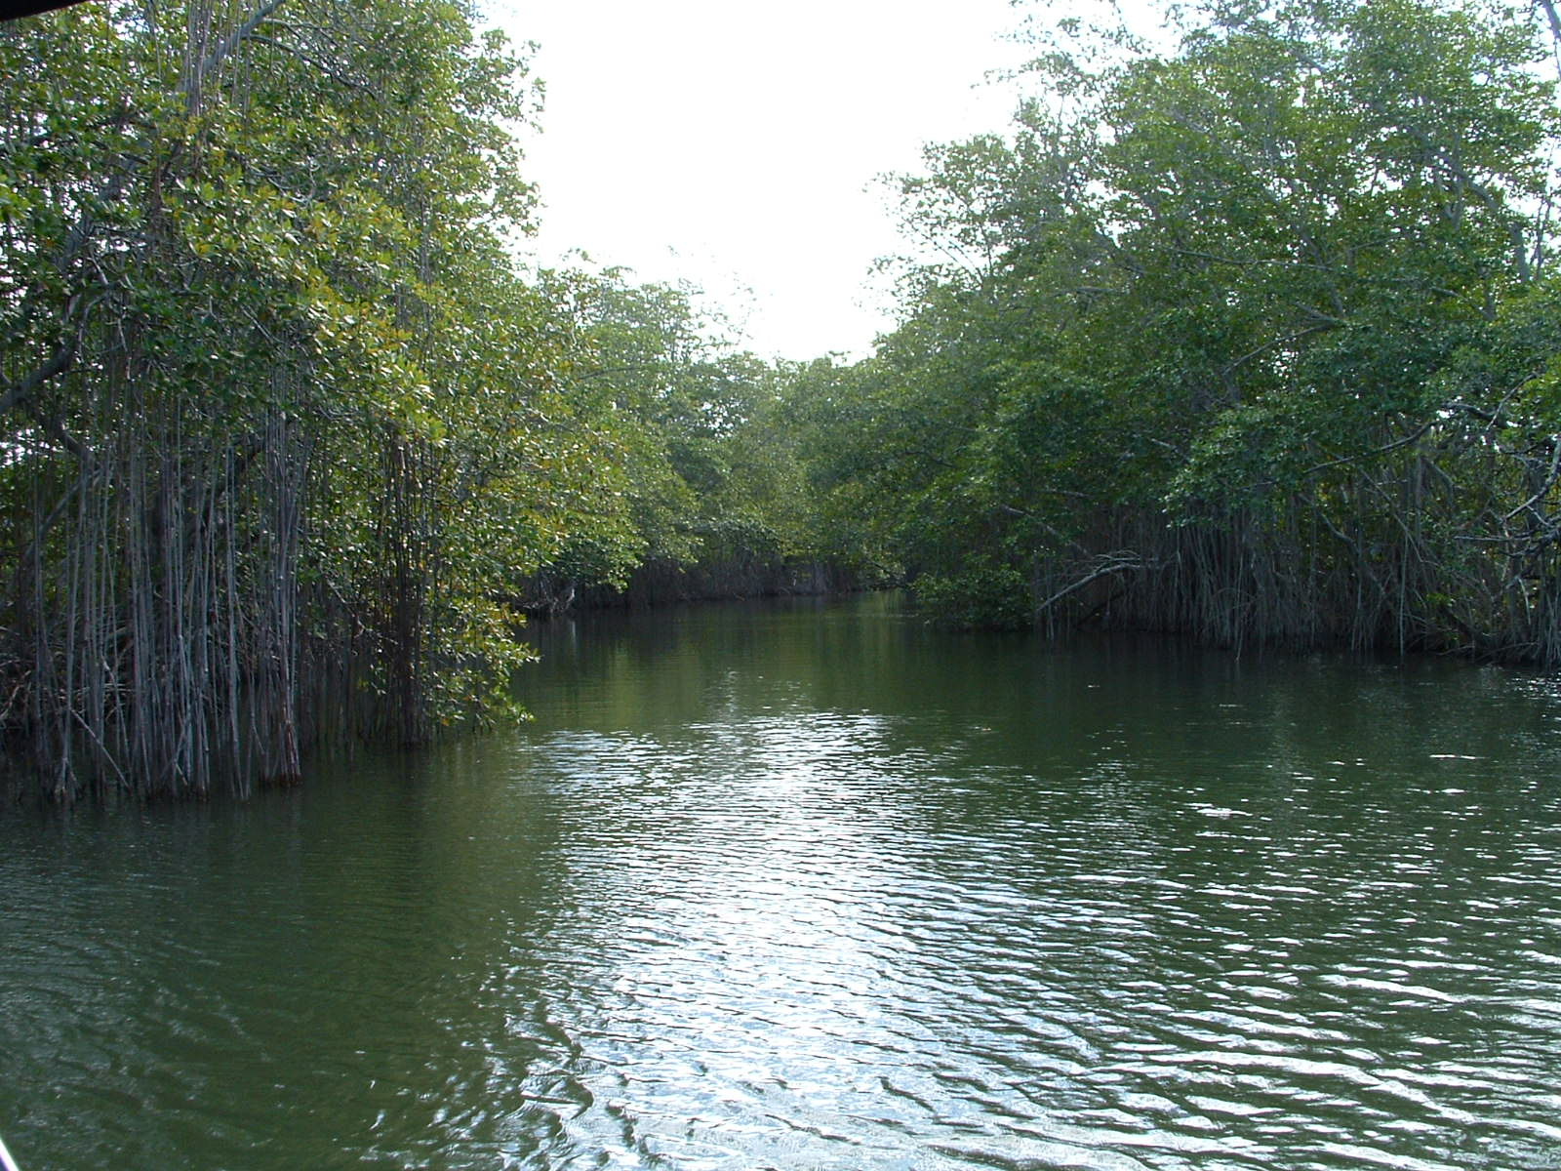
Sustainable Tourism
COLBOURNE COLLEGE

Slide 2
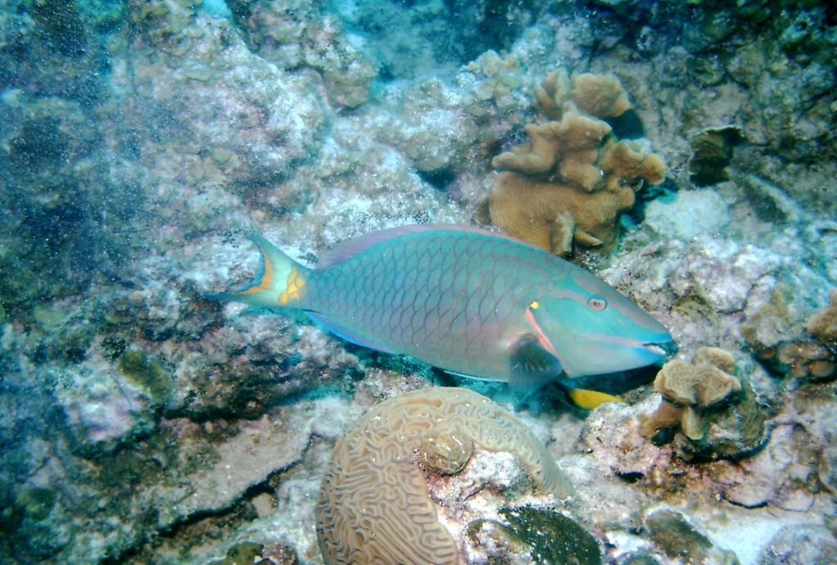
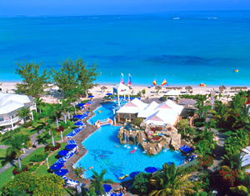
INTRODUCTION
WE WILL REVIEW THE EVOLUTION OF THE SUSTAIBLE TOURISM CONCEPT (including SUSTAINABLE DEVELOPMENT)
Notes:
Not relevant

Slide 3
Review of Lecture #1
Tourism is one of the fastest growing industries in the world
In the Caribbean, tourism is highly dependent on environmental resources
Uncontrolled tourism growth can cause environmental degradation , destruction of fragile ecosystems such as coral reefs and mangroves, and social & cultural conflict, undermining the basis of tourism

Slide 4
Review of Lecture 1
SUSTAINABLE TOURISM:
Is the development and Management of resources in such a manner that economic, social and aesthetic needs can be fulfilled while maintaining cultural integrity, essential ecological processes, biological diversity and life support systems (World Tourism Organization)

Slide 5
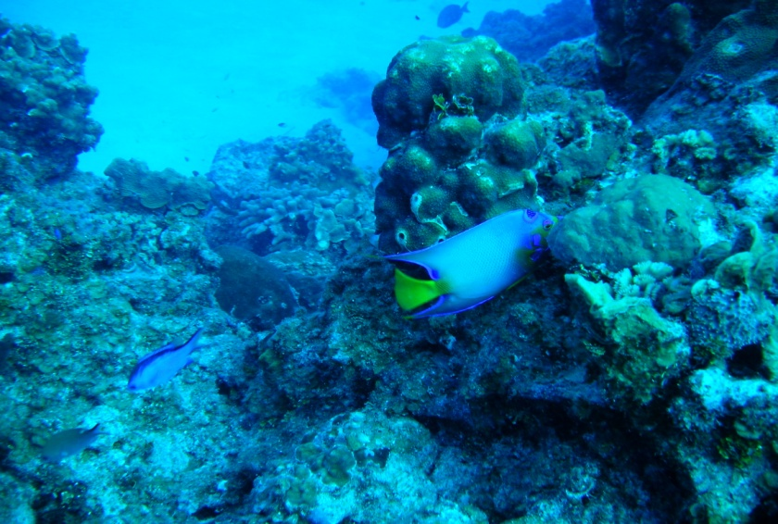
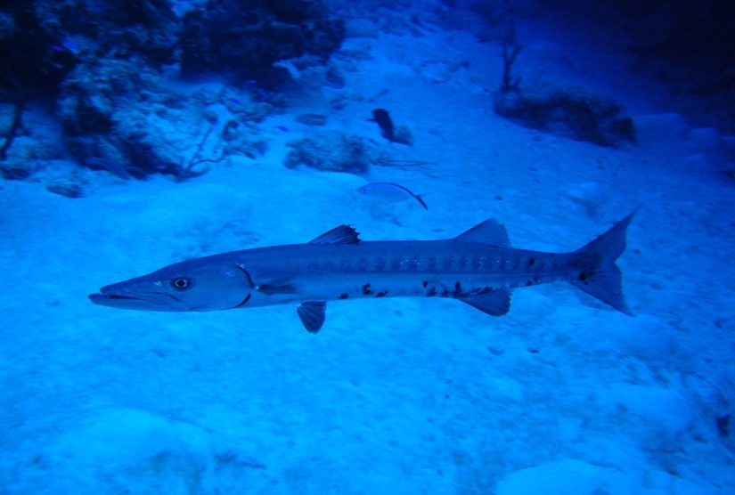
INTRODUCTION (cont’d.)
SUSTAINABLE DEVELOPMENT:
DEVELOPMENT that meets the needs of the present without compromising the ability of future generations to meet their own needs
Notes:
Not relevant

Slide 6
WHY IS THERE A NEED FOR SUSTAINABLE DEVELOPMENT?
Worldwide Population is growing at a rapid rate. By 2050, 8.9 billion persons will be living in the world (most of them in developing countries) – this has implications for the availability and sustainable use of various resources
-In 1950, the total Caribbean Population was 8.9 million and it is projected that by 2050, it will rise to 31.3 million
Wide variety of critical environmental threats (degradation of soil, water and marine resources, air pollution, and loss of biodiversity)
Widespread, persistent poverty and human misery – despite growing affluence for many

Slide 7
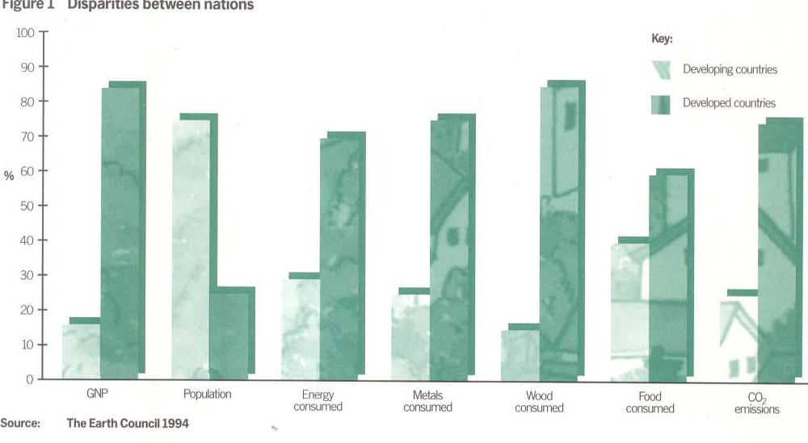
WHY IS THERE A NEED FOR SUSTAINABLE DEVELOPMENT?

Slide 8
JOURNEY TOWARDS SUSTAINABLE DEVELOPMENT
1972 – Stockholm Conference on Human Environment
- recognized that environmental problems are inseparable from those of human welfare and from the process of economic development and that many forms of development erode the environmental resources on which human livelihoods and welfare depend
1987 - Bruntland Report (Our Common Future)
In our common Future, the Commission concluded that “a new development path was required, one that sustained human progress not just in a few places for a few years, but for the entire planet into the distant future
1992-UN Conference on Environment & Development -Agenda 21
Comprehensive Programme of Action adopted by 182 countries
Involves Govt., private sector, NGOs, CBOs, UN agencies, etc
As the World’s largest industry, Travel and Tourism has a leading role to play in achieving the goals of Agenda 21

Slide 9
JOURNEY TOWARDS SUSTAINABLE DEVELOPMENT
1994 – BARBADOS PROGRAMME OF ACTION (BPOA)
-Looked at the Special Needs of Small Island Developing States
-Environmental consequences of ill conceived development can have catastrophic effects
- Need to mange coastal and marine resources, land resources, freshwater resources, energy resources, biodiversity resources, wastes and tourism resources
- Tourism if not properly planned and managed could significantly degrade the environment on which it depends
- Adopt integrated planning and policies to ensure sustainable tourism development
2000 - Millennium Development Goals (UN Millennium Summit)
- Identified Performance Targets and timelines
- 8 main goals including Eradication of Extreme Poverty and hunger and Environmental Sustainability (Conservation and protection of natural resources, and improved sanitation and access to safe drinking water

Slide 10
JOURNEY TOWARDS SUSTAINABLE DEVELOPMENT
2002- Johannesburg Summit
Review of the Progress of the countries in the world in achieving sustainable development
Implementation Plan recommended that sustainable tourism development should be promoted and that energy considerations such as energy efficiency should be used in the tourism sector
2005 - Mauritius Meeting (Review of the Implementation of the BPOA)

Slide 11
MAIN COMPONENTS OF SUSTAINABLE DEVELOPMENT
Economic:
Ensure viable, long-term economic operations, providing economic benefits to all stakeholders that are fairly distributed, including stable employment and income-earning opportunities and social services and contributing to poverty alleviation. This implies that our economic systems are managed so that we live off the dividend of our resources, maintaining and improving the asset base
Reduction in wasteful levels of consumption of energy and other natural resources in rich countries
- More Efficient Use of resources using cleaner, less resource intensive technologies
Notes:
SAME AS OBJECTIVES FOR RECYCLE FOR LIFE

Slide 12
MAIN COMPONENTS OF SUSTAINABLE DEVELOPMENT
ENVIRONMENTAL
Make optimal use of environmental resources
conserve and protect natural heritage and biodiversity
Manage freshwater, coastal and marine and land resources and minimize pollution of these resources

Slide 13
MAIN COMPONENTS OF SUSTAINABLE DEVELOPMENT
Social:
Means significant progress towards stable populations
Distribution of population is important -reduced migration to cities by vigorously promoting rural development – using tourism, agricultural and other economic activities
Ensuring basic needs –primary health care, literacy and clean water
Improving social well being, protecting cultural diversity and investing in human capital
Men, women an children must be the centre of attention – with development woven around people, not people around development

Slide 14
Why the need for Sustainable development of Tourism
Tourism & Travel Industry is the world’s largest industry
The tourism product relies on clean seas, pristine mountain slopes, unpolluted water, litter free streets, well preserved buildings and diverse cultural traditions
Sustainable tourism management initiatives can reduce operational costs and increase profits

Slide 15
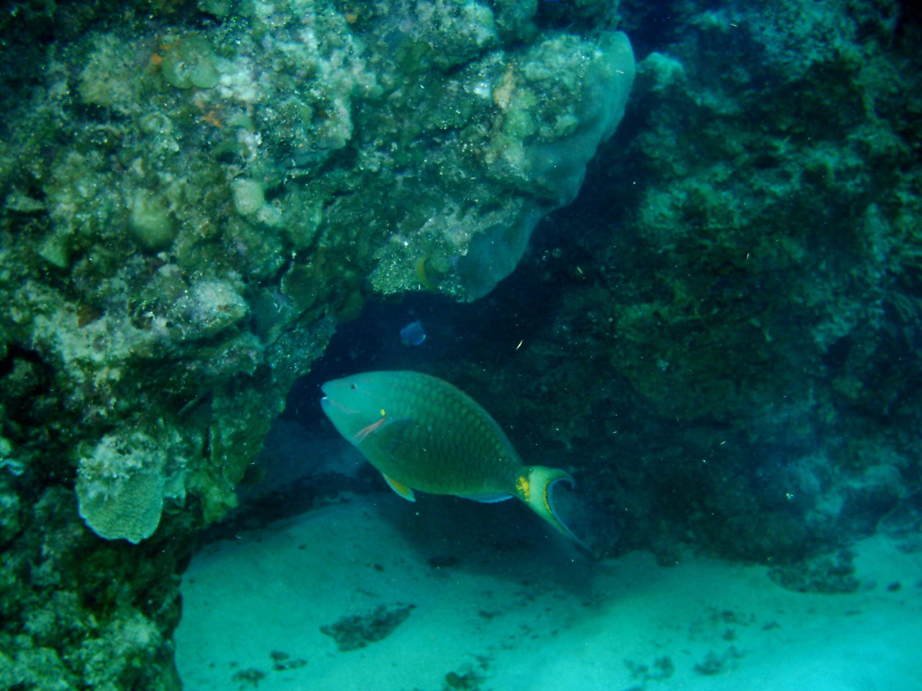
Sustainable Tourism Guidelines
The World Tourism Organisation’s guidelines for sustainable tourism development are:
travel and tourism should assist people in leading healthy and productive lives in harmony with nature;
tourism development should be appropriate to place, reflecting its scale and character;
environmental protection should constitute and integral part of the tourism development process;
sustainable tourism development should ensure a fair distribution of benefits and costs;
tourism development issue should be handled with the participation of all stakeholders with decision being taken at the local level;
travel and tourism should use its capacity to create employment for women and local people to the fullest extent;
tourism development should recognise and support the identity, culture and interests of local people

Slide 16
Reference
ACT Consulting Associates (1997). Developing an Ecotourism Strategy. Report on the Findings of the Conference on Sustainable Tourism, Roseau, Dominica.
Tourism in Jamaica, An Economic Analysis, JTB Statistics 1997.
(WCED, Our Common Future, 1987).
Carney, D. (ed) (1998). Sustainable Rural Livelihoods: What Contribution can we make? DFID. London

