Slide 1
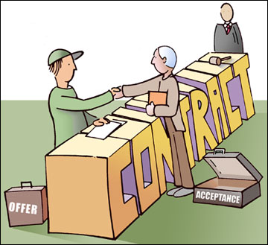
ASPECTS OF CONTRACT AND NEGLIGENCE FOR BUSINESS
Lecturer: Judith Robb-Walters
Lesson2

Slide 2
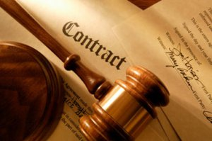
ASPECTS OF CONTRACT AND NEGLIGENCE FOR BUSINESS
LO 1: Understand the essential elements of a valid contract in a business context
September – November 2014

Slide 3
The Basic Syllabus
- Understand the essential elements of a valid contract in a business context.
Be able to apply the elements of a contract in business situations.
Understand principles of liability in negligence in business activities
Be able to apply principles of liability in negligence in business situations.

Slide 4
LEARNING OBJECTIVES
At the end of the class, students should be able to:
- Discuss the impact of different types of contract.

Slide 5
OVERVIEW
A handshake may, in fact, legally seal a deal. In many instances an agreement can be legally binding even if it is not formalized in writing. In other situations, though a writing might be necessary. Contract law is an ancient practice and some very old traditions still shape the way oral agreements are applied and enforced today.

Slide 6
Face to Face
At its core, what makes a contract legally binding is that it involves the exchange of valuable consideration. A promise to do something for nothing is gratuitous and, in general, not enforceable unless other conditions are met. But, an agreement to do something, give something, or forego some legal right in exchange for a reciprocal promise is a binding contract. Such verbal contracts, or handshake deals, are legally binding if they can be evidenced in court.

Slide 7
Face to Face
English law allows parties to reach a binding and legally enforceable contract without the need to put the terms of the agreement into a written form. The dangers associated with such agreements have been evident in recent case law, and below we consider three examples of cases that demonstrate how the lack of a formal written agreement can cause problems for both parties involved. Noel Edmonds v Ulrik Lawson [2011] demonstrates how oral agreements can lead to misunderstandings between the parties, which can result in significant legal costs when the courts are required to interpret the terms of the agreement. The Court of Appeal decision in BVM Management Ltd v Yeomans [2011] shows the confusion that can be caused by the lack of certainty of the terms of oral contracts, and also illustrates the risks of not clearly establishing at which stage during contract negotiations a draft agreement is final. Lastly, the Court of Appeal decision in Sharma v Simposh[2011] provides a useful reminder that an oral agreement can be void because the agreement in question requires specific formalities under statute.

Slide 8
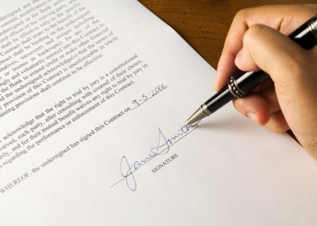
Written Contract
A written contract generally refers to a written document outlining an agreement between two parties. The parties can be individuals, businesses, or organizations. All factors or portions in the agreement must be included in the agreement, and each party involved has to sign the document in order for it to be considered valid.
The purpose of the written contract is generally to ensure that both parties fully understand the agreement and are committed to complying to its stipulations. Contracts may between a buyer and a seller or a product, between someone hiring the other person to complete a specific job, or between two parties who are undergoing a business venture together. When each individual or business signs the contract, he or she is acknowledging than an agreement was made and that he or she understands the responsibilities involved.

Slide 9
Distance Selling Contracts
The Distance Selling Regulations were passed to protect consumers when they shop online or enter into other contracts at a distance from the supplier. The rationale for giving consumers special protection in such deals is that the consumer does not have the benefit of meeting face-to-face with the supplier and inspecting the goods or services offered for sale.
Properly called the Consumer Protection (Distance Selling) Regulations 2000, the Regulations do not apply to contracts between businesses. They have been in force across the UK since 31st October 2000 and they implement a 1997 EU Directive on the protection of consumers in respect of distance contracts.
The Regulations give consumers a right to:
receive clear information about the supplier, the goods or services and the sale before deciding to buy;
confirmation of this information in writing;
a cancellation period of 7 working days in which to withdraw from the contract; and
protection from payment card fraud.

Slide 10
Impact Contract
There is wide latitude in how precedent can impact a contract at time of negotiation. Legally, precedent means an authoritative prior decision, principle of law, case law, controlling law, established doctrine, legal doctrine, model, ruling or standard changes in a contract at time of negotiation. At the negotiating table, as long as the issue being negotiated isn't illegal, either through case law or legal doctrine, it is negotiable. Precedent may play a role in the negotiating position of one side or the other but it is not binding while negotiations are under way.

Slide 11
REVIEW QUESTIONS
2).When an offeree agrees to be bound by all the terms of an offer, which one of the following is not applicable?
A) It must be a mirror image of the offer
B) It must be in writing
C) It must be communicated to the offeror
D) It must be firm
3).Should a company selling products online provide protection for customers sin respect of the usage of their creidt card.
True
False

Slide 12
REVIEW QUESTIONS
Which one of the following statements is incorrect?
A) A term may be implied into a contract by a court in order to make the contract fairer between the parties.
b) A term may be implied into a contract by way of custom.
C)A term may be implied into a contract by way of business efficacy by a court.
D)A term may be implied into a contract by a statute.

Slide 13
Further readings
Oral Agreements - By Joseph Nicholson, eHow Contributon
What Is a Written Contract? - Written By: Erin J. Hill
Out-law.com page 430
knowledgetonegotiate.blogspot.co.uk
Legal Definition of Precedent as Related to Contract Changes By Chuck Ayers
http://www.inhouselawyer.co.uk/

