Slide 1
Learning outcome will see students being able to :
D1. – Provide a critical analysis of the complexities of different types of business structures and the interrelationships of the different organizational functions.

Slide 2
Concepts for critical analysis
SWOT analysis
Porter’s Five forces Analysis-
PESTLE.

Slide 3
SWOT Analysis
Strength – what makes the organisation strong?
Weakness- what factors would weaken the organisations ability to function efficiently or effectively
Opportunities- what opportunities exists to expand grow or become more efficient
Threats- who or what are the business greatest threats .What could possibly hurt the organisation’s image / operations

Slide 4
Porter’s Five Forces
Industry Rivalry-( degree of competition among existing firms)
Threat of Substitutes- (products or services)
Bargaining Power of Buyers- Powerful buyers have a significant impact on prices
Bargain Power Suppliers- powerful suppliers can demand premium prices and limit your profits
Barriers to entry- (threats/ease of access for new entrants)

Slide 5
PESTLE
Political: These factors determine the extent to which a government may influence the economy or a certain industry.
Economic: These factors are determinants of an economy’s performance that directly impacts a company and have resonating long term effects.
Social: These factors scrutinize the social environment of the market, and gauge determinants like cultural trends, demographics, population analytics
Technological: These factors pertain to innovations in technology that may affect the operations of the industry and the market favorably or unfavorably.
Legal: These factors have both external and internal sides. There are certain laws that affect the business environment in a certain country while there are certain policies that companies maintain for themselves.
Environmental: These factors include all those that influence or are determined by the surrounding environment.

Slide 6
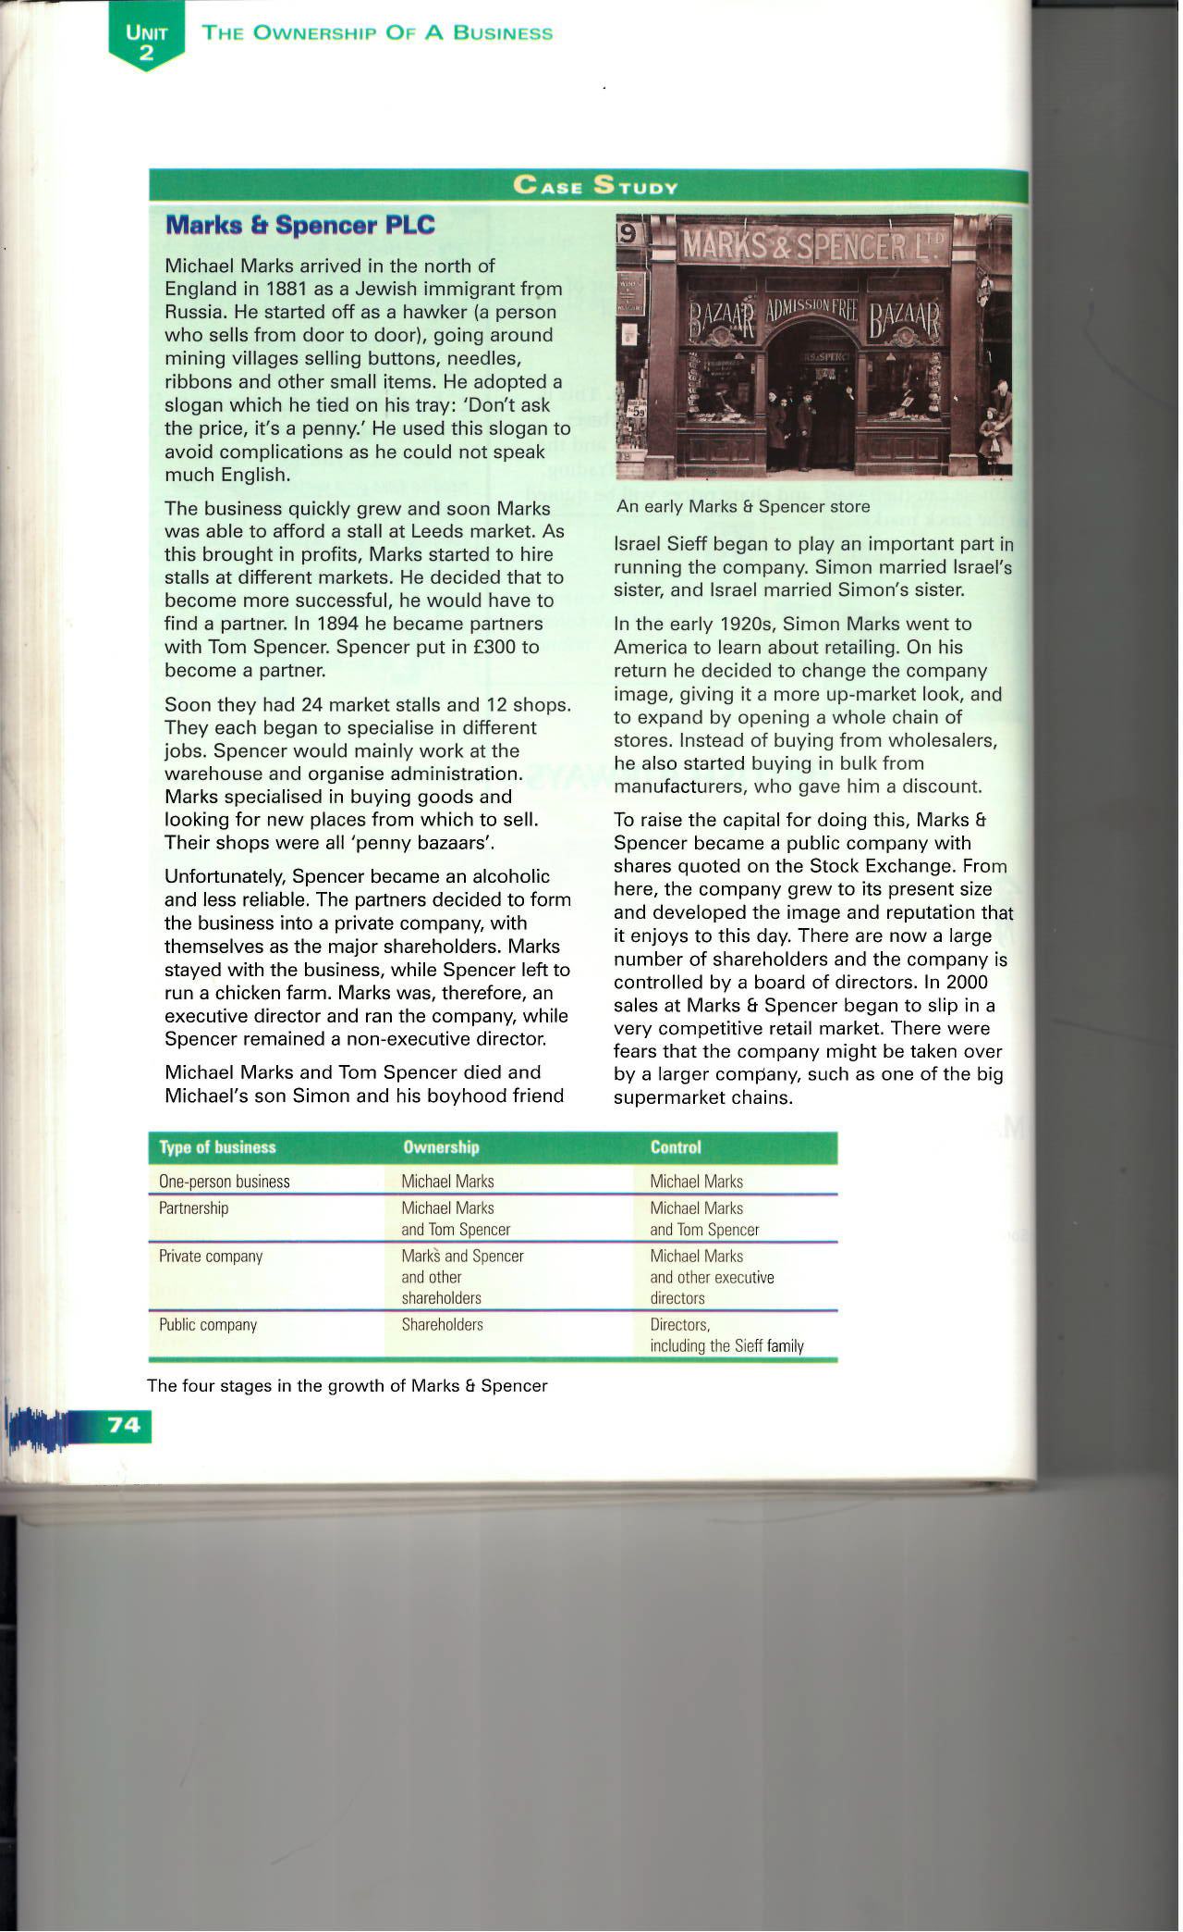

Slide 7
Reference
ONLINE RESOURCES
Entrepreneurship.org (2015) – Defining your business strategy{online} Available at: http://www.entrepreneurship.org/- accessed January 2016
Investopedia.com (2016)- Defintion Business Structures{Online} Available at http://www.investopedia.com/ - accessed January 2016
Smallbusiness.chron.com (2016)- Organisational Structures-{online} Available at http://smallbusiness.chron.com/- accesses January 8,2017
yourarticlelibrary.com (2017)- Business Function and Structure(online)
Available .yourarticlelibrary.com/ accessed January 2, 2017
LIBRARY RESOURCES
Business Studies For You 2nd edition - David Needham and Robert Dransfield (Nelson Thornes) Pages 74

