Slide 1
Human Resource Management
Unit 9 & 12
Week 8

Slide 2
Learning Outcomes:
Unit 9:
Understand the recruitment and selection process
Unit 12:
Understand employment legislation relating to the aviation industry

Slide 3
Assessment Criteria
Unit 9:
AC 3.1 – Discuss a job description and a person specification for a selected service industry job
Unit 12:
P5 – Outline current employment legislation
P6 – Explain how complying with current employment legislation impacts on the aviation industry

Slide 4
Recruitment Process
UNIT 9

Slide 5
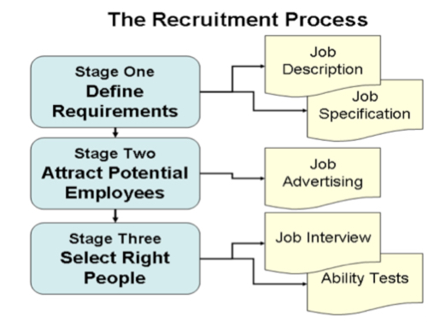

Slide 6
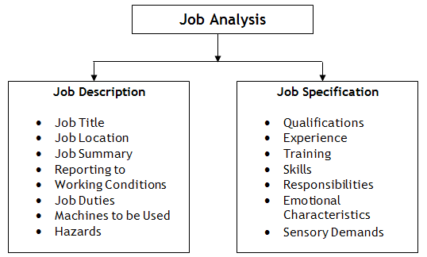

Slide 7
Job Analysis
Job analysis is the systematic study of jobs to determine what activities and responsibilities they include, their relative importance in comparison with other jobs, the personal qualifications necessary for performance of the jobs and the conditions under which the work is performed. (Jivani, 2014)

Slide 8
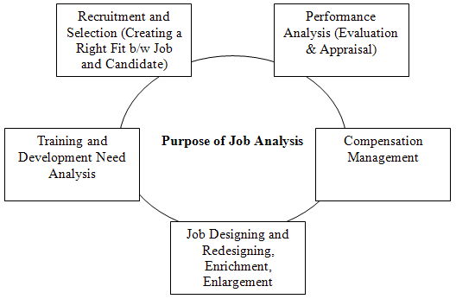
Purpose of a Job Analysis
Notes:
Recruitment and Selection: Job Analysis helps in determining what kind of person is required to perform a particular job. It points out the educational qualifications, level of experience and technical, physical, emotional and personal skills required to carry out a job in desired fashion. The objective is to fit a right person at a right place.

Slide 9
Job Description versus Job Specification
Job Description
Person/Job Specification
Outlines the primary duties and responsibilities of a given position in a company
Outlines the qualities and qualifications required of someone in the role

Slide 10
Purpose of JD
The main purpose of job description is to collect job-related data in order to advertise for a particular job. It helps in attracting, targeting, recruiting and selecting the right candidate for the right job.
It is done to determine what needs to be delivered in a particular job. It clarifies what employees are supposed to do if selected for that particular job opening.
It gives recruiting staff a clear view what kind of candidate is required by a particular department or division to perform a specific task or job.
It also clarifies who will report to whom.
(Managementstudyguide.com, 2017)

Slide 11
Purpose of Job Specification
Described on the basis of job description, job specification helps candidates analyze whether are eligible to apply for a particular job vacancy or not.
It helps recruiting team of an organization understand what level of qualifications, qualities and set of characteristics should be present in a candidate to make him or her eligible for the job opening.
Job Specification gives detailed information about any job including job responsibilities, desired technical and physical skills, conversational ability and much more.
It helps in selecting the most appropriate candidate for a particular job.
(Managementstudyguide.com, 2017)

Slide 12
Sample JD & Job Specification
http://www.sidc.lv/web.nsf/0/688EA2313661EFDFC2257766003BE480/$FILE/Restaurant%20waiter.pdf
http://www.bouncepingpong.com/sites/default/files/Bartender%20-%20Job%20Description.pdf

Slide 13
Employment Legislation (Aviation)
UNIT 12

Slide 14
Employment Legislation in Aviation
In addition to general employment legislation, the aviation industry would see added regulations of which the HRM departments must be mindful
Pre-employment checks
Training
General

Slide 15
Pre-Employment Checks
Employment History
Up to 10 years
Criminal History
Designed to uncover and criminal activities
Education History
Verification of educational and professional certification
Citizenship Verification
Citizenship & worker status verification
Watch Lists Screening
Information culled from screening is checked against various watch lists, such as terrorist, criminal and immigration

Slide 16
Training
Mandated Security Training
General Security Awareness Training (GSAT)
Manual Handling
Various licenses and certifications required for certain positions such as:
Pilot
Mechanics, etc
Notes:
Manual handling in the aviation industry presents many challenges, for example, handling of baggage into or out of an aircraft hold and using a range of equipment including belt conveyors, baggage dollies etc.

Slide 17
General
See week 5 presentation

Slide 18
References
Green, J. (2017). Cite a Website - Cite This For Me. [online] Ourpastimes.com. Available at: http://ourpastimes.com/faa-background-check-requirements-5942837.html [Accessed 6 Mar. 2017].
Jivani, S. (2014). JOB ANALYSIS, JOB DESCRIPTION AND JOB SPECIFICATION. [online] LinkedIn. Available at: https://www.linkedin.com/pulse/20140916051732-51307174-job-analysis-job-description-and-job-specification [Accessed 6 Mar. 2017].
Managementstudyguide.com. (2017). Job Description & Job Specification - Definition, Purpose, PPT. [online] Available at: http://www.managementstudyguide.com/job-description-specification.htm [Accessed 7 Mar. 2017].

