Slide 1
Human Resources Management
Units 9 & 12
Week 3

Slide 2
Learning Outcomes (LO1)
Understand Human Resources Management
Be Able to carry out recruitment for the aviation industry as part of the HR Team

Slide 3
Assessment Criteria
AC 1.2 – Justify a Human Resources plan based on an analysis of supply and demand for a selected service industry business
P3 - Plan a recruitment programme for an aviation organisation

Slide 4
AC 1.2 – Justify a Human Resources plan based on an analysis of supply and demand for a selected service industry business

Slide 6
Importance
Future Manpower Needs
Coping With Change
Recruitment Of Talented Personnel
Development Of Human Resources
(Significance Or Importance Of Human Resource Planning, 2013)

Slide 7
Gap Analysis Model
The difference between what is needed and what is available. It also represents the difference between where you are and where you want to be.
Follows a demand and supply analysis
Gap analysis involves comparing the workforce supply projection to the workforce demand forecast
Importantly you need to identify the reason for the gap.

Slide 8
Gap Analysis Model
Attempts to answer the following questions:
What new skills will the organisation need to accomplish its goals and objectives?
Does the organisation’s workforce currently have the anticipated needed skills?
What job functions or skills will no longer be required?
The organisation will establish workforce strategies based on the results of this analysis.
Analysis results may show one of the following:
A shortage - when projected supply is less than forecast demand
A surplus - when projected supply is greater than forecast demand

Slide 9
Challenges/Issues
Time
Cost
Morale
(Landers)

Slide 10
HR Action Plan
HR strategies for meeting your organization's needs in the future:
Restructuring strategies
Training and development strategies
Recruitment strategies
Outsourcing strategies
Collaboration strategies
(Hrcouncil.ca, 2017)

Slide 11
P3 - Plan a recruitment programme for an aviation organisation

Slide 12
Recruitment & Selection Process

Slide 13
Definitions
Terms that refer to the process of attracting and choosing candidates for employment. (BusinessDictionary.com, 2017)
Recruitment can be defined as searching for and obtaining a pool of potential candidates with the desired knowledge, skills and experience to allow an organisation to select the most appropriate people to fill job vacancies against defined position descriptions and specifications.
(Ahri.com.au, 2017)

Slide 14
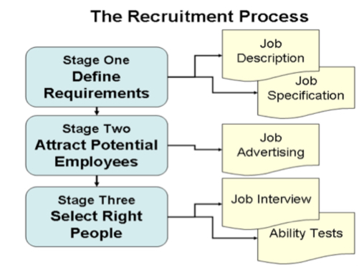

Slide 15
Recruitment Steps
1. Identify Vacancy & Evaluate Need
2. Develop Position Description
3. Develop Recruitment Plan

Slide 16
Recruitment Steps
4. Select a search Committee
5. Post Position & Implement Recruitment Plan
6. Review Applicants and Develop short list

Slide 17
Recruitment Steps
7. Conduct Interviews
8. Select Candidate
9. Finalise Recruitment

Slide 18
JDs vs Job Specification
Job Description
Job Specification
utlines the primary duties and responsibilities of a givenposition in a company
outlines the qualities and qualifications required of someone in the role

Slide 19
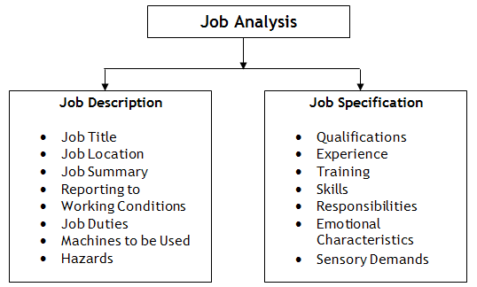

Slide 20
Recruitment Plan
Defining requirements
Allocating budget
Sourcing
Internal
External
Third Party
Screening
Assessing
Selecting
Orientation
(Ali, 2017)

Slide 21
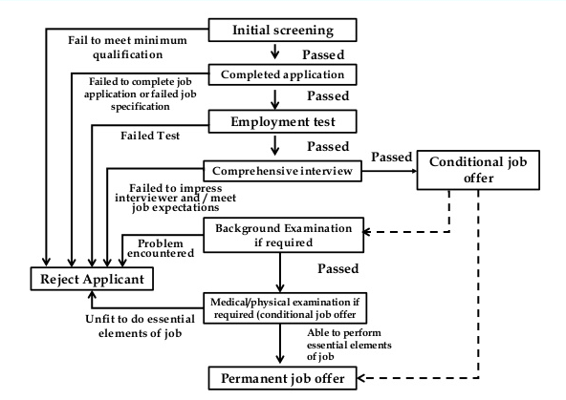
Selection Process

Slide 23
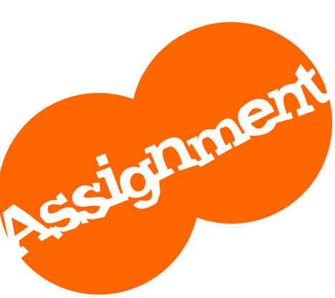

Slide 24
References
Significance Or Importance Of Human Resource Planning. (2013). [Blog] Account-Management. Available at: http://accountlearning.blogspot.com/2013/01/significance-or-importance-of-human.html [Accessed 16 Jan. 2017].
Hrcouncil.ca. (2017). Strategic HR Planning | HR Planning | HR Toolkit | hrcouncil.ca. [online] Available at: http://hrcouncil.ca/hr-toolkit/planning-strategic.cfm [Accessed 16 Jan. 2017].

Slide 25
References
Ali, V. (2017). Ensuring the Right Hire – A Recruitment Plan. [Blog] Barrett Rose & Lee Inc. Available at: http://www.barrettrose.com/ensuring-the-right-hire-steps-for-a-recruitment-plan/ [Accessed 25 Jan. 2017].
Hr.ucr.edu. (2017). Human Resources: Recruitment & Selection Hiring Process. [online] Available at: https://hr.ucr.edu/recruitment/guidelines/process.html#step3 [Accessed 25 Jan. 2017].

Slide 26
References
Landers, J. (2017). Advantages & Disadvantages of a Gap Analysis | eHow. [online] eHow. Available at: http://www.ehow.com/info_8092305_advantages-disadvantages-gap-analysis.html [Accessed 25 Jan. 2017].
Ahri.com.au. (2017). Recruitment and Selection. [online] Available at: https://www.ahri.com.au/assist/recruitment-and-selection [Accessed 25 Jan. 2017].
BusinessDictionary.com. (2017). What is recruitment and selection? definition and meaning. [online] Available at: http://www.businessdictionary.com/definition/recruitment-and-selection.html [Accessed 25 Jan. 2017].

