Slide 1
CUSTOMER SERVICE
UNIT CODE: J/601/1790

Slide 2
UNIT 3: CUSTOMER SERVICE
LEARNING OUTCOME 2: UNDERSTAND THE PURPOSE OF PROMOTING A CUSTOMER-FOCUESED CULTURE

Slide 3
THE BASIC SYLLABUS
1. UNDERSTAND CUSTOMER SERVICE POLICIES WITHIN BUSINESS AND SERVICE CONTEXTS
2. UNDERSTAND THE PURPOSE OF PROMOTING A CUSTOMER-FOCUESED CULTURE.
3.BE ABLE TO INVESTIGATE CUSTOMER REQUIREMENTS AND EXPECTATIONS
4.BE ABLE TO PROVIDE CUSTOMER SERVICE WITHIN BUSINESS AND SERVICES CONTEXTS TO MEET REQIURED STANDARDS.

Slide 4
LEARNING OUTCOMES
UNDERSTAND THE PURPOSE OF PROMOTING A CUSTOMER-FOCUESED CULTURE
AC 2. 2: ANALYZE HOW CUSTOMER PERCEPTION IS INFLUENCED BY CUSTOMER SERVICE PROVISION

Slide 5
OVERVIEW
The act of performing a task for a business or person that wants or requires it in exchange for acceptable compensation. A business that specializes in some form of service provision usually needs to have qualified staff members on hand that are regularly available to perform the services that it offers to consumers.

Slide 6
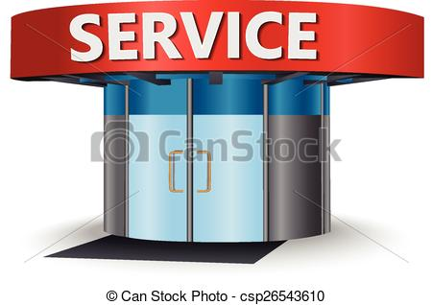
CUSTOMER SERVICE PROVISION
Customer service is the provision of service to customers before, during and after the purchase of any product. Customer service is a series of activities designed in order to enhance the experience of the customers. The sole purpose of the customer service is to meet the expectations of the customers so that they are satisfied with the outcome.

Slide 7
CUSTOMER PERCEPTION
This refers to the process by which a customer selects, organizes, and interprets information/stimuli inputs to create a meaningful picture of the brand or the product. It is a three stage process that translates raw stimuli into meaningful information. Each individual interprets the meaning of stimulus in a manner consistent with his/her own unique biases, needs and expectations. Three stages of perception are exposure, attention and interpretation.

Slide 8
CUSTOMER PERCEPTION
In simpler terms, it is how a customer see's a particular brand with whatever he or she has been able to understand by watching the products, its promotions, feedback etc. It is the image of that particular brand in the mind of the customer

Slide 9
CUSTOMER SERVICE CULTURE
Companies that are lauded for their superior customer service, you almost always find that those companies create a culture that supports excellence in customer service. It's not that they simply train their employees in customer service skills. What they do is ensure that customer service is interwoven into everything the company does. Customer service excellence simply becomes the way things are done around here.

Slide 10
CUSTOMER SERVICE CULTURE
With respect to customer service, a customer service culture involves a set of beliefs, values, and action options that are communicated to all members of the organization, so they can be used to guide and mold interactions and decision-making regarding customers.

Slide 11
CUSTOMER PERCEPTION AND QUALITY CUSTOMER SERVICE
Perceptions are always considered in relation to expectations (Zeithaml, Bitner and Gremler, 2009:87). Perceptions are formed through customers’ assessment of the quality of service provided by a company and whether they are satisfied with the overall service (Zeithaml and Bitner, 2003, p.84). (Zeithaml, Bitner and Gremler, 2009:102) Zeithaml and Bitner (2003) argue that because perceptions may shift over time and therefore it is necessary for companies to continually assess customer perceptions (Zeithaml and Bitner, 2003:85).

Slide 12
CUSTOMER PERCEPTION AND QUALITY CUSTOMER SERVICE
Customer satisfaction is the outcome felt by buyers who have experienced a company performance that has fulfilled expectations. Customers are satisfied when their expectations are met and delighted when their expectations are exceeded. Satisfied customers remain loyal longer, buy more, are less price sensitive, and talk favorably about the company.

Slide 13
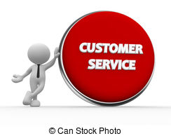
CUSTOMER PERCEPTION AND QUALITY CUSTOMER SERVICE
To create customer satisfaction, companies must manage their value chain as well as the whole value delivery system in a customer-centered way. The company’s goal is not only to get customers, but even more importantly to retain customers. Customer relationship marketing provides the key to retaining customers and involves providing financial and social benefits as well as structural ties to the customers.

Slide 14
CUSTOMER PERCEPTION AND QUALITY CUSTOMER SERVICE
Companies must decide how much relationship marketing to invest in different market segments and individual customers, from such levels as basic, reactive, accountable, proactive, and full partnership. Much depends on estimating customer lifetime value against the cost stream required to attract and retain these customers.

Slide 15
INFLUENCES OF SERVICE PROVISION ON CUSTOMER PERCEPTIONS
Quality customer service is the key element required for a successful business. In this customer driven market, where competition is becoming stiffer day by day and critical deadlines are rife, one cannot think of business growth without exceptional customer service. A number of organizations underestimate the importance of customer satisfaction, while laying the foundation of their business. They focus on the quality of services, organizational infrastructure but often overlook the fact that it is consumers who can make or break a business

Slide 16
INFLUENCES OF SERVICE PROVISION ON CUSTOMER PERCEPTIONS
Quality customer service can benefit your business in countless ways and by observing the importance of customer service you can take measures to provide your consumers with a positive experience.
The best way to promote your business products and services is word of mouth marketing.

Slide 17
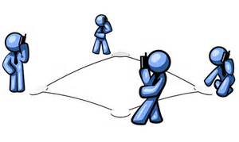
INFLUENCES OF SERVICE PROVISION ON CUSTOMER PERCEPTIONS
When customers receive satisfactory and quality services from an organization, they tend to discuss it in their social network, which leads to direct publicity and increased popularity of an organization.
Quality services can help you expand your client base but great customer service is the key to retain your clients and stand out of the crowd.

Slide 18
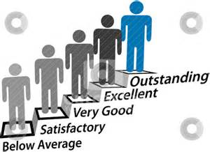
INFLUENCES OF SERVICE PROVISION ON CUSTOMER PERCEPTIONS
If your customers are happy, your investors and business partners will be happy as well, and this ultimately leads to higher profits. With a strong client base you can win the trust of investors and make the most of every viable business opportunity.

Slide 19
UNIT 7 CUSTOMER SERVICE IN THE AVATION INDUSTRY
UNIT CODE: A/504/2282
P6: COMPARE CUSTOMER SERVICE STARTGIES DEVELOPED BY AVIATION ORGANISATIONS

Slide 20
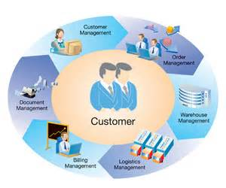
CUSTOMER SERVICE STRATEGY
A customer service strategy is an important part of any business plan. Since business relies on customer satisfaction, any good business should develop a strategy that not only draws in customers, but keeps them happy so they are not tempted to try out a competitor.

Slide 21
CUSTOMER SERVICE STRATEGY
A customer experience strategy will help achieve higher customer satisfaction, reduce churn and increase revenue. A well designed strategy starts with defining what customer experiences you want to deliver, then making sure those experiences are consistent across all channels.

Slide 22
CUSTOMER SERVICE STRATEGY
Before you can find new customers and increase sales, you need to understand who your customer is, what value proposition you offer to customers, and what your competition is currently offering in the market and where there are gaps for a new entrant.

Slide 23
UNIT 7 CUSTOMER SERVICE IN THE AVATION INDUSTRY
UNIT CODE: A/504/2282
M 1: ANALYSE HOW CUSTOMER SERVICE PROVISION IS IMPLEMENTED IN AVIATION ORGANISATIONS

Slide 24
CUSTOMER SERVICE PROVISION
Customer service is the support you offer your customers — both before and after they buy your product — that helps them have an easy and enjoyable experience with you. It’s more than just providing answers; it’s an important part of the promise your brand makes to its customers. And it’s a critical to the success of your business.
A service provision has more than one definition, depending on the context in which you use the term. In a business context, it usually refers to trading an intangible resource, such as a skill or specialized knowledge, for some form of compensation.

Slide 25
REFERENCES
Friel, David et al. "What Is Customer Service?". N.p., 2017. Web. 20 Jan. 2017.
"What Is Service Provision? Definition And Meaning". BusinessDictionary.com. N.p., 2017. Web. 20 Jan. 2017.
"Customer Perception Definition & Meaning | Marketing Dictionary | MBA Skool-Study.Learn.Share.". MBA Skool-Study.Learn.Share.. N.p., 2017. Web. 20 Jan. 2017
"What Is A Customer Service Culture?". Customerservicezone.com. N.p., 2017. Web. 23 Jan. 2017.
Agabu Phiri, Maxwell and Thobeleni Mcwabe Mcwabe. "CUSTOMERS’ EXPECTATIONS AND PERCEPTIONS OF SERVICE QUALITY: THE CASE OF PICK N PAY SUPERMARKET STORES IN PIETERMARITZBURG AREA, SOUTH AFRICA". International Journal of Research In Social Sciences 3.1 (2013): n. pag. Web. 23 Jan. 2017.

Slide 26
REFERENCES
"Chapter 3—Building Customer Satisfaction, Value, And Retention". Ruby.fgcu.edu. N.p., 2017. Web. 23 Jan. 2017.
Estep, Meredith. "Top 10 Benefits Of Quality Customer Service". Unitiv.com. N.p., 2017. Web. 23 Jan. 2017.
Harris, David. "Definition Of A Customer Service Strategy | Ehow". eHow. N.p., 2017. Web. 23 Jan. 2017.
Beard, Ross. "5 Customer Experience Strategies That Work". Client Heartbeat Blog. N.p., 2017. Web. 24 Jan. 2017.
"How To Find New Customers And Increase Sales". Inc.com. N.p., 2017. Web. 24 Jan. 2017.

Slide 27
REFERENCES
Schieltz, Matthew and Matthew Schieltz. "How To Develop A Customer Service Model | Ehow". eHow. N.p., 2017. Web. 24 Jan. 2017.
"3 Customer Service Models For Success". Rabidofficemonkey.com. N.p., 2017. Web. 24 Jan. 2017.
Center, Success, What important?), and Salesforce Desk.com. "What Is Customer Service? (And Why Is It Important?) | Desk.Com". Desk.com. N.p., 2017. Web. 28 Jan. 2017.
Lohrey, Jackie and Jackie Lohrey. "Definition Of Service Provision | Ehow". eHow. N.p., 2017. Web. 28 Jan. 2017.

