Slide 1
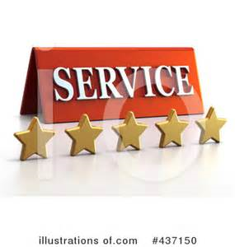
CUSTOMER SERVICE
UNIT CODE: J/601/1790

Slide 2
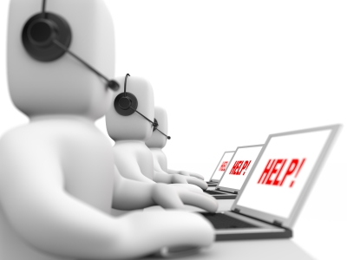
UNIT 3: CUSTOMER SERVICE
LEARNING OUTCOME 3: BE ABLE TO INVESTIGATE CUSTOMER REQUIREMENTS AND EXPECTATIONS

Slide 3
THE BASIC SYLLABUS
1. UNDERSTAND CUSTOMER SERVICE POLICIES WITHIN BUSINESS AND SERVICE CONTEXTS
2. UNDERSTAND THE PURPOSE OF PROMOTING A CUSTOMER-FOCUSED CULTURE.
3.BE ABLE TO INVESTIGATE CUSTOMER REQUIREMENTS AND EXPECTATIONS
4.BE ABLE TO PROVIDE CUSTOMER SERVICE WITHIN BUSINESS AND SERVICES CONTEXTS TO MEET REQUIRED STANDARDS.

Slide 4
LEARNING OUTCOMES
BE ABLE TO INVESTIGATE CUSTOMER REQUIREMENTS AND EXPECTATIONS
AC 3.2: Carry out research on customer requirements and satisfaction levels for a selected business, suggesting potential improvements

Slide 5
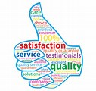
OVERVIEW
Customer satisfaction surveys are a form of research in which you ask your customers for their views on issues that indicate how well or how badly your company is performing. Satisfaction surveys are a valuable tool for businesses, helping you gain a better understanding of your customers' requirements and concerns so that you improve your products and your standards of service in line with customers' needs.

Slide 6
RESEARCH ABOUT CUSTOMER REQUIREMENTS AND SATISFACTION LEVEL
Understanding what customers really want and how their needs, requirements, and attitudes change over time will require a combination of discipline, persistence, creativity, sensitivity, science, and, sometimes, luck.
The Six Sigma activity includes a strategy and system for continually tracking and updating customer requirements, competitor activities, market changes, etc. aka, a Voice of the Customer (VOC) system.

Slide 7
RESEARCH ABOUT CUSTOMER REQUIREMENTS AND SATISFACTION LEVEL
A description of specific, measurable performance standards for each key output, as defined by the Customer(s):
-Observable and (if possible) measurable service standards for key interfaces with Customers.
-An analysis of performance and service standards based on their relative importance to customers and customer segments and their impact on business strategy.

Slide 8
RESEARCH ABOUT CUSTOMER REQUIREMENTS AND SATISFACTION LEVEL
The tasks you must undertake to develop these deliverables are shown in the figure on the next slide achieving the first task, an ongoing customer feedback system, is really a long-term goal. In the initial stages of a Six Sigma effort you are likely to focus on high-priority input from customers rather than revamp your entire customer-monitoring effort. Because the ability to really listen to the customer is becoming so critical to business success, however, begin with that major initiative.

Slide 9
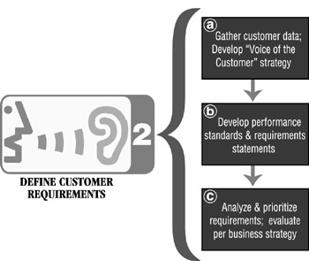
RESEARCH ABOUT CUSTOMER REQUIREMENTS AND SATISFACTION LEVEL

Slide 10
RESEARCH ABOUT CUSTOMER REQUIREMENTS AND SATISFACTION LEVEL
A great way to gather feedback is to conduct customer satisfaction surveys. They can provide tremendous insights into which products and services are making your customers happy, which ones are hurting your bottom line, and which ones you should look into developing further.

Slide 11
RESEARCH ABOUT CUSTOMER REQUIREMENTS
They’re also a great way to show customers that you value their opinion and want to do everything possible to improve their experience. In that sense, conducting customer satisfaction surveys can actually increase customer satisfaction. After all, every person appreciates being listened to.

Slide 12
RESEARCH ABOUT CUSTOMER REQUIREMENTS
Primary Research: The goal of primary research is to gather data from analyzing current sales and the effectiveness of current practices. Primary research also takes competitors' plans into account, giving you information about your competition.

Slide 13
RESEARCH ABOUT CUSTOMER REQUIREMENTS
Secondary Research: The goal of secondary research is to analyze data that has already been published. With secondary data, you can identify competitors, establish benchmarks and identify target segments.

Slide 14
RESEARCH ABOUT CUSTOMER REQUIREMENTS
Your segments are the people who fall into your targeted demographic--people who live a certain lifestyle, exhibit particular behavioural patterns or fall into a predetermined age group.

Slide 15
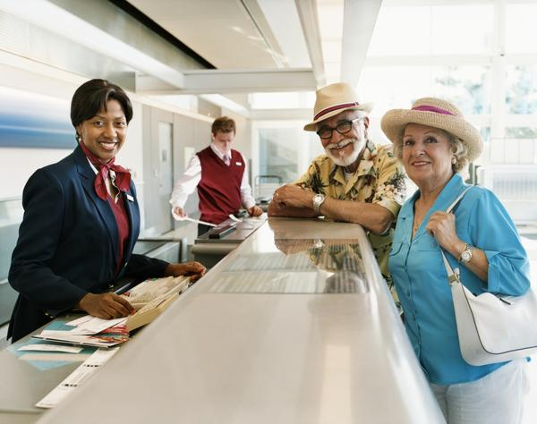
UNIT 7 CUSTOMER SERVICE IN THE AVIATION INDUSTRY
DI : EVALUATE HOW CUSTOMER SERVICE MODELS AND STRATEGIES CONTRIBUTE TO THE DELIVERY OF EFFECTIVE CUSTOMER SERVICE

Slide 16
CUSTOMER SERVICE MODELS
It’s a simple and well-known fact: companies can be built or broken by their customer service models. If a customer has a terrible experience that is not properly remedied, he or she will unlikely return. This unhappy person will probably share details of the experience with friends and family members.
At the same time, if an experience is overwhelmingly positive, the customer will likely become a loyal one that returns time and time again.
A customer service strategy is an important part of any business plan. Since business relies on customer satisfaction, any good business should develop a strategy that not only draws in customers, but keeps them happy so they are not tempted to try out a competitor.

Slide 17
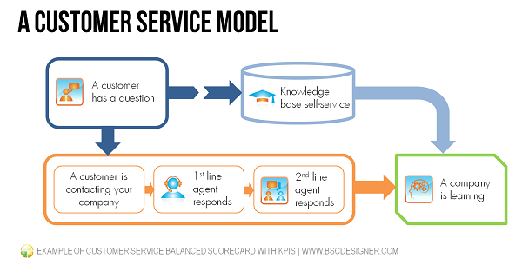

Slide 18
CUSTOMER EXPECTATIONS
Customer expectations refers to the perceived value or benefits that the customers seek when purchasing a good or availing a service. They are the result of the ‘learning’ process and can be formed very quickly because even first impressions matter a lot. Once established, these expectations can hold significant influence in decision-making processes and can be very hard to change.

Slide 19
CUSTOMER EXPECTATIONS
Airline customers have raised their expectations around seating packages, staff interactions, priority treatment, requiring airlines to think more like retailers and less like a mode of transportation amid rising operating costs. Faced with rising operating costs, evolving customer needs and global challenges, the Airline industry offers a great learning place for other industries.

Slide 20
CUSTOMER EXPECTATIONS
On and off the runway, customers are pushing airlines to think more like retailers and less like a mode of transportation. Expectations around seating packages, interactions with staff and priority treatment are some of the experiences that matter to customers.

Slide 21
MEETING CUSTOMER NEEDS
Understanding customer needs will help you define new market opportunities and drive → innovation and → revenue growth in every aspect of your organization.
In the → new rapidly changing economy, however, customer predictability is dead.

Slide 22
MEETING CUSTOMER NEEDS
"Whatever a customer wants today may not be what he or she wants tomorrow. Or he or she may want more of it. If you're offering low prices, customers want those prices slashed further. If you're offering state-of-the art products, they want them newer still.

Slide 23
MEETING CUSTOMER NEEDS
In meeting ever-increasing customer demands for lower, faster, better, and newer, companies are driving themselves and their competitors to the brink.
You can't predict the future, but by establishing effective → change management practices you can be ready for whatever it brings.

Slide 24
MEASURING AND IMPROVING CUSTOMER SERVICE
The quality of your customer service is an increasingly important factor in nurturing positive customer loyalty. However, it remains the case that many organisations are still not monitoring, measuring or even managing the service quality of their contact centre agents, despite the fact that a single interaction between them and the customer can make or break a relationship.

Slide 25
MEASURING AND IMPROVING CUSTOMER SERVICE
As a managerial procedure of continues improvement(CI), lean-six-sigma is considered a process that can improve services or products continuously in order to achieve high product/service quality, competitive costs and reduced delivery times, leading to the satisfaction of customers . The aviation industry nowadays requires continuous improvement to raise the levels of customers’ satisfaction. This satisfaction can be achieved through many managerial procedures (such as lean-six-sigma procedures), in order to ensure the business’s viability.

Slide 26
REFERENCES
"Benefits Of A Customer Satisfaction Survey". Smallbusiness.chron.com. N.p., 2017. Web. 13 Feb. 2017.
Deren, Rafal et al. "Customer Satisfaction Surveys: Before You Start - Fluidsurveys". FluidSurveys. N.p., 2017. Web. 13 Feb. 2017.
"Chapter 13: Defining Customer Requirements (Roadmap Step 2) | Engineering360". Globalspec.com. N.p., 2017. Web. 13 Feb. 2017.
Pyle, Lesley and Read more. "How To Do Market Research--The Basics". Entrepreneur. N.p., 2017. Web. 13 Feb. 2017.
Savkin, Aleksey and Aleksey Savkin. "Example Of Customer Service Balanced Scorecard With Kpis". Balanced Scorecard Software - BSC Designer. N.p., 2017. Web. 14 Feb. 2017.

Slide 27
REFERENCES
"3 Customer Service Models For Success". Rabid Office Monkey for Business. N.p., 2017. Web. 14 Feb. 2017.
Harris, David. "Definition Of A Customer Service Strategy | Ehow". eHow. N.p., 2017. Web. 14 Feb. 2017.
"Customer Expectations Definition | Marketing Dictionary | MBA Skool-Study.Learn.Share.". MBA Skool-Study.Learn.Share.. N.p., 2017. Web. 14 Feb. 2017.
"Experience Radar: Lessons Learned From The Airline Industry". PwC. N.p., 2017. Web. 14 Feb. 2017.
"KNOWING YOUR CUSTOMER - Understanding Customer Needs And Defining New Market Opportunities". 1000ventures.com. N.p., 2017. Web. 15 Feb. 2017.

Slide 28
REFERENCES
"Six Steps To Successful Monitoring Of Your Customer Service". MyCustomer. N.p., 2017. Web. 17 Feb. 2017.
http://waset.org/publications/9997202/using-lean-six-sigma-in-the-improvement-of-service-quality-at-aviation-industry-case-study-at-the-departure-area-in-kkiaWeb. 17 Feb. 2017.

