Slide 1
CUSTOMER SERVICE
UNIT CODE: J/601/1790

Slide 2
UNIT 3: CUSTOMER SERVICE
LEARNING OUTCOME 4: BE ABLE TO PROVIDE CUSTOMER SERVICE WITHIN BUSINESS AND SERVICES CONTEXTS TO MEET REQUIRED STANDARDS.

Slide 3
THE BASIC SYLLABUS
1. UNDERSTAND CUSTOMER SERVICE POLICIES WITHIN BUSINESS AND SERVICE CONTEXTS
2. UNDERSTAND THE PURPOSE OF PROMOTING A CUSTOMER-FOCUSED CULTURE.
3.BE ABLE TO INVESTIGATE CUSTOMER REQUIREMENTS AND EXPECTATIONS
4.BE ABLE TO PROVIDE CUSTOMER SERVICE WITHIN BUSINESS AND SERVICES CONTEXTS TO MEET REQUIRED STANDARDS.

Slide 4
LEARNING OUTCOMES
BE ABLE TO PROVIDE CUSTOMER SERVICE WITHIN BUSINESS AND SERVICES CONTEXTS TO MEET REQUIRED STANDARDS
AC 4.2: REVIEW OWN PERFORMANCE IN THE DELIVERY OF CUSTOMER SERVICE AND MAKE RECOMMENDATIONS FOR IMPROVEMENT

Slide 5
OVERVIEW
Understanding the various types of customers that you may encounter while attempting to sell products or services is an important part of the marketing process.

Slide 6
TYPES OF CUSTOMERS
Customers play the most significant part in business. In fact the customer is the actual boss in a deal and is responsible for the actually profit for the organization. Customer is the one who uses the products and services and judges the quality of those products and services.

Slide 7
TYPES OF CUSTOMERS
Hence it’s important for an organization to retain customers or make new customers and flourish business. To manage customers, organizations should follow some sort of approaches like segmentation or division of customers into groups because each customer has to be considered valuable and profitable.

Slide 8
TYPES OF CUSTOMERS
Creating a product or service that appeals to customers in different age groups can expand your sales and profits, but it also can create brand-management problems.

Slide 9
TYPES OF CUSTOMERS
When customers see different messages about a business, including who the company is trying to serve, buyers might look for someone else who better caters to their unique needs.

Slide 10
TYPES OF CUSTOMERS
Understanding some basics for marketing to different age groups will help you maximize sales without damaging your brand.

Slide 11
TYPES OF CUSTOMERS

Slide 12
TYPES OF CUSTOMERS
Elderly customers are not easily satisfied. It takes a long time to materialize a sale. Therefore, the salesman should appreciate their wisdom and experience. He should give much respect to them and may seek their advice only to satisfy their ego. If time permits, the salesman should stretch his sales talk by explaining every details of the product to be sold.

Slide 13
TYPES OF CUSTOMERS
It's important for companies that want to grow to be able to provide customer service that meets the needs of a multicultural customer base. Whether that means understanding the varied cultural backgrounds of customers or providing customer service in different languages depends on what you sell and who your customer is.

Slide 14
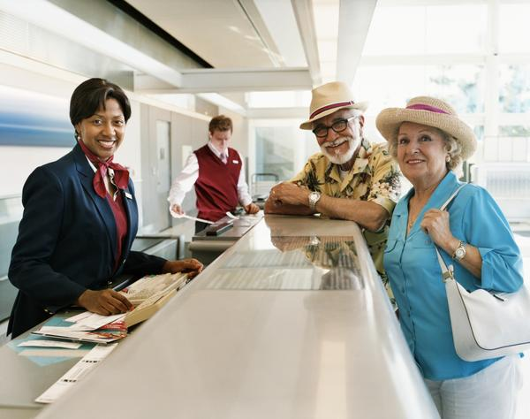
UNIT 7 CUSTOMER SERVICE IN THE AVATION INDUSTRY
P 9: DEMONSTARTE EFFECTIVE CUSTOMER SERVICE SKILLS IN ROUTINE AND NON ROUTINE SITUATIONS

Slide 15
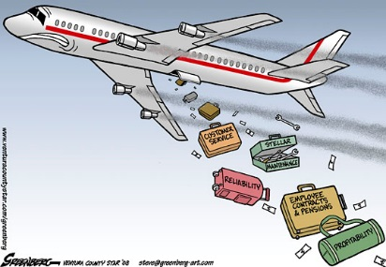
BARRIERS TO COMMUNICATION
There are many reasons why interpersonal communications may fail. In many communications, the message (what is said) may not be received exactly the way the sender intended. It is, therefore, important that the communicator seeks feedback to check that their message is clearly understood.

Slide 16
BARRIERS TO COMMUNICATION
There are several barriers that affects the flow of communication in an organization. These barriers interrupt the flow of communication from the sender to the reciever, thus making communication ineffective. It is essential for managers to overcome these barriers. The main barriers of communication are summarized below.

Slide 17
BARRIERS TO COMMUNICATION
Barriers to Communication:
-Cultural differences. The norms of social interaction vary greatly in different cultures, as do the way in which emotions are expressed. For example, the concept of personal space varies between cultures and between different social settings.
-Language differences and the difficulty in understanding unfamiliar accents.
-Emotions: Emotional state at a particular point of time also affects communication. If the receiver feels that communicator is angry he interprets that the information being sent is very bad. While he takes it differently if the communicator is happy and jovial (in that case the message is interpreted to be good and interesting).

Slide 18
BARRIERS TO COMMUNICATION
Barriers to Communication:
-Emotional – Trouble listening can occur if one is consumed with emotion. Hostility, anger, fear, and other emotions make it hard to hear outside of one’s self.
The major environmental / physical are Time, Place, Space, Climate and Noise. Some of them are easy to alter whereas, some may prove to be tough obstacles in the process of effective communication. These factors may just cause distraction leading to inattentiveness or totally alter the message, causing miscommunication.

Slide 19
BARRIERS TO COMMUNICATION
Barriers to Communication:
-Interpersonal are what ultimately keep us from reaching out to each other and opening ourselves up, not just to be heard, but to hear others. Oddly enough, this can be the most difficult area to change. Some people spend their entire lives attempting to overcome a poor self-image or a series of deeply rooted prejudices about their place in the world. They are unable to form genuine connections with people because they have too many false perceptions blocking the way.

Slide 20
REFERENCES
"What Are The Five Types Of Customer Segmentation?". Smallbusiness.chron.com. N.p., 2017. Web. 22 Mar. 2017.
"Different Types Of Customers". Managementstudyguide.com. N.p., 2017. Web. 22 Mar. 2017.
"How To Appeal To Customers Of Different Ages". Smallbusiness.chron.com. N.p., 2017. Web. 22 Mar. 2017.
"Cite A Website - Cite This For Me". Mobygames.com. N.p., 2017. Web. 23 Mar. 2017.
Khanna, Vikrant. "How A Salesman Should Deal With Elderly Customers ?". Preservearticles.com. N.p., 2017. Web. 23 Mar. 2017.

Slide 21
REFERENCES
Service, The. "The Importance Of Multi-Cultural Customer Service". Business News Daily. N.p., 2017. Web. 23 Mar. 2017.
2011-2017, (c). "Barriers To Effective Communication | Skillsyouneed". Skillsyouneed.com. N.p., 2017. Web. 23 Mar. 2017.
"Communication Barriers - Reasons For Communication Breakdown". Managementstudyguide.com. N.p., 2017. Web. 23 Mar. 2017.
"Barriers To Communication". Communication Studies. N.p., 2017. Web. 23 Mar. 2017.
"Physical/Environmental Barriers". Communication Theory. N.p., 2017. Web. 23 Mar. 2017.
"The Seven Barriers Of Communication". Guides. N.p., 2017. Web. 23 Mar. 2017.

