Slide 1
CUSTOMER SERVICE
UNIT CODE: J/601/1790

Slide 2
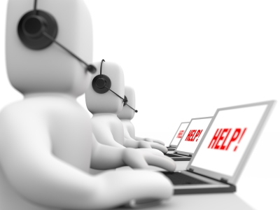
UNIT 3: CUSTOMER SERVICE
LEARNING OUTCOME 4: BE ABLE TO PROVIDE CUSTOMER SERVICE WITHIN BUSINESS AND SERVICES CONTEXTS TO MEET REQUIRED STANDARDS.

Slide 3
THE BASIC SYLLABUS
1. UNDERSTAND CUSTOMER SERVICE POLICIES WITHIN BUSINESS AND SERVICE CONTEXTS
2. UNDERSTAND THE PURPOSE OF PROMOTING A CUSTOMER-FOCUSED CULTURE.
3.BE ABLE TO INVESTIGATE CUSTOMER REQUIREMENTS AND EXPECTATIONS
4.BE ABLE TO PROVIDE CUSTOMER SERVICE WITHIN BUSINESS AND SERVICES CONTEXTS TO MEET REQUIRED STANDARDS.

Slide 4
LEARNING OUTCOMES
BE ABLE TO PROVIDE CUSTOMER SERVICE WITHIN BUSINESS AND SERVICES CONTEXTS TO MEET REQUIRED STANDARDS
AC 4.2: REVIEW OWN PERFORMANCE IN THE DELIVERY OF CUSTOMER SERVICE AND MAKE RECOMMENDATIONS FOR IMPROVEMENT

Slide 5
OVERVIEW
Organizations should follow some sort of approaches like segmentation or division of customers into groups because each customer has to be considered valuable and profitable.

Slide 6
TYPES OF CUSTOMERS
A customer service representative, will have opportunities to work with disabled customers. Not all disabilities are obvious. Any customer may have a disability, even customers with no outward signs of injury or impairment.

Slide 7
TYPES OF CUSTOMERS
And even those customers will obvious disabilities may not want to be coddled and could become offended if you rush to their aid or patronize them.

Slide 8
TYPES OF CUSTOMERS
When assisting a disabled person, ask yourself the following three questions:

Slide 9
TYPES OF CUSTOMERS
-Does the customer need assistance? For example, is anything obstructing the customer’s view, mobility or access to a product?

Slide 10
TYPES OF CUSTOMERS
Can I improve things right now? Do you have the ability or authority to better the customer’s experience (e.g., move products positioned high on a shelf down so that a customer in a wheelchair can more easily see them)?

Slide 11
TYPES OF CUSTOMERS
Is this a more substantial issue that I should share with my boss? For example, if you are unable to communicate with hearing impaired customers, perhaps it’s time for at least one rep to receive training in sign language, and you’ll need to discuss that with your boss.

Slide 12
TYPES OF CUSTOMERS
It seems self evident that companies should try to satisfy their customers. Satisfied customers usually return and buy more, they tell other people about their experiences, and they may well pay a premium for the privilege of doing business with a supplier they trust.

Slide 13
TYPES OF CUSTOMERS
Statistics are bandied around that suggest that the cost of keeping a customer is only one tenth of winning a new one. Therefore, when we win a customer, we should hang on to them.

Slide 14
TYPES OF CUSTOMERS
A dissatisfied customer is one who feels a business did not provide a product or service as expected. Dissatisfied customers' emotions tend to be short-lived and result in passive, if any, action, such as not returning to the business.

Slide 15
TYPES OF CUSTOMERS
Some jobs, such as bartending, and other hospitality professions can involve dealing with customers impaired, usually by alcohol, by sometimes due to drug use, or due to some mental or emotional instability.

Slide 16
TYPES OF CUSTOMERS
These situations are amongst the most challenging, and they aren't limited to staff that work where liquor is sold. One never knows when one will be faced by an intoxicated person who is also a customer.

Slide 17
TYPES OF CUSTOMERS
Guidelines To Follow:
-The goal changes to one of safety, for the customer service rep, for other customers, AND for the impaired person. So, safety first.

Slide 18
TYPES OF CUSTOMERS
Remember that by definition impaired customers aren't exercising good judgment. Even faced with three or four staff members, an intoxicated customer may want to take "everyone on". When in doubt, contact the police.

Slide 19
TYPES OF CUSTOMERS
Don't argue with drunk patrons. Again, their thinking is impaired, and not only are they not interested in what you have to say, they can't process it rationally. Speak calmly, and in a straight-forward and non-aggressive tone.

Slide 20
TYPES OF CUSTOMERS
There is NO magic universal solution to dealing with impaired customers. Do not try to deal with aggressive drunks on your own. If necessary, exit the situation until help is available. This applies even if you are much larger, or stronger. Don't get sucked into making ANY physical contact until help is available.

Slide 21
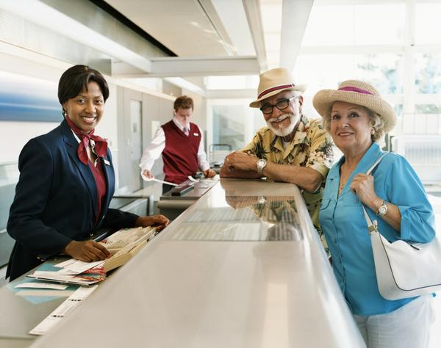
UNIT 7 CUSTOMER SERVICE IN THE AVATION INDUSTRY
P 9: DEMONSTRATE EFFECTIVE CUSTOMER SERVICE SKILLS IN ROUTINE AND NON ROUTINE SITUATIONS

Slide 22
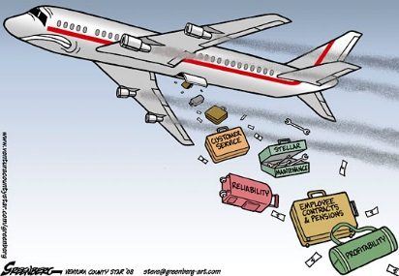
METHODS TO OVERCOME BARRIERS TO COMMUNICATION
There are many barriers to communication and these may occur at any stage in the communication process. Barriers may lead to your message becoming distorted and you therefore risk wasting both time and/or money by causing confusion and misunderstanding. Effective communication involves overcoming these barriers and conveying a clear and concise message.

Slide 23
METHODS TO OVERCOME BARRIERS TO COMMUNICATION
The following seven ways can be use to overcome the barriers to communication:
1) Understand others see things differently to you.
2) Get feedback from the receiver.
3) As often as possible, speak face-to-face.

Slide 24
METHODS TO OVERCOME BARRIERS TO COMMUNICATION
4) Use language that fits the audience
5) Use the right communication channel.
6) Have integrity and honesty in your communications
7) Make it easy for others to listen to you

Slide 25
REFERENCES
“Different Types Of Customers". Managementstudyguide.com. N.p., 2017. Web. 27 Mar. 2017.
Columbia Books, LLC. "Assisting Disabled Customers". Workplace Survival. N.p., 2017. Web. 28 Mar. 2017.
"What Is The Difference Between A Dissatisfied Customer & An Angry Customer?". Smallbusiness.chron.com. N.p., 2017. Web. 28 Mar. 2017.
"Customer Satisfaction Survey: How To Measure Satisfaction". B2B International. N.p., 2017. Web. 28 Mar. 2017.
"Impaired Customers: What To Do?". Customerservicezone.com. N.p., 2017. Web. 28 Mar. 2017.

Slide 26
REFERENCES
2011-2017, (c). "Barriers To Effective Communication | Skillsyouneed". Skillsyouneed.com. N.p., 2017. Web. 28 Mar. 2017.
http://www.mtdtraining.com/blog/7-ways-to-overcome-barriers-to-communication.htm

