Slide 1
CUSTOMER SERVICE
UNIT CODE: J/601/1790

Slide 2
UNIT 3: CUSTOMER SERVICE
LEARNING OUTCOME 4: BE ABLE TO PROVIDE CUSTOMER SERVICE WITHIN BUSINESS AND SERVICES CONTEXTS TO MEET REQUIRED STANDARDS.

Slide 3
THE BASIC SYLLABUS
1. UNDERSTAND CUSTOMER SERVICE POLICIES WITHIN BUSINESS AND SERVICE CONTEXTS
2. UNDERSTAND THE PURPOSE OF PROMOTING A CUSTOMER-FOCUSED CULTURE.
3.BE ABLE TO INVESTIGATE CUSTOMER REQUIREMENTS AND EXPECTATIONS
4.BE ABLE TO PROVIDE CUSTOMER SERVICE WITHIN BUSINESS AND SERVICES CONTEXTS TO MEET REQUIRED STANDARDS.

Slide 4
LEARNING OUTCOMES
BE ABLE TO PROVIDE CUSTOMER SERVICE WITHIN BUSINESS AND SERVICES CONTEXTS TO MEET REQUIRED STANDARDS
AC 4.1:DELIVER CUSTOMER SERVICE IN A BUSINESS AND SERVICE ENVIRONMENT

Slide 5
OVERVIEW
Customer service has an impact on both existing customers and potential customers. However, there is great value in ensuring you deliver a positive customer service. Business should be built around how to deliver excellent customer service. It’s easy to forget its importance when you are building your brand’s web presence and marketing your website.

Slide 6
DELIVER CUSTOMER SERVICE IN A BUSINESS AND SERVICE ENVIRONMENT
Too many companies don't understand that while delivering excellent customer service is one of the key ingredients for repeat business, it's that special personal relationship with one customer and one associate that provides the link between customer satisfaction and customer retention. The service delivered by frontline associates must be viewed as the first step in the journey of loyalty.

Slide 7
DELIVER CUSTOMER SERVICE IN A BUSINESS AND SERVICE ENVIRONMENT
Ten tips for delivering customer service in a business environment:
1. Make sure that every one of your frontline associates is capable of making a good first impression.
2. Show appreciation to your customers. Thanking customers in a meaningful and thoughtful manner on every customer/frontline encounter shows customers you care and appreciate their business.

Slide 8
DELIVER CUSTOMER SERVICE IN A BUSINESS AND SERVICE ENVIRONMENT
3. Review your letters and email communications to ensure that they sound welcoming, personalized and make your customers feel important and appreciated.
4. Create a culture whereby your associates are treated as family and neighbors and they will, in turn, treat your customers the same way. Customers notice and appreciate when a company appreciates their associates.

Slide 9
DELIVER CUSTOMER SERVICE IN A BUSINESS AND SERVICE ENVIRONMENT
5.Answer questions from customers by not only responding to their direct inquiry, but by providing them with additional useful information. Customers often enjoy learning more about a potential purchase than what's written on a tag or in a brochure.
6. Understand that the underlying ingredient of customer service is helping people.

Slide 10
DELIVER CUSTOMER SERVICE IN A BUSINESS AND SERVICE ENVIRONMENT
7.Getting a big, warm hello can go a long way in giving a customer the feeling of "Hey, this company is really happy to see me.“
8. Leverage the return counter in a retail store environment to make customers feel comfortable about returning an item and offering special attention to help them find what they need. Make the return process an enjoyable and nondefensive process.

Slide 11
DELIVER CUSTOMER SERVICE IN A BUSINESS AND SERVICE ENVIRONMENT
9. Listen to customer comments such as, "This is the first time I used your site," "I just moved into the neighborhood," "I just happened to stop by," and take those opportunities to engage the customer to build a relationship and lifetime of loyalty.
10. 0. Make sure you thank your employees and reward them appropriately. -

Slide 12
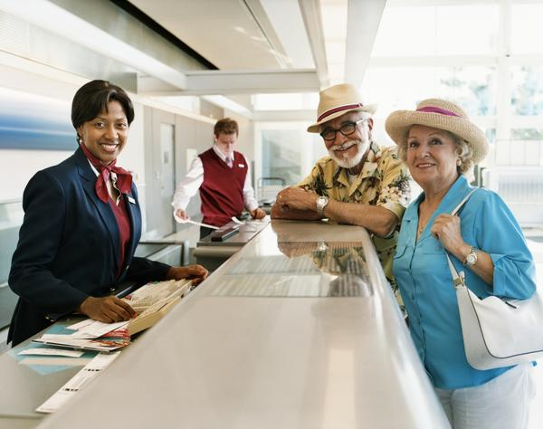
UNIT 7 CUSTOMER SERVICE IN THE AVATION INDUSTRY
P9: DEMONSTRATE EFFECTIVE CUSTOMER SERVICE SKILLS IN ROUTINE AND NON-ROUTINE SITUATIONS

Slide 13
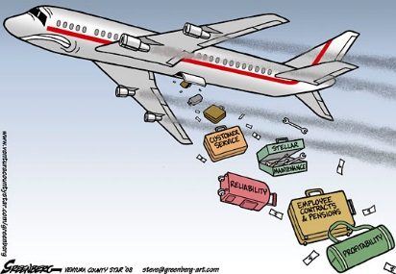
CUSTOMER SERVICE ROUTINE SITUATIONS
A customer service representative interacts with a company’s customers to provide them with information to address inquiries regarding products and services. In addition, they deal with and help resolve any customer complaints.

Slide 14
REFERENCES
"Five Ways To Deliver Excellent Customer Service". CRM Blog: Articles, Tips and Strategies by SuperOffice. N.p., 2017. Web. 23 Feb. 2017.
Service, 10. "10 Ways To Deliver Great Customer Service". Business News Daily. N.p., 2017. Web. 24 Feb. 2017.
"Duties & Responsibilities Of A Customer Service Representative". Smallbusiness.chron.com. N.p., 2017. Web. 24 Feb. 2017.

