Slide 1
CUSTOMER SERVICE
UNIT CODE: J/601/1790

Slide 2
UNIT 3: CUSTOMER SERVICE
LEARNING OUTCOME 4: BE ABLE TO PROVIDE CUSTOMER SERVICE WITHIN BUSINESS AND SERVICES CONTEXTS TO MEET REQUIRED STANDARDS.

Slide 3
THE BASIC SYLLABUS
1. UNDERSTAND CUSTOMER SERVICE POLICIES WITHIN BUSINESS AND SERVICE CONTEXTS
2. UNDERSTAND THE PURPOSE OF PROMOTING A CUSTOMER-FOCUSED CULTURE.
3.BE ABLE TO INVESTIGATE CUSTOMER REQUIREMENTS AND EXPECTATIONS
4.BE ABLE TO PROVIDE CUSTOMER SERVICE WITHIN BUSINESS AND SERVICES CONTEXTS TO MEET REQUIRED STANDARDS.

Slide 4
LEARNING OUTCOMES
BE ABLE TO PROVIDE CUSTOMER SERVICE WITHIN BUSINESS AND SERVICES CONTEXTS TO MEET REQUIRED STANDARDS
AC 4.1:DELIVER CUSTOMER SERVICE IN A BUSINESS AND SERVICE ENVIRONMENT

Slide 5
OVERVIEW
Customer Service Delivery taps into business, marketing, and psychological research and practices to provide a wealth of knowledge about customer service. With contributions from some of the best-known industrial and organizational psychology experts in customer service.

Slide 6
DELIVER CUSTOMER SERVICE IN A BUSINESS AND SERVICE ENVIRONMENT
Customer Service Delivery also provides a framework for customer service as a process and an outcome. The authors address a wide range of topics that are crucial to today’s competitive business environment: customer expectations, loyalty satisfaction, product versus service delivery, measurement, brand equity, regional and cultural differences, and organizational impact.

Slide 7
DELIVER CUSTOMER SERVICE IN A BUSINESS AND SERVICE ENVIRONMENT
Customer Service Delivery explores human resource staffing practices and service delivery by including proven selection strategies for hiring top quality service workers, an analysis of the personality correlates of service performance, and a comprehensive review of assessment instruments that predict customer service performance.

Slide 8
DELIVER CUSTOMER SERVICE IN A BUSINESS AND SERVICE ENVIRONMENT
Great service feels like a gift. It makes us want to continue to do business with an organization over the long haul. And that alone is the secret to business success – retaining customers by providing great customer service. With so much competition out there, customer loyalty is the single most important attribute your business can have.

Slide 9
DELIVER CUSTOMER SERVICE IN A BUSINESS AND SERVICE ENVIRONMENT
You achieve loyalty by doing “the little things” that make customers want to deal with you again and again and recommend you to their friends. The real difference is how a business makes their customers feel. If customers feel valued, most will remain loyal. If they feel under-valued, sooner or later they will defect to a competitor.

Slide 10
DELIVER CUSTOMER SERVICE IN A BUSINESS AND SERVICE ENVIRONMENT
Customer service is at the core of any successful business, as it provides an incentive for customers to come back. Bringing in new customers is great, but won't keep a business profitable for long if those customers don't come back for more--and they will only do this if they are happy. If they are happy, they will do your marketing for you, spreading the word and bringing in new customers.

Slide 11
DELIVER CUSTOMER SERVICE IN A BUSINESS AND SERVICE ENVIRONMENT
Maintaining a consistently high level of customer service is a challenge for any company. In order to continuously exceed customer expectations, service firms must recognize that every aspect of their business has an impact on customer service in some form, not just those aspects of their business which involve face-to-face customer contact.

Slide 12
DELIVER CUSTOMER SERVICE IN A BUSINESS AND SERVICE ENVIRONMENT
It comes across in a business and its employees' attitude, customer treatment, and approach to customer service.
Examples of excellence in service quality include personalized service, good return policies, complaints desks and hotlines, being able to speak to a human being when calling for service, and so on.

Slide 13
DELIVER CUSTOMER SERVICE IN A BUSINESS AND SERVICE ENVIRONMENT
Examples of excellence in service quality include personalized service, good return policies, complaints desks and hotlines, being able to speak to a human being when calling for service, and so on. Customer service should be included as part of an overall approach to systematic improvement, as a customer service experience can change the entire perception a customer has of the organization .

Slide 14
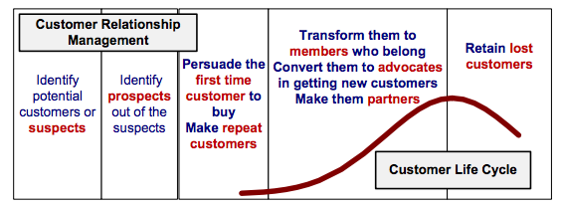
DELIVER CUSTOMER SERVICE IN A BUSINESS AND SERVICE ENVIRONMENT

Slide 15
DELIVER CUSTOMER SERVICE IN A BUSINESS AND SERVICE ENVIRONMENT
Customer Service Delivery also provides a framework for customer service as a process and an outcome. The authors address a wide range of topics that are crucial to today’s competitive business environment: customer expectations, loyalty satisfaction, product versus service delivery, measurement, brand equity, regional and cultural differences, and organizational impact.

Slide 16
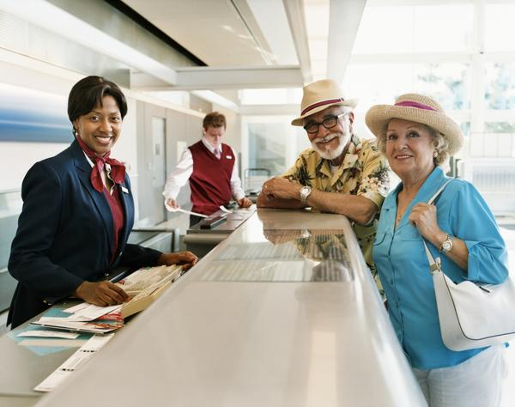
UNIT 7 CUSTOMER SERVICE IN THE AVATION INDUSTRY
P9: DEMONSTRATE EFFECTIVE CUSTOMER SERVICE SKILLS IN ROUTINE AND NON-ROUTINE SITUATIONS

Slide 17
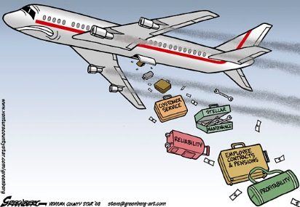
CUSTOMER SERVICE NON ROUTINE SITUATIONS
Non-routine decision- making is quite risky and involves a lot of anxiety and stress. There are a number of factors that should be taken in to account in order to reach the conclusion. Ground rules or sufficient information to guide through the process do not exist. Cases of similar situations, the decision-making processes that were followed and their outcomes are not available.

Slide 18
CUSTOMER SERVICE NON ROUTINE SITUATIONS
There are too many options to consider and their potential outcomes are totally unclear. There is no one to offer advice and the decision has a massive impact on people connected to it along with the decision maker.

Slide 19
REFERENCES
Fogli, Lawrence. Customer Service Delivery. 1st ed. San Francisco: Jossey-Bass, 2006. Print.
"Wow Your Customers: 3 Keys For Delivering Great Customer Service | Dennis Snow". Snowassociates.com. N.p., 2017. Web. 8 Mar. 2017.
"Delivering Excellent Service Quality". Boundless. N.p., 2017. Web. 8 Mar. 2017.
Soumya, Nitya. "Non-Routine Decisions Define A Manager's Mettle". The Hindu. N.p., 2017. Web. 8 Mar. 2017.

