Slide 1

UNIT 40: BUSINESS WORK EXPEREINCE
LECTURER:JUDITH ROBB-WALTERS

Slide 2
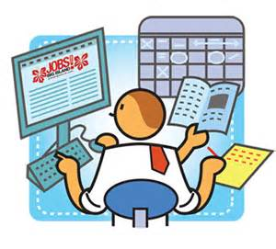
UNIT 40: BUSINESS WORK EXPEREINCE
LEARNING OUTCOME 1: UNDERSTAND WAYS TO ARRANGE APPROPRIATE INDUSTRY EXPERIENCE

Slide 3
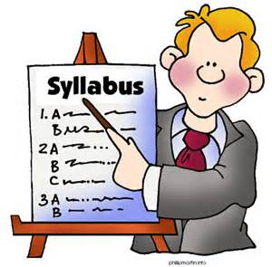
THE BASIC SYLLABUS
1. Understand ways to arrange appropriate industry experience.
2. Be able to agree aims and objectives of work-based project with others.
3.Be able to monitor and evaluate progress of work-based project.
4. Be able to present report on work-based project.

Slide 4
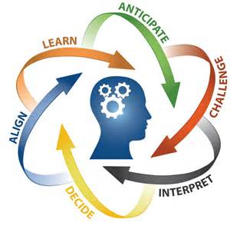
LEARNING OUTCOMES
Understand ways to arrange appropriate industry experience
At the end of the class the students should be able to:
AC 1.2 Explain the structure of the host organization and the sector in which it operates

Slide 5

OVERVIEW
Management reports or business reports help managers make decisions which are vital to the operation of a company. These reports inform managers of different aspects of the business and can help them make decisions that may have a profound impact on the business. These reports collect data from accounting transactions and present them in ways to facilitate decision making.

Slide 6

TEAMWORKING
Bruce Tuckman's contribution to teamwork theory recognised four stages in team development. This has proved very popular in the understanding of what is teamwork. Working in teams can be both beneficial and challenging at the same time.

Slide 7
TEAMWORKING
Sharing work can be less than ideal if the team members don’t work well together. In most team settings, you’ll have a leader and one or two other people who share the workload for the entire team.

Slide 8
TEAMWORKING
This can lead to pent-up feelings of resentment on the part of the worker bees, and sometimes the other team members can feel left out. Teams that work well together can greatly increase workplace productivity and creates a more cohesive company culture. Here are seven tips that will help your company’s teams work well together.

Slide 9

LEADERSHIP
Leadership is a process by which a person influences others to accomplish an objective and directs the organization in a way that makes it more cohesive and coherent.
This definition is similar to Northouse's (2007, p3) definition — Leadership is a process whereby an individual influences a group of individuals to achieve a common goal.
Leaders carry out this process by applying their leadership knowledge and skills. This is called Process Leadership (Jago, 1982).

Slide 10
LEADERSHIP
However, we know that we have traits that can influence our actions. This is called Trait Leadership (Jago, 1982), in that it was once common to believe that leaders were born rather than made. While leadership is learned, the skills and knowledge processed by the leader can be influenced by his or hers attributes or traits; such as beliefs, values, ethics, and character. Knowledge and skills contribute directly to the process of leadership, while the other attributes give the leader certain characteristics that make him or her unique.

Slide 11
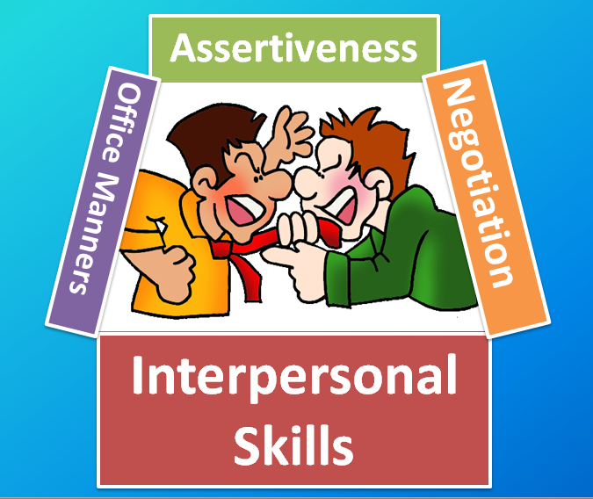
INTERPERSONAL SKILLS
Interpersonal skills are the life skills we use every day to communicate and interact with other people, both individually and in groups. People who have worked on developing strong interpersonal skills are usually more successful in both their professional and personal lives.
Employers often seek to hire staff with 'strong interpersonal skills' - they want people who will work well in a team and be able to communicate effectively with colleagues, customers and clients.

Slide 12

OPERATIONAL/TECHNICAL SKILLS
Technical skills apply to specific job requirements. In other words, technical skills are practical and often pertain to mechanical or scientific subjects. Typically, you attain these from training and through experience in a field. For example, a research scientist’s technical skills might include the ability to use and maintain laboratory equipment, and a baker’s technical skills might include operating kitchen equipment and maintaining sanitary cooking areas.

Slide 13

CUSTOMER CARE
The process of delivering high quality service to internal and external customer. Customer care results in high levels of customer satisfaction leading to long term buying relationships between suppliers and customers.
Organisations that provide a high standard of customer care tend to have the following characteristics.
- High quality products or services that represent value for money.

Slide 14
CUSTOMER CARE
-A high standard of after –sales service.
-Friendly and helpful staff who are well trained and knowledgeable.
-A positive response to customer enquires and demands.
-A ‘can do’ rather than ‘can’t do’ approach.
-A regular appraisal of the service the provide in order to improve that service.
-The ability to be self-critical in a positive way.

Slide 15

COMMUNICATION
Communication is the process of exchanging information and ideas. There are many means of communication. To be an effective and valuable member of your workplace it is important that you become skilled in all of the different methods of communication that are appropriate.
For communication to occur it must pass from a sender to a receiver. This must occur irrespective of the form of communication.
For communication to be effective it must be understood by the receiver and be able to be responded to. This means that total communication involves speaking, reading, listening, and reasoning skills.

Slide 16
COMMUNICATION
As communications pass from the source to the receiver there is plenty of opportunity for its original meaning to change or alter. Therefore listening, reasoning and feedback is an important part of the process as it is an opportunity for the sender to make sure the receiver has understood the message.
The other consideration is the “noise” associated with the communication – what else is happening, what are the distractions, the baggage etc. Noise can have a big impact on the message the receiver decodes.

Slide 17

NETWORKING
To formally begin your networking journey, you need to start forming a more detailed and specific answer to the question-
“What’s a network?”
A combination of person usually having a common interest sharing information and services among the group.

Slide 18
NETWORKING
For many people, the thought of business networking can seem like a chore or even a nerve-wracking ordeal. When done properly, business networking can be enjoyable and helpful to one's career. In the past business networking was usually done in-person; however, today many people also use the Internet as another means of widening their professional networks. In both cases, it is important to brush up on networking strategies and etiquette for successful results.
One of the first advantages of business networking is that it allows us to meet new people.

Slide 19
NETWORKING
While it is a great way to increase our profiles or business awareness, not all of these people will necessarily turn into new customers or sales leads; however, they can help to introduce us to other business opportunities further down the line. Meeting other professionals provides a fresh forum for people from different professional backgrounds to exchange ideas. They might offer information on how to do something better, or how things are done elsewhere. Sometimes, business networking leads to new connections, mentors, or careers.

Slide 20
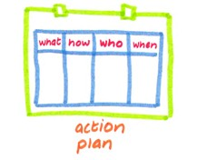
ACTION PLANNING
An action plan is a document that lists what steps must be taken in order to achieve a specific goal.
The purpose of an action plan is to clarify what resources are required to reach the goal, formulate a timeline for when specific tasks need to be completed and determine what resources are required.
In project management, a well-developed action plan can serve as a blueprint for the project manager to break a large project down into smaller, more manageable SMART (Specific, Measurable, Attainable, Realistic and Time-based) goals.

Slide 21

PROBLEM SOLVING
Problems are at the center of what many people do at work every day. Whether you're solving a problem for a client (internal or external), supporting those who are solving problems, or discovering new problems to solve, the problems you face can be large or small, simple or complex, and easy or difficult.
A fundamental part of every manager's role is finding ways to solve them. So, being a confident problem solver is really important to your success. Much of that confidence comes from having a good process to use when approaching a problem. With one, you can solve problems quickly and effectively. Without one, your solutions may be ineffective, or you'll get stuck and do nothing, with sometimes painful consequences.

Slide 22
PROBLEM SOLVING
With one, you can solve problems quickly and effectively. Without one, your solutions may be ineffective, or you'll get stuck and do nothing, with sometimes painful consequences.
There are four basic steps in solving a problem:
Defining the problem.
Generating alternatives.
Evaluating and selecting alternatives.
Implementing solutions.

Slide 23

ICT/COMPUTER LITERACY
ICT is an acronym that stands for Information Communications Technology.
A good way to think about ICT is to consider all uses of digital technology that exist to help individuals, businesses and organisations use information. ICT covers any product that will store, retrieve, manipulate, transmit or receive information electronically in a digital form. For example, personal computers, digital television, email, robots.
So ICT is concerned with the storage, retrieval, manipulation, transmission or receipt of digital data. Importantly, it is also concerned with the way these different uses can work with each other.

Slide 24
ICT/COMPUTER LITERACY
In business, ICT is often categorised into two broad types of product:
-Traditional computer-based technologies (things you can typically do on a personal computer or using computers at home or at work).
-Digital communication technologies (which allow people and organisations to communicate and share information digitally)

Slide 25

FLEXIBILITY
Flexibility is about an employee and an employer making changes to when, where and how a person will work to better meet individual and business needs. Flexibility enables both individual and business needs to be met through making changes to the time (when), location (where) and manner (how) in which an employee works. Flexibility should be mutually beneficial to both the employer and employee and result in superior outcomes.

Slide 26
FLEXIBILITY
Formal flexibility: Policies are officially approved human resources policies, as well as any official policies that give supervisors discretion to provide flexibility.
Informal flexibility: Policies that are not official and not written down but are still available to some employees, even on a discretionary basis.

Slide 27

BIBLIOGRAPHY
Small Business - Chron.com,. "What Are Examples Of Managerial Reports?". N.p., 2015. Web. 27 Dec. 2015.
Blog.eskill.com,. "How To Get A Team To Work Together". N.p., 2015. Web. 27 Dec. 2015.
Sharma, Manoj, and Shilpan Jain. "Leadership Management: Principles, Models And Theories". Global Journal of Management and Business Studies. 3.3 (2015): 309-318. Web. 28 Dec. 2015.
2011-2015, (c). "What Are Interpersonal Skills? | Skills You Need". Skillsyouneed.com. N.p., 2015. Web. 28 Dec. 2015.

Slide 28
BIBLIOGRAPHY
Small Business - Chron.com,. "The Difference Between Technical Skills & Business Skills". N.p., 2015. Web. 28 Dec. 2015.
Atkinson, Frank. Customer Care. 2011. Print.
WORKPLACE COMMUNICATION. A Commonwealth of Australia project funded by: Department of Education, Employment and Workplace Relations, 2015. Print.
Miller, Joel. "Business Networking Essentials | Admedia". Admedia.com. N.p., 2015. Web. 28 Dec. 2015.
"Introduction To Networking". Networking Basics CCNA 1 Companion Guide. 1st ed. Pearson, 2015. 3. Print.

Slide 29
BIBLIOGRAPHY
WhatIs.com,. "What Is Action Plan? - Definition From Whatis.Com". N.p., 2015. Web. 28 Dec. 2015.
Mindtools.com,. "What Is Problem Solving?". N.p., 2015. Web. 28 Dec. 2015.
Tutor2u.net,. "What Is ICT? | Business | Tutor2u". N.p., 2015. Web. 28 Dec. 2015.
WHAT IS WORKPLACE FLEXIBILITY?. 1st ed. Chestnut Hill, MA 02467: Sloan Center on Aging & Work at Boston College, 2015. Web. 28 Dec. 2015.
Practical Management Skills,. "What Is Teamwork, Define Teamwork". N.p., 2015. Web. 29 Dec. 2015.

Slide 30

FURTHER READING LIST
Montana, P, and B Charnov. "ORGANIZATIONAL STRUCTURES: CONCEPTS AND F0RMATS". Management: A Streamlined Course For Students And Business People.. 1st ed. New York: N.p., 2016. Web. 10 Jan. 2016.
Bbc.co.uk,. "BBC - GCSE Bitesize: Primary, Secondary And Tertiary Sectors". N.p., 2016. Web. 10 Jan. 2016.

